Slide 1

Natural Flood Management & NbS in Inishowen
By Trish Murphy & John Doherty
A workshop demonstration to the Nature-based Solutions Conference
Dundalk IT
10th and 11th June 2026

Slide 2
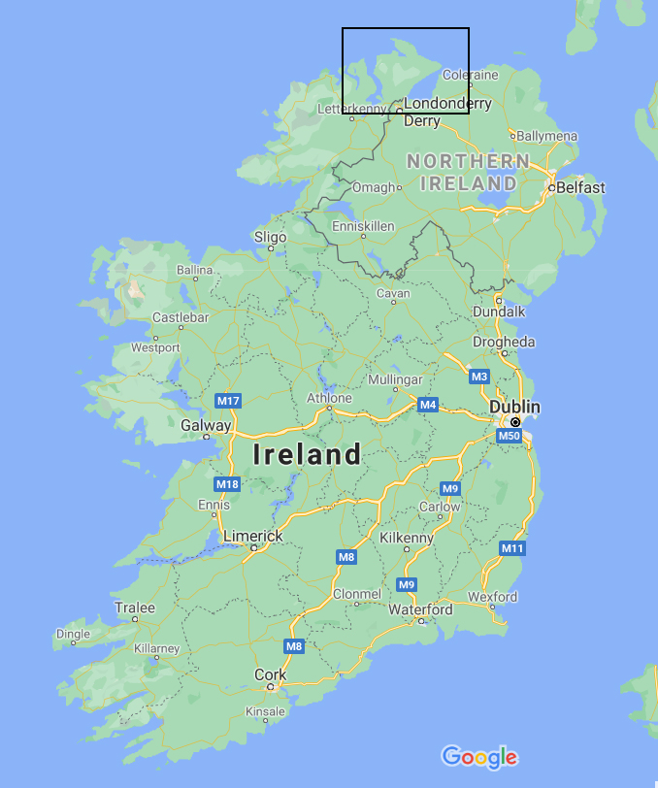
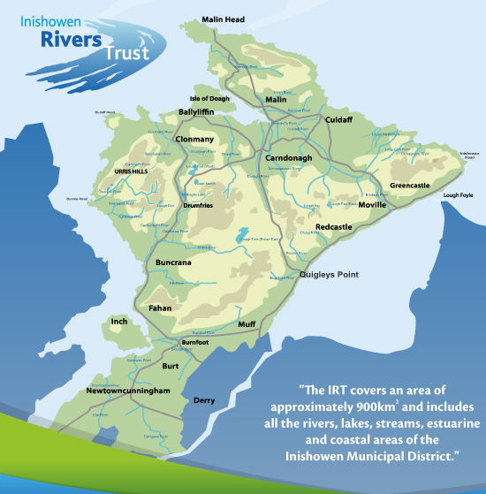
About IRT
Established as a CLG in August 2016
Strong community focus
Run a volunteer programme
Education & awareness
Involvement in Farming projects (FFW & ACRES)
Revetments, Invasive species, Biodiversity projects, restoration

Slide 3

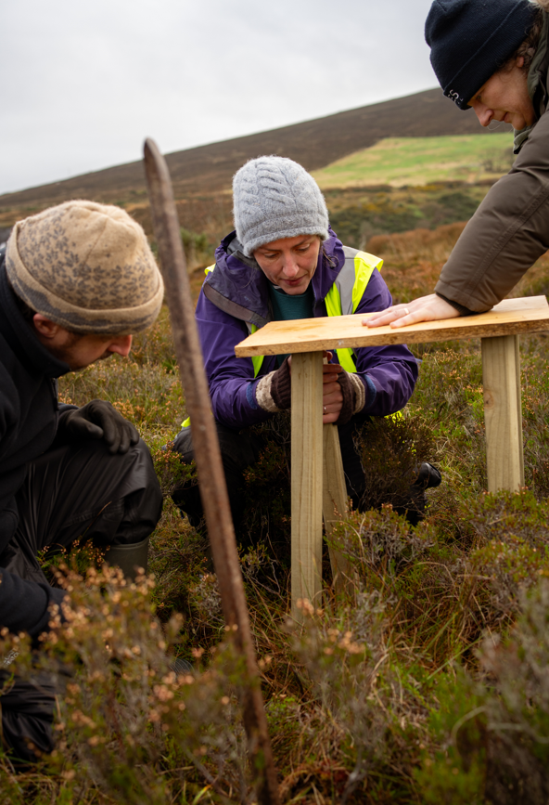
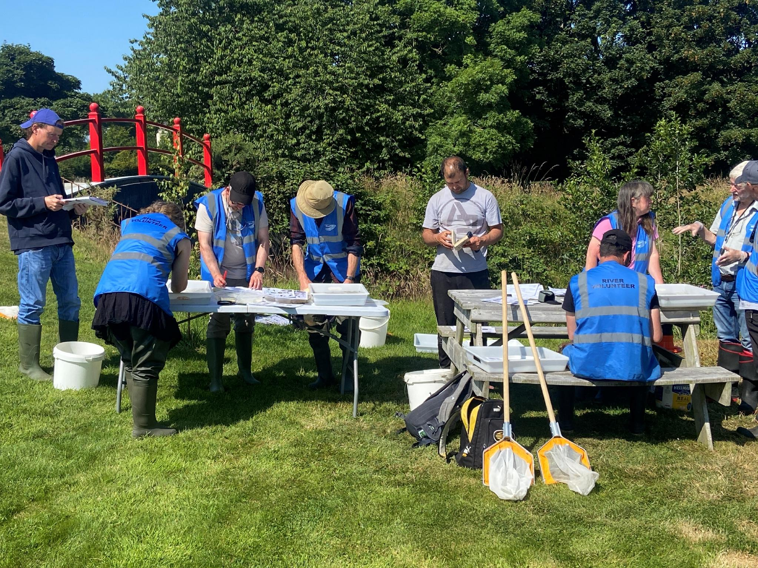
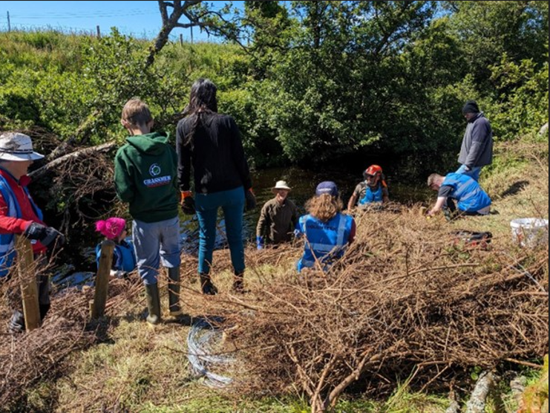
Volunteer Programme
BUILD CAPACITY TO DELIVER

Slide 4
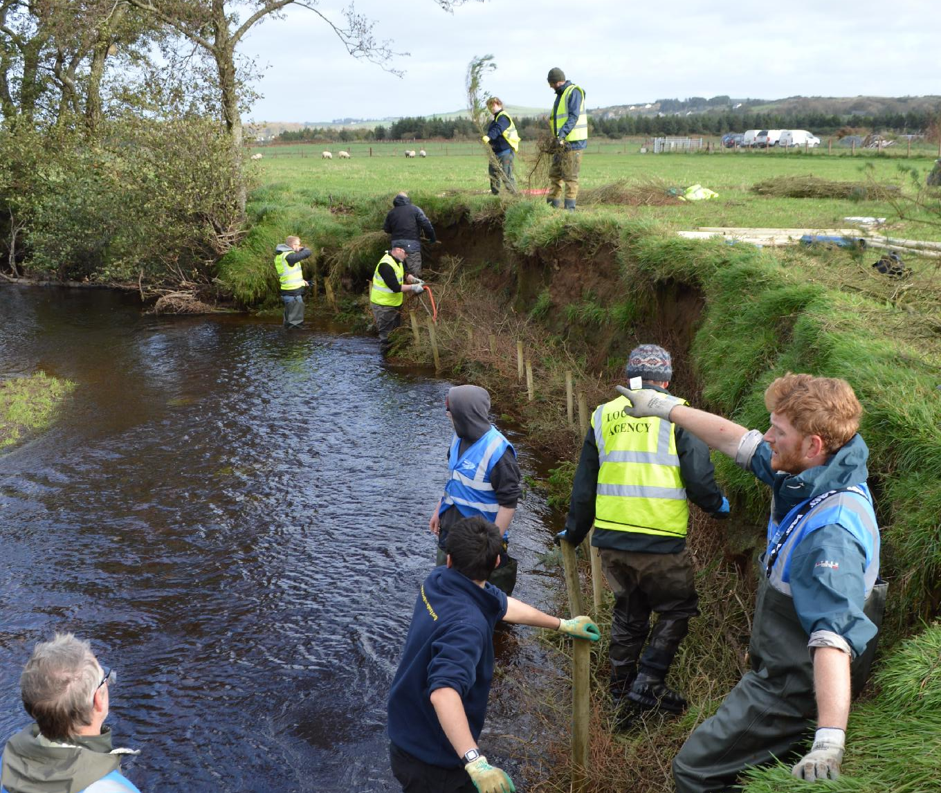
Nature-based Solutions
Practical experience
  Revetments, spiling, use of large woody material, fish passage, leaky dams, ponds, peatland restoration, riparian buffers
Knowledge (hydromorphology, river processes, local rivers)
Embedded in community
Agency collaboration

Slide 5
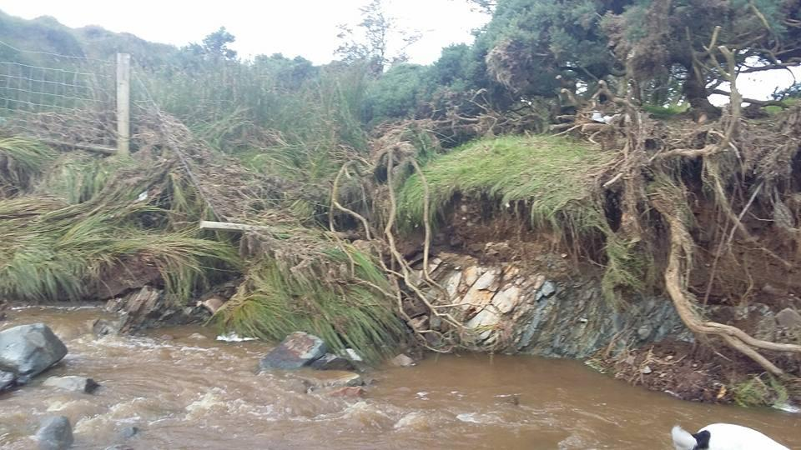
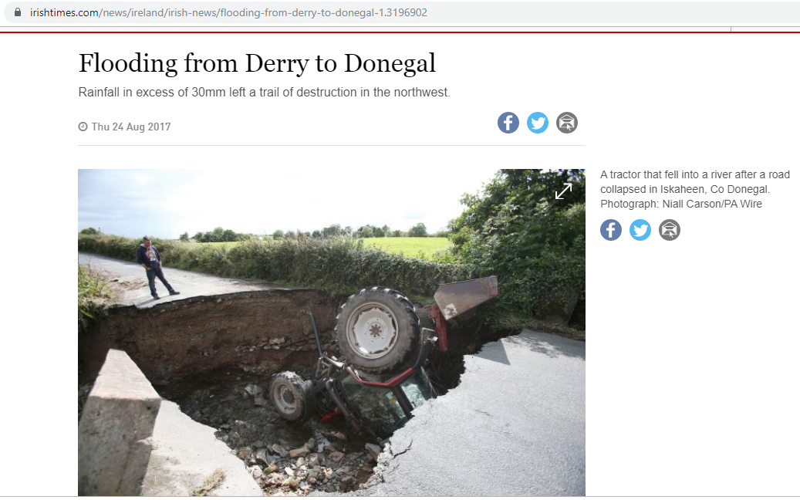
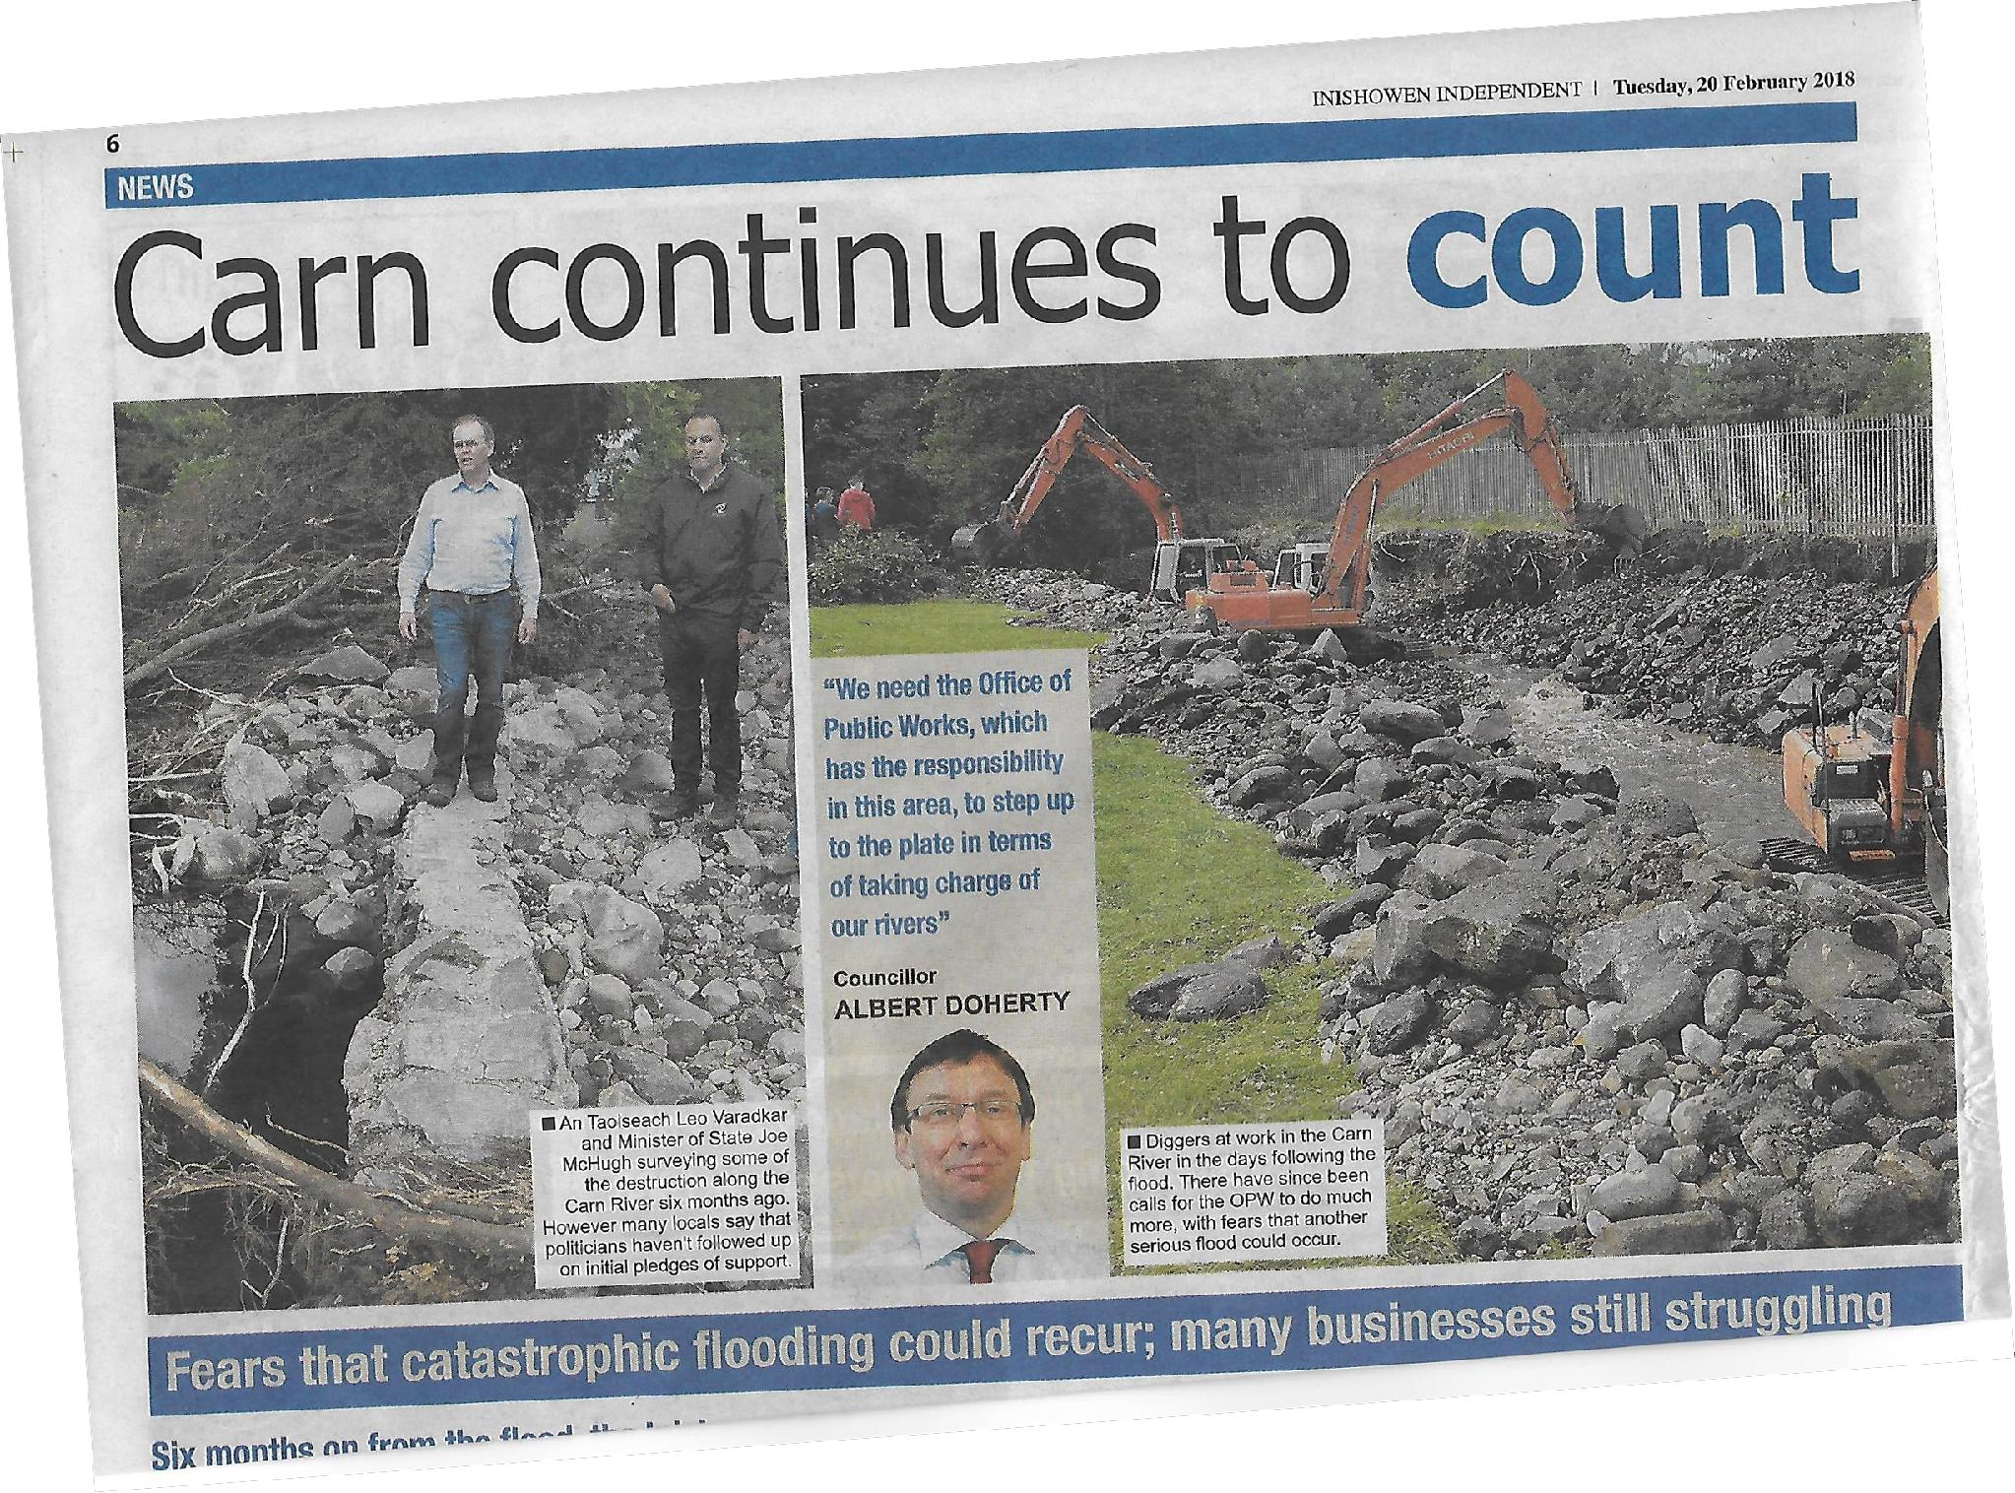
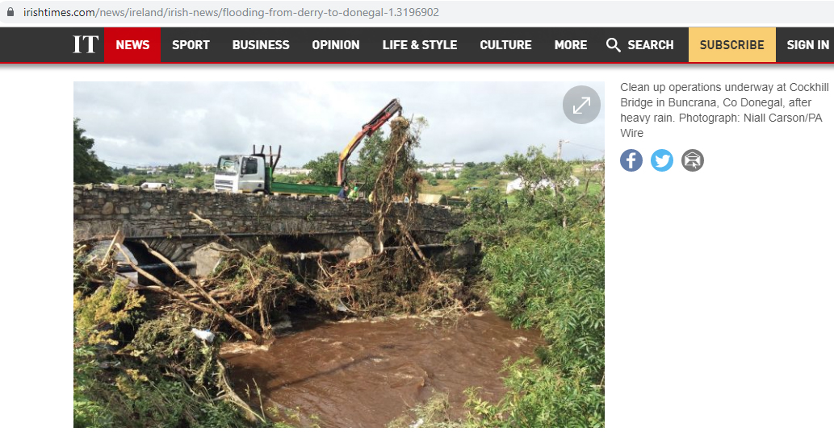
Inishowen Flood
22nd August 2017

Slide 6
Natural Flood Management
After the flood of 2017, IRT began looking into natural water retention measures. 3 phase project:
1. Awareness raising
  Feb 2018 Slow the Flow event to introduce concept to community. Funded by LAWPRO/OPW
  Sep-Oct 2018 Awareness of measures for river restoration and woodlands for water. Funded by LAWPRO
2. Scoping Project
  Nov 2018 Collaboration with Trinity College to look at potential for NFM in Inishowen. Funded by OPW.
  Mar-Jul 2020 Community Consultations to gauge interest
3. Implementation
  Dec 2020 Secured funds from multiple agencies to implement measures
  (EU Leader, OPW, LAWPRO, Donegal CoCo)

Slide 7

Project Partners
Flooding consultant
Landowner Liaison
Ecologist
Works Contractor
Film Services
Branding and Promotion
Community facilities
Agencies
EU LEADER
OPW
LAWPRO
Donegal CoCo
~€ 135,000

Slide 8
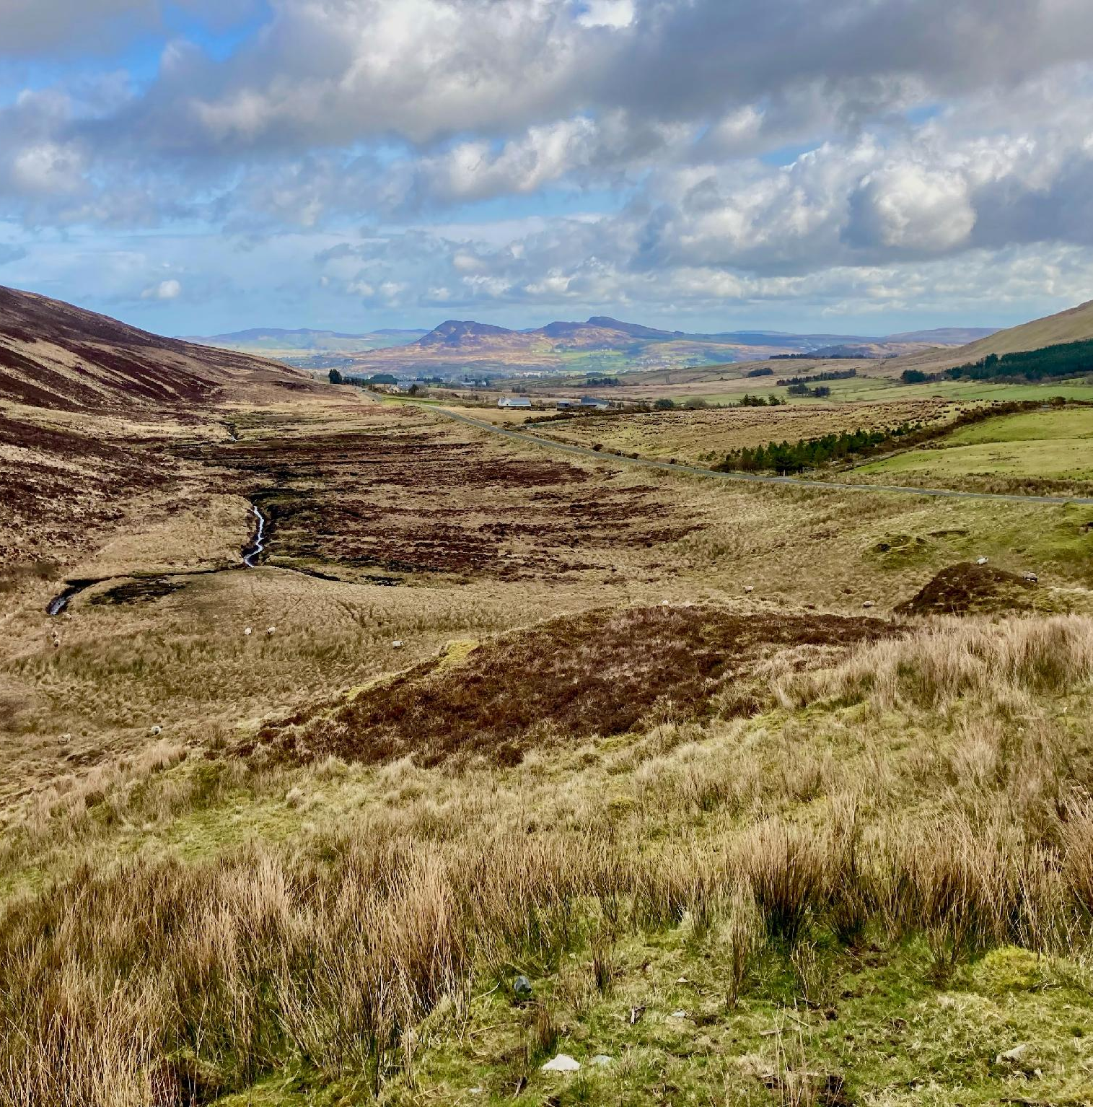
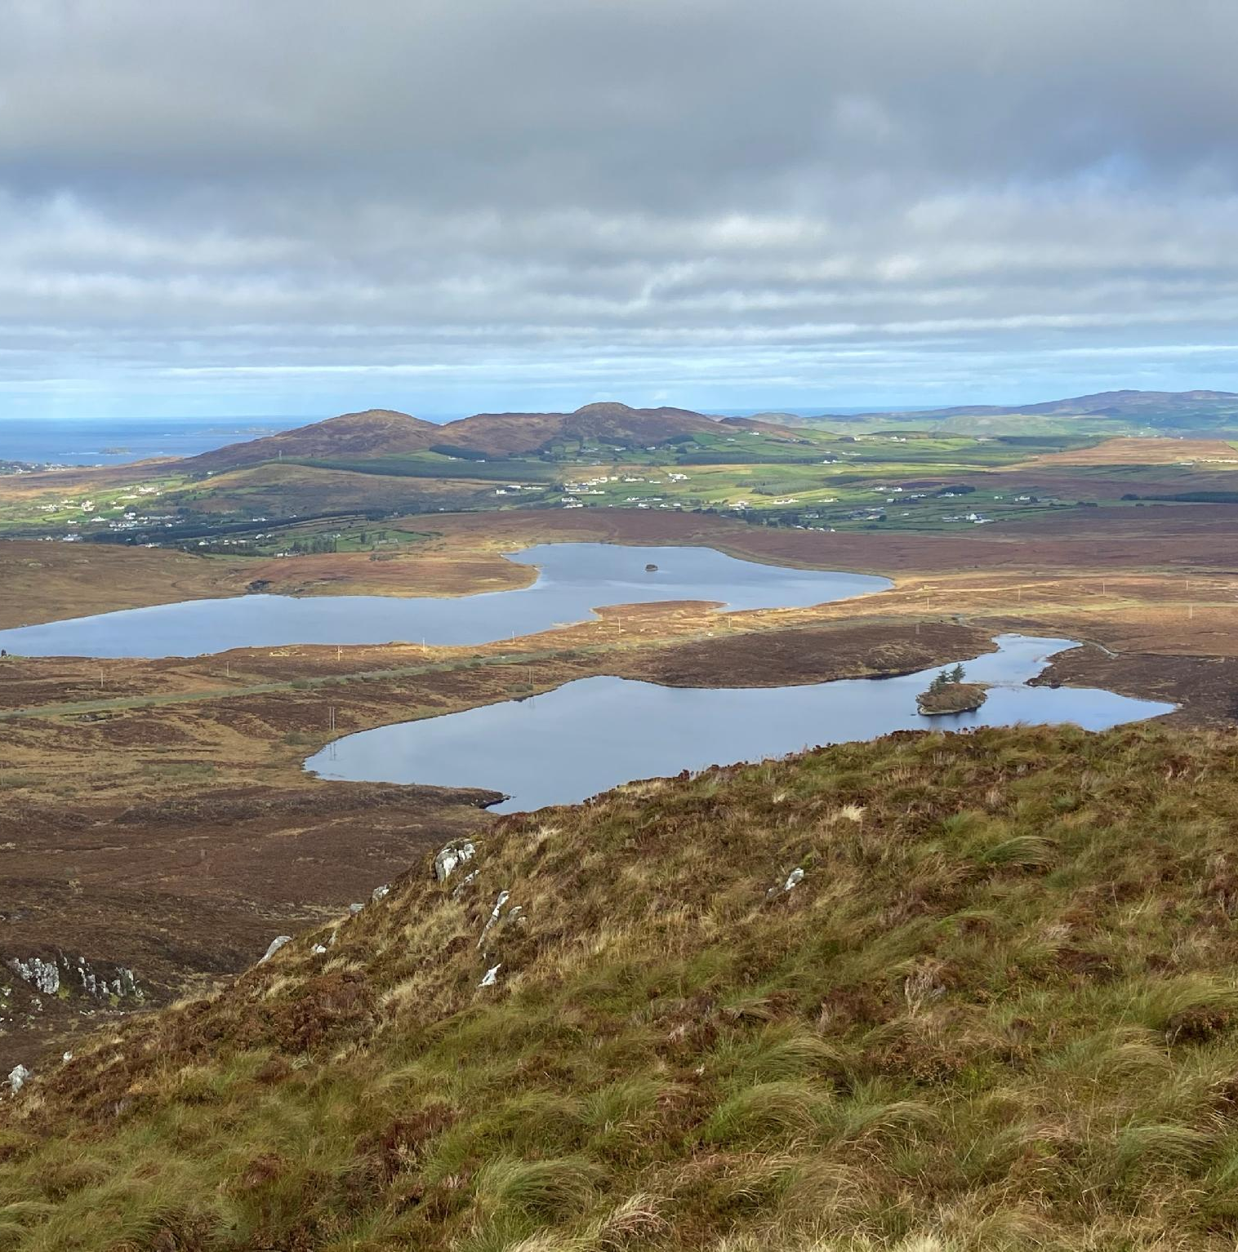
Parts of the project area upper catchment

Slide 9
Planning &
Project Elements

Slide 10

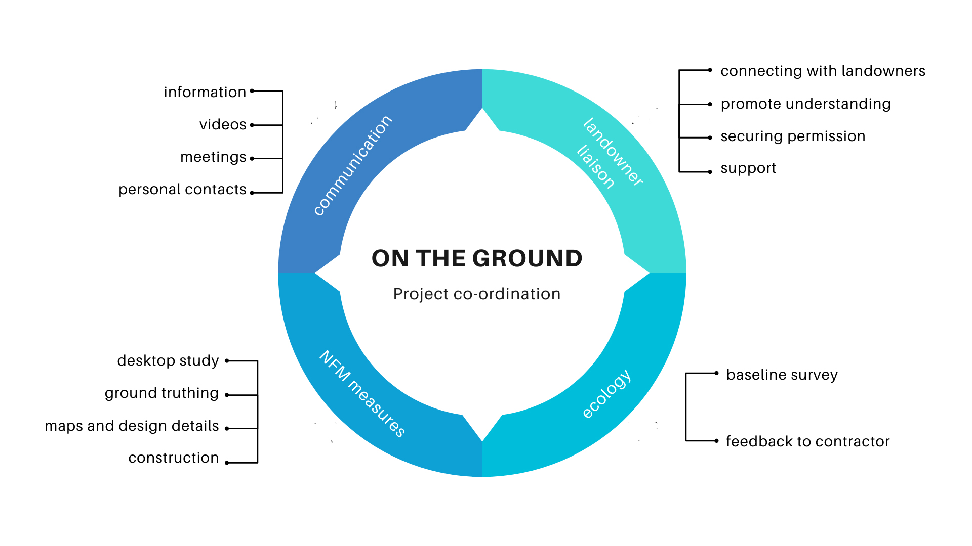
Notes:
Missing element = Baseline flow monitoring

Slide 11

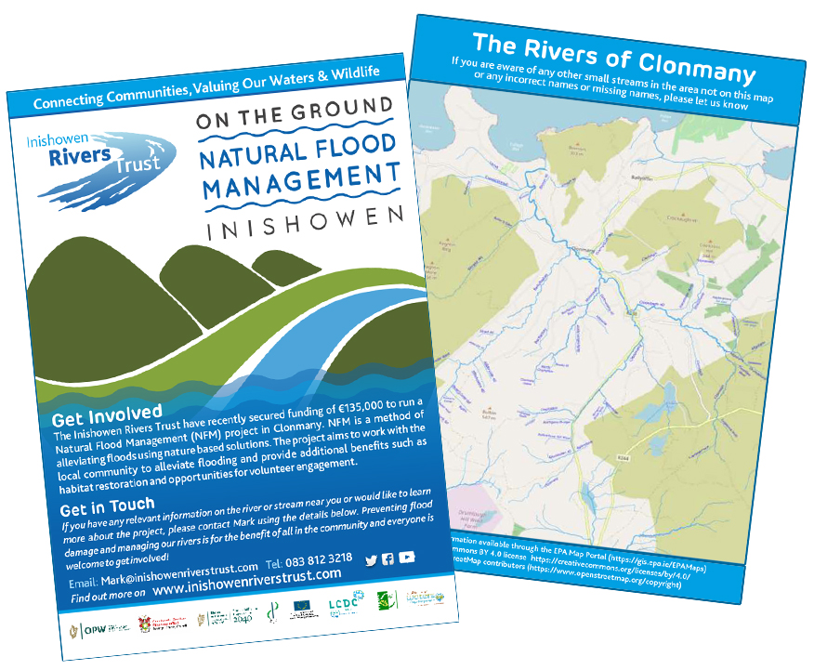
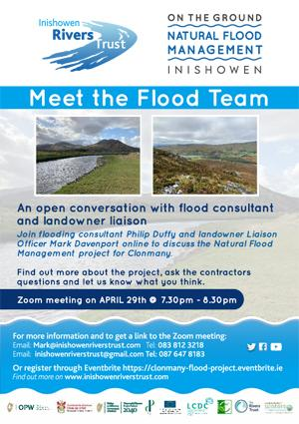
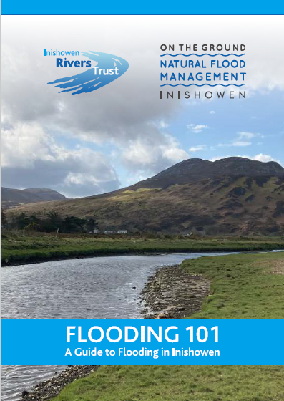
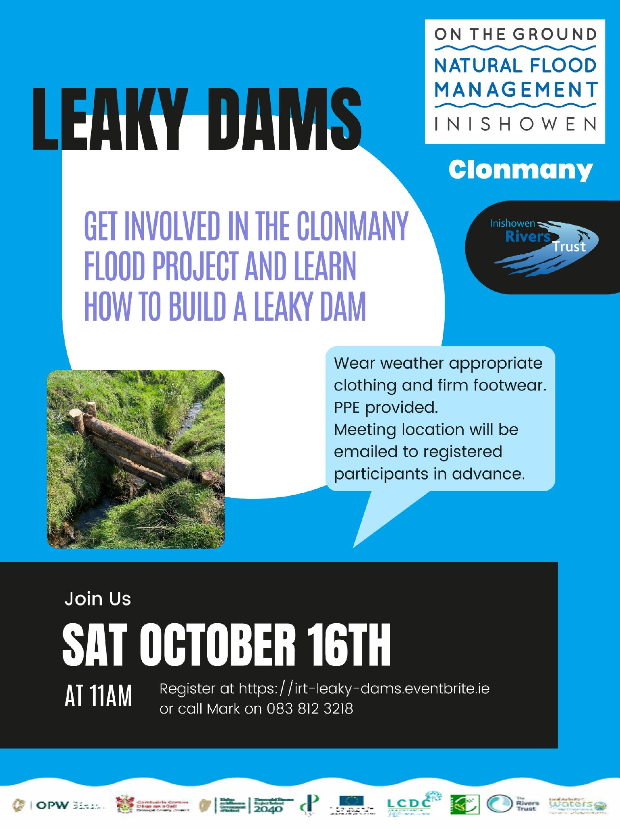

Community Engagement
Flooding 101
Guide to Flooding

Slide 12
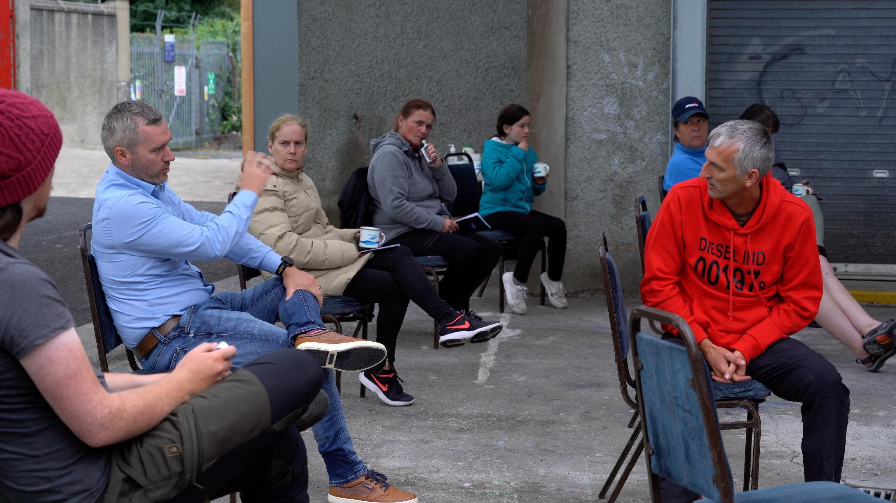
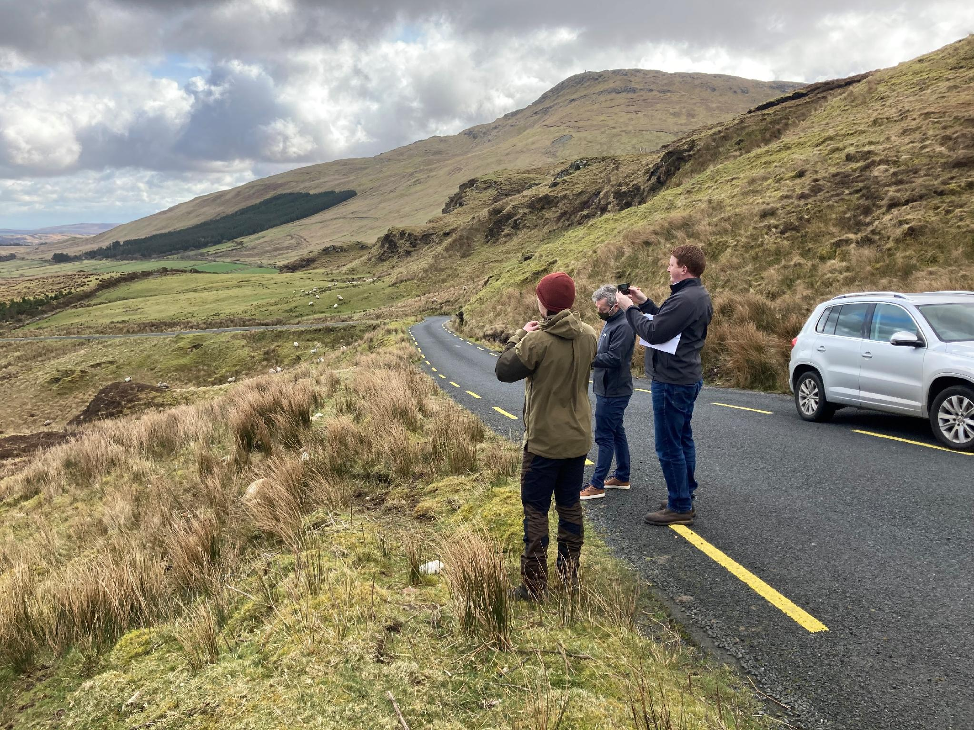
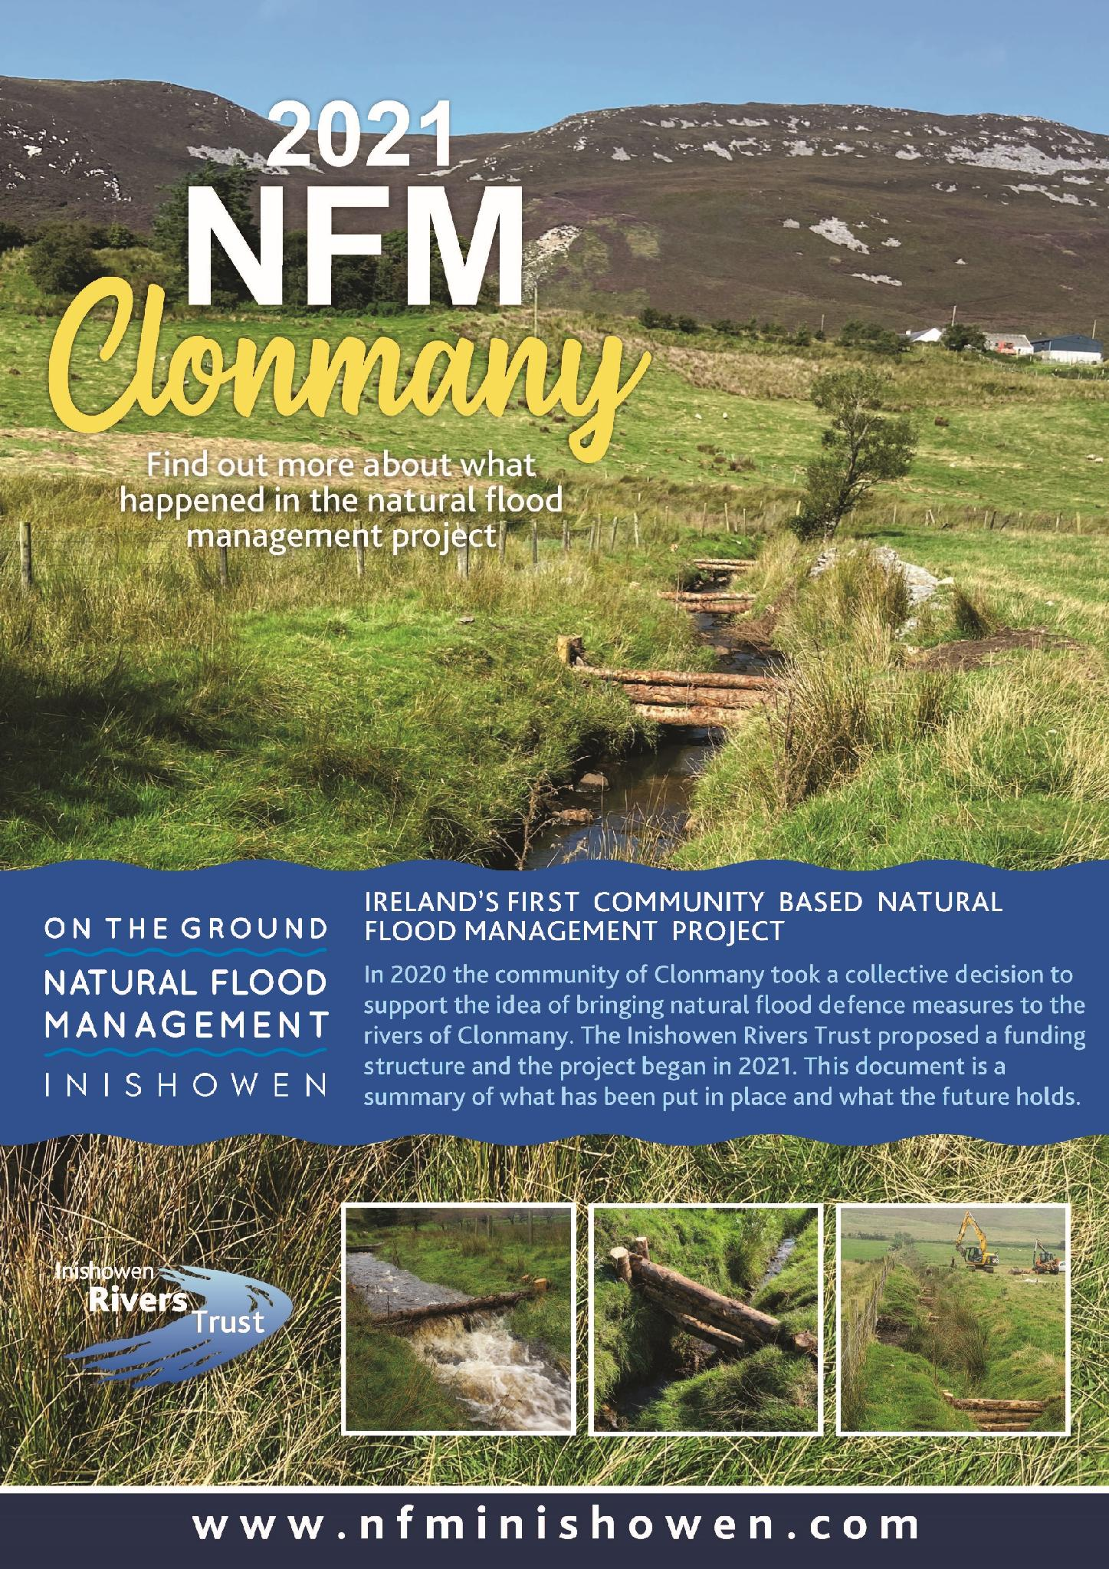
Community Engagement
Landowners & Consents
200 locals contacted
30 landowners engaged
8 landowners agreed
www.nfminishowen.com

Slide 13
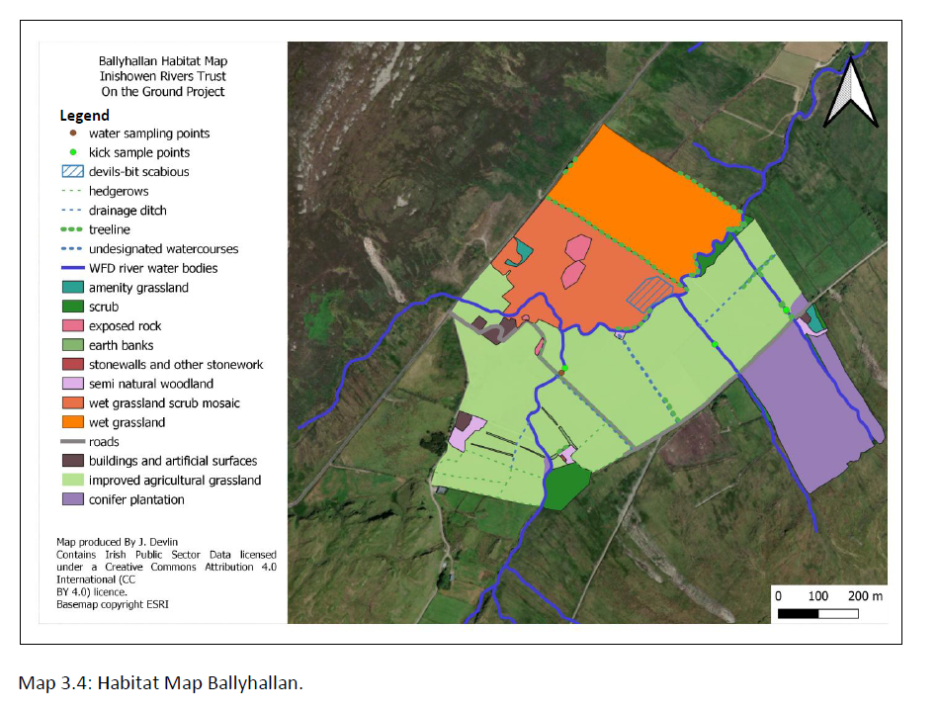
Ecological assessment of sites

Slide 14
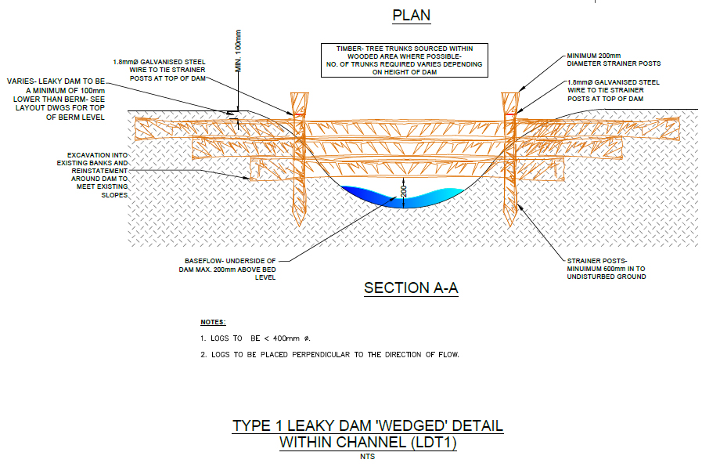
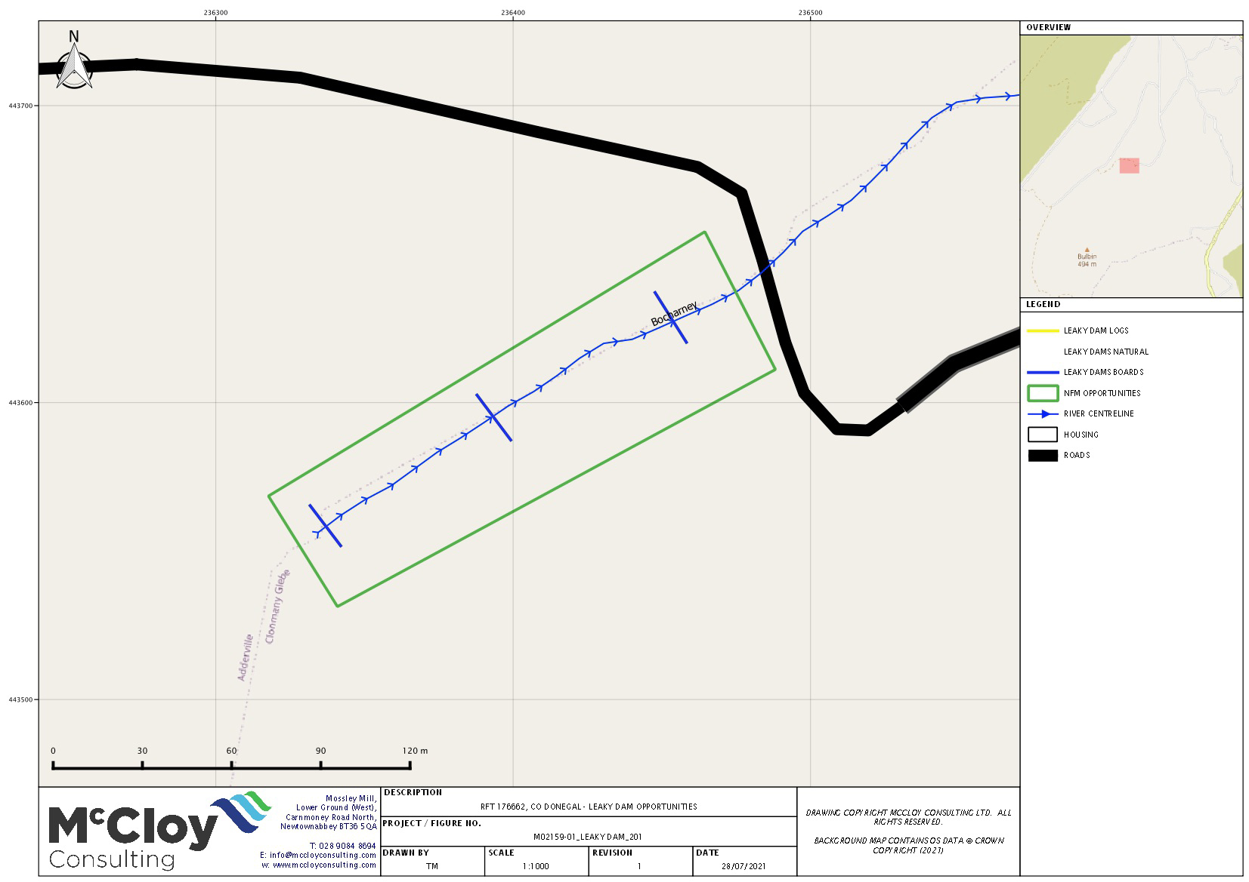

Slide 15
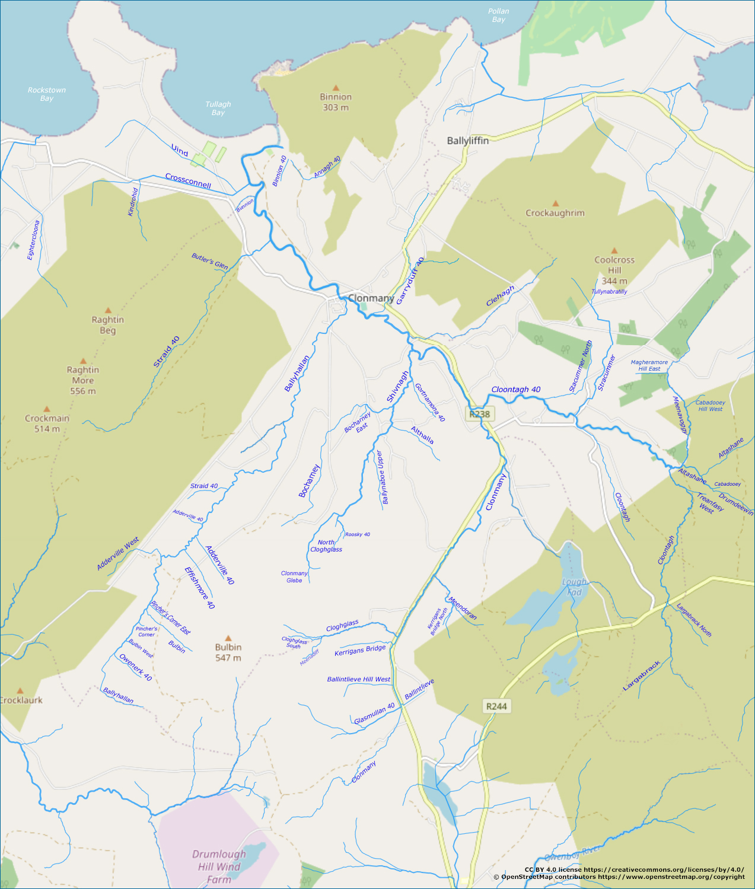
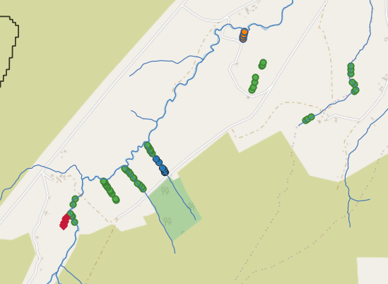
NFM Clonmany
Author: Inishowen Rivers Trust 2022
OSM Map Data. Prepared using QGIS

Slide 16
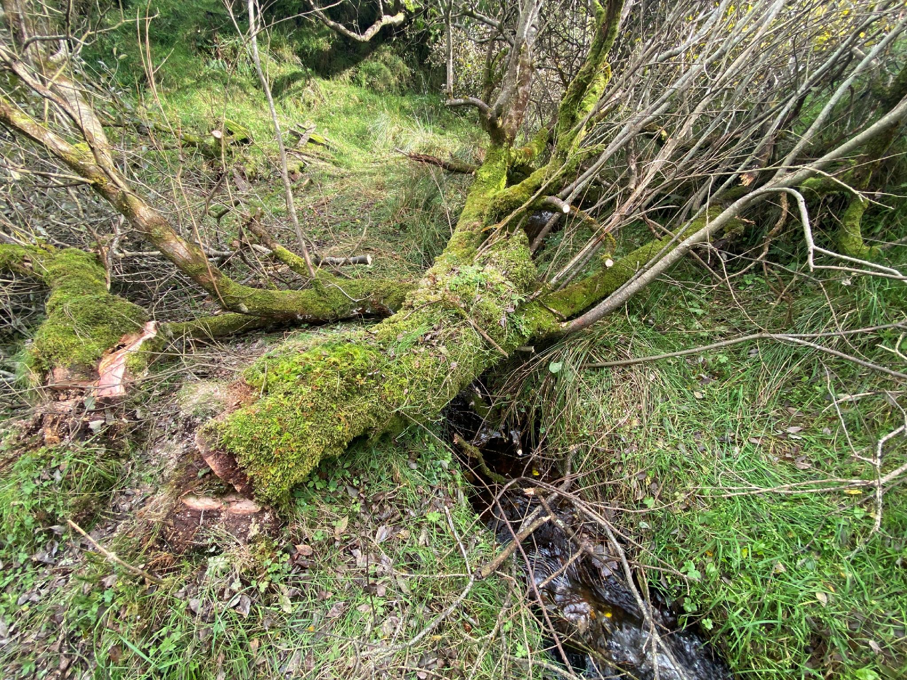
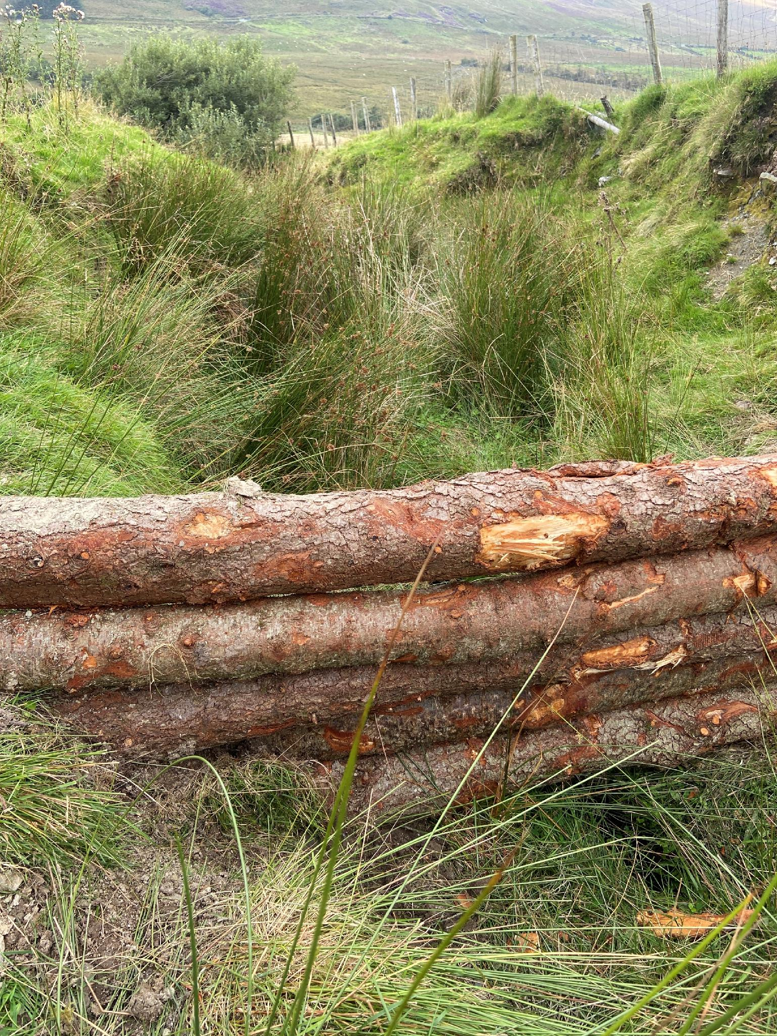
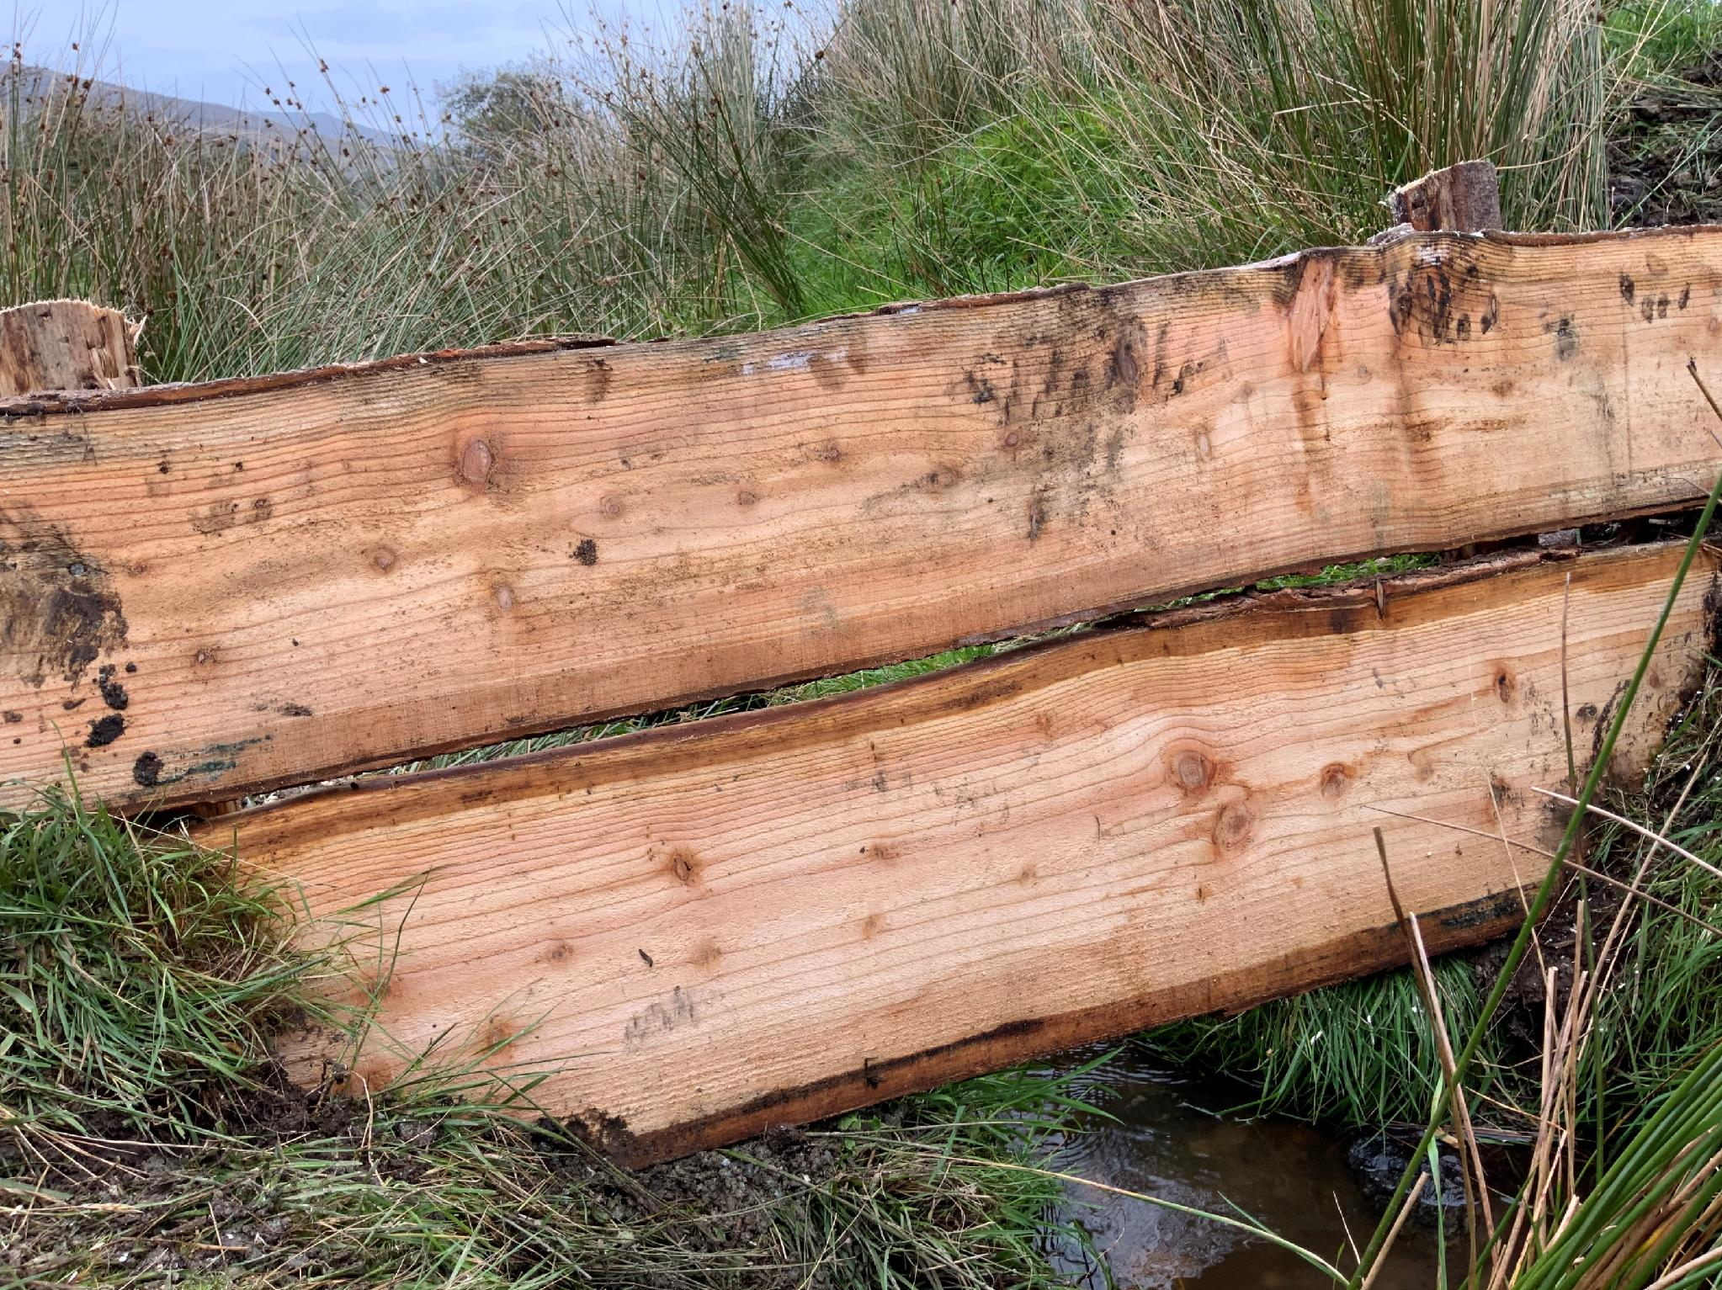
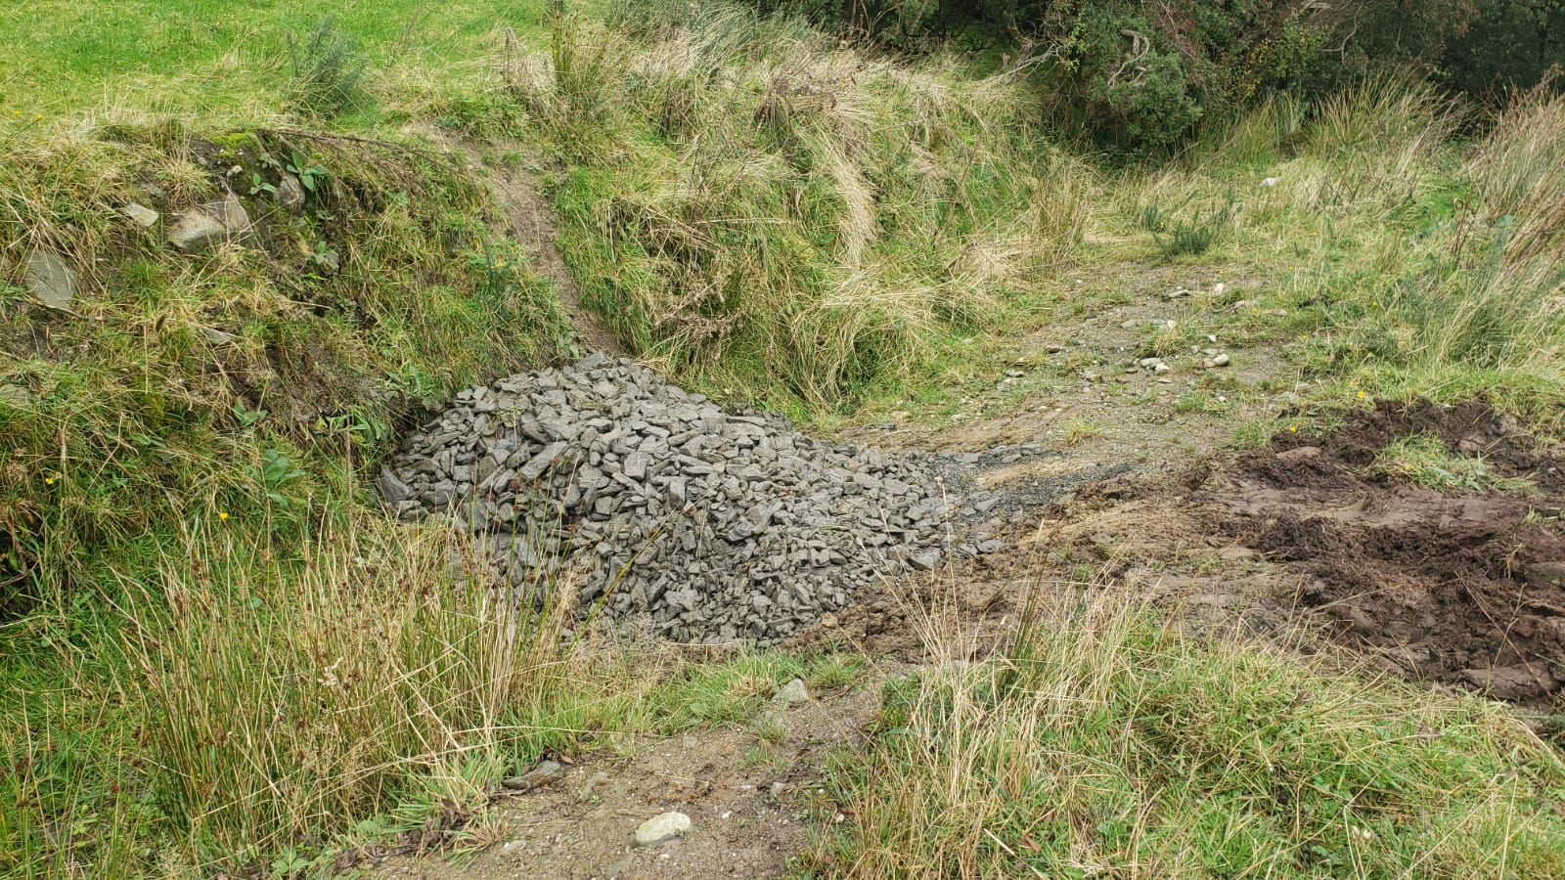
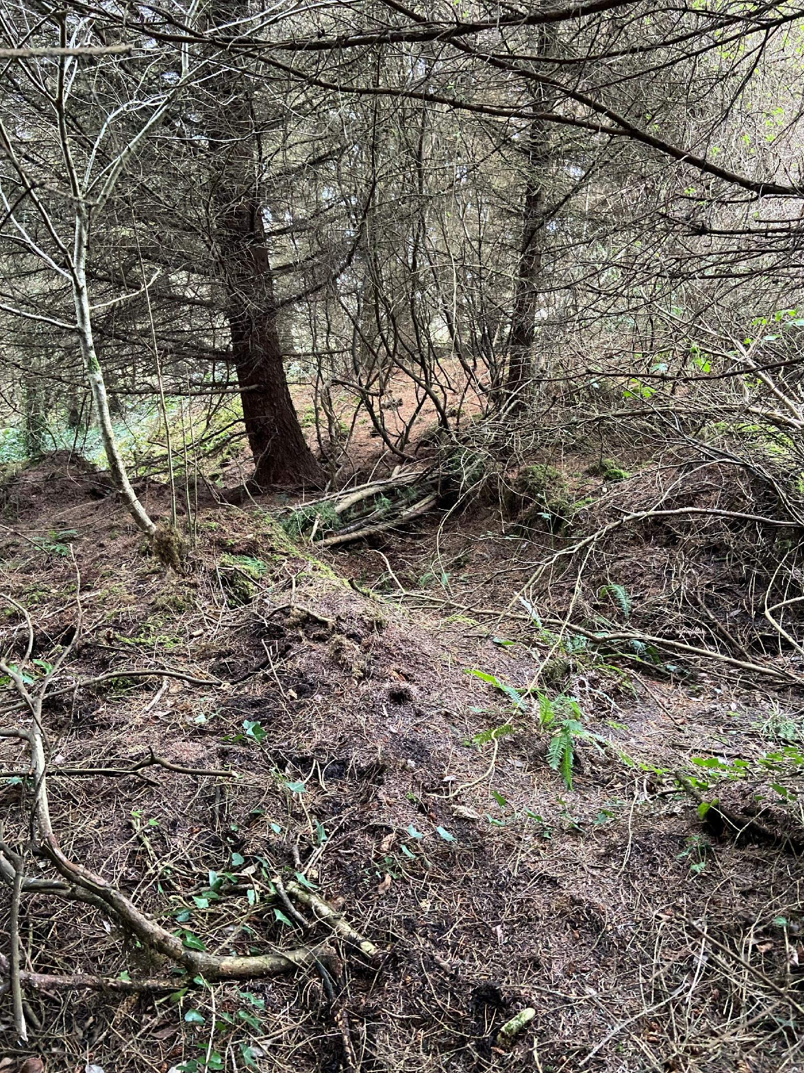
NFM measures
52 Log leaky dams
7 Natural log dams
6 Boarded dams
4 Check dams
Gully stuffing
Natural leaky dam
Log leaky dam
Check dam
Boarded dam
Gully stuffing

Slide 17
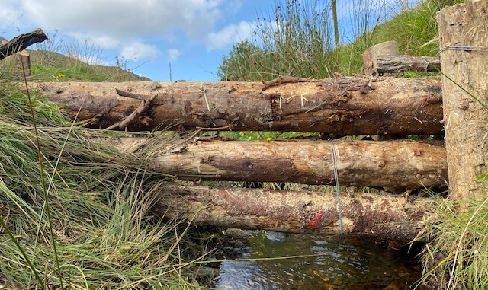
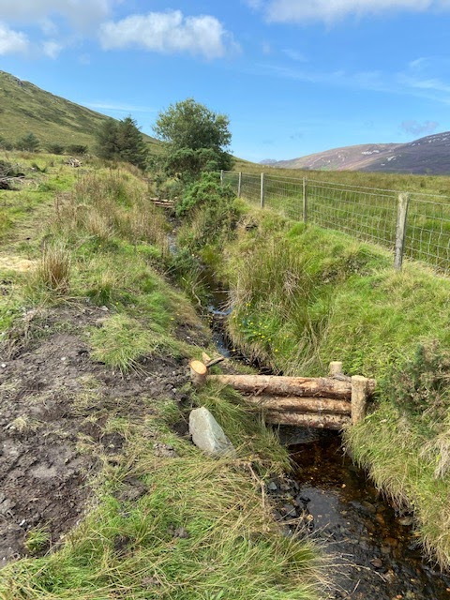
Log leaky dams
  approx. 0.5m³ / dam of larch or spruce
  Install 3-5 per day
  Cost ~ €568 each for labour and materials

Slide 18
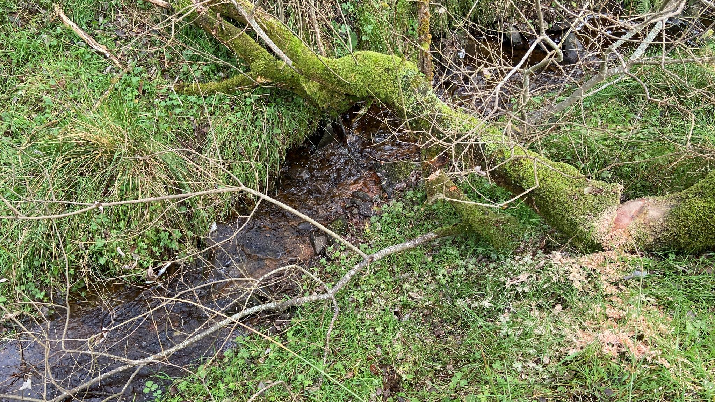
Natural log leaky dams
  Very little riparian vegetation on local tributaries
  Installed 7 in one day
  Cost ~ €150 each for labour and materials (rebar)

Slide 19
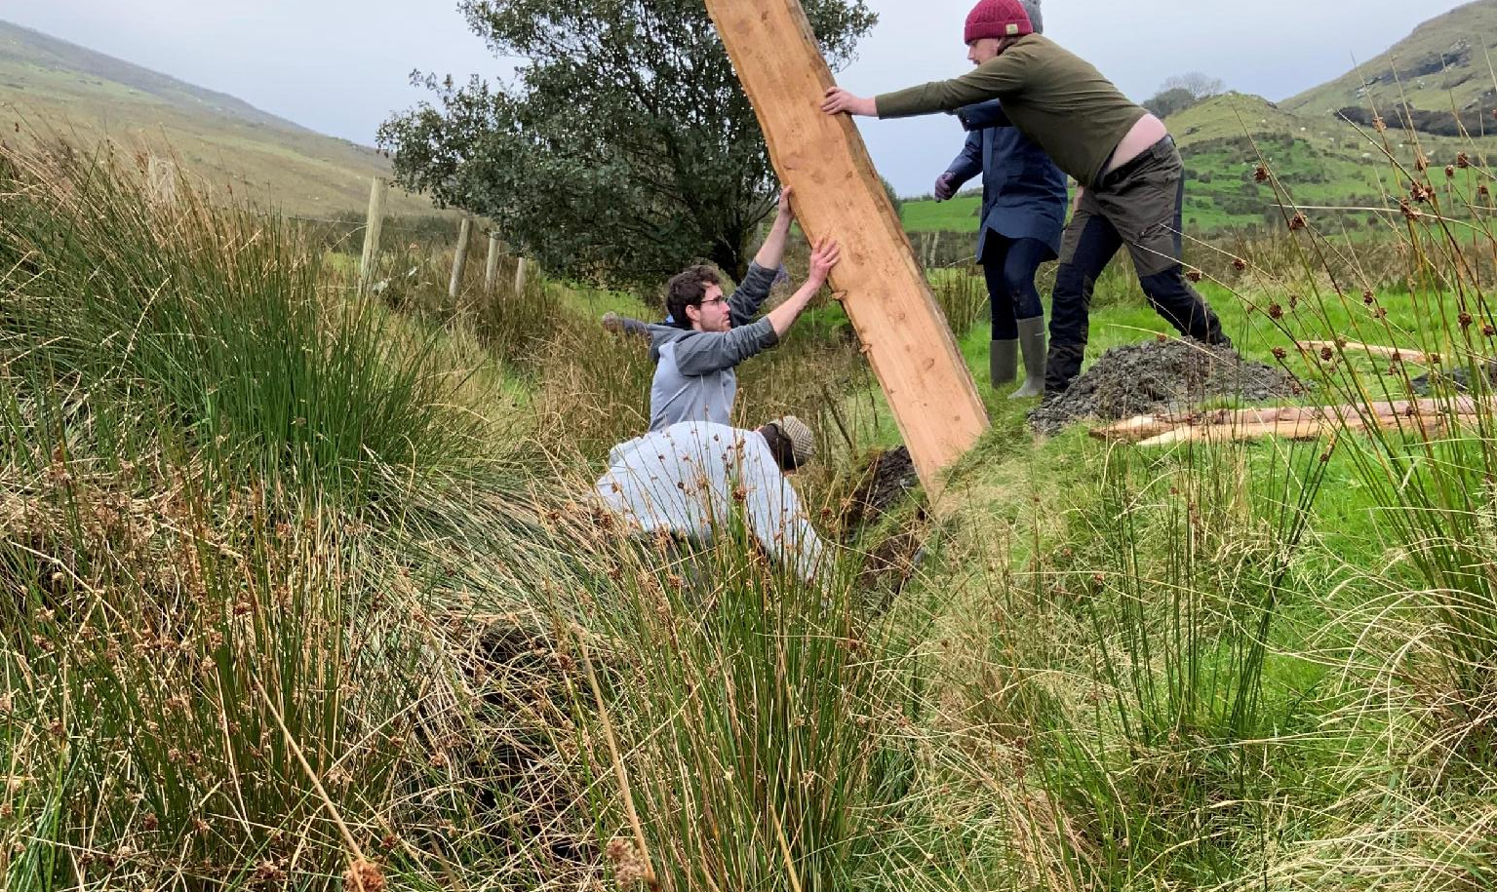
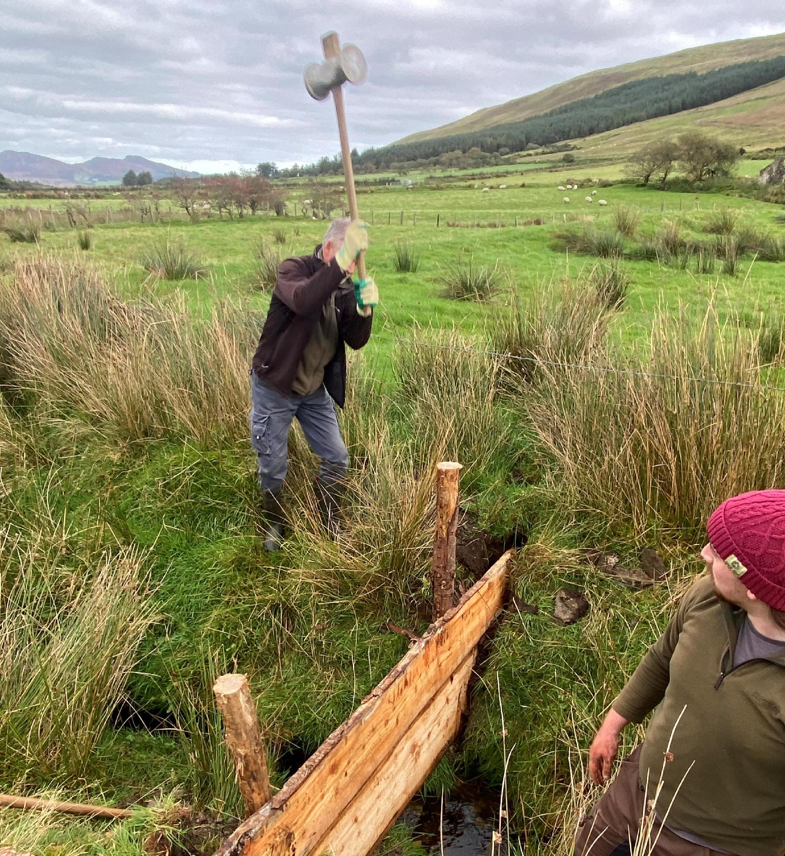
Boarded leaky dams
  2 inch larch boards
  Installed with help of volunteers
  Cost ~ €384 each for preparation, labour and materials

Slide 20
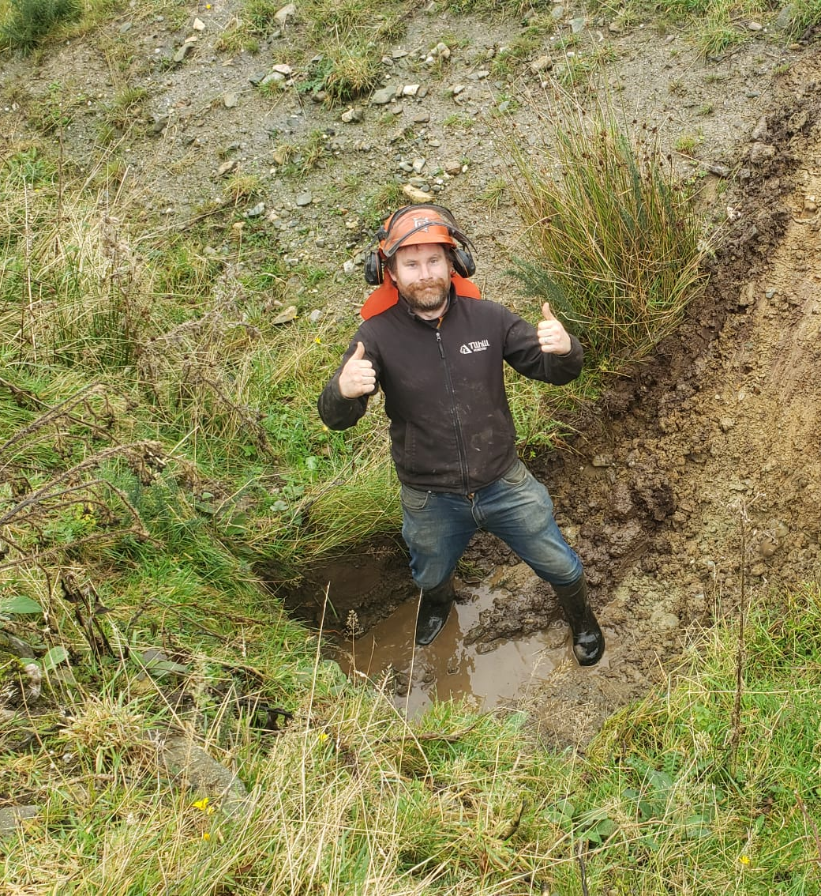
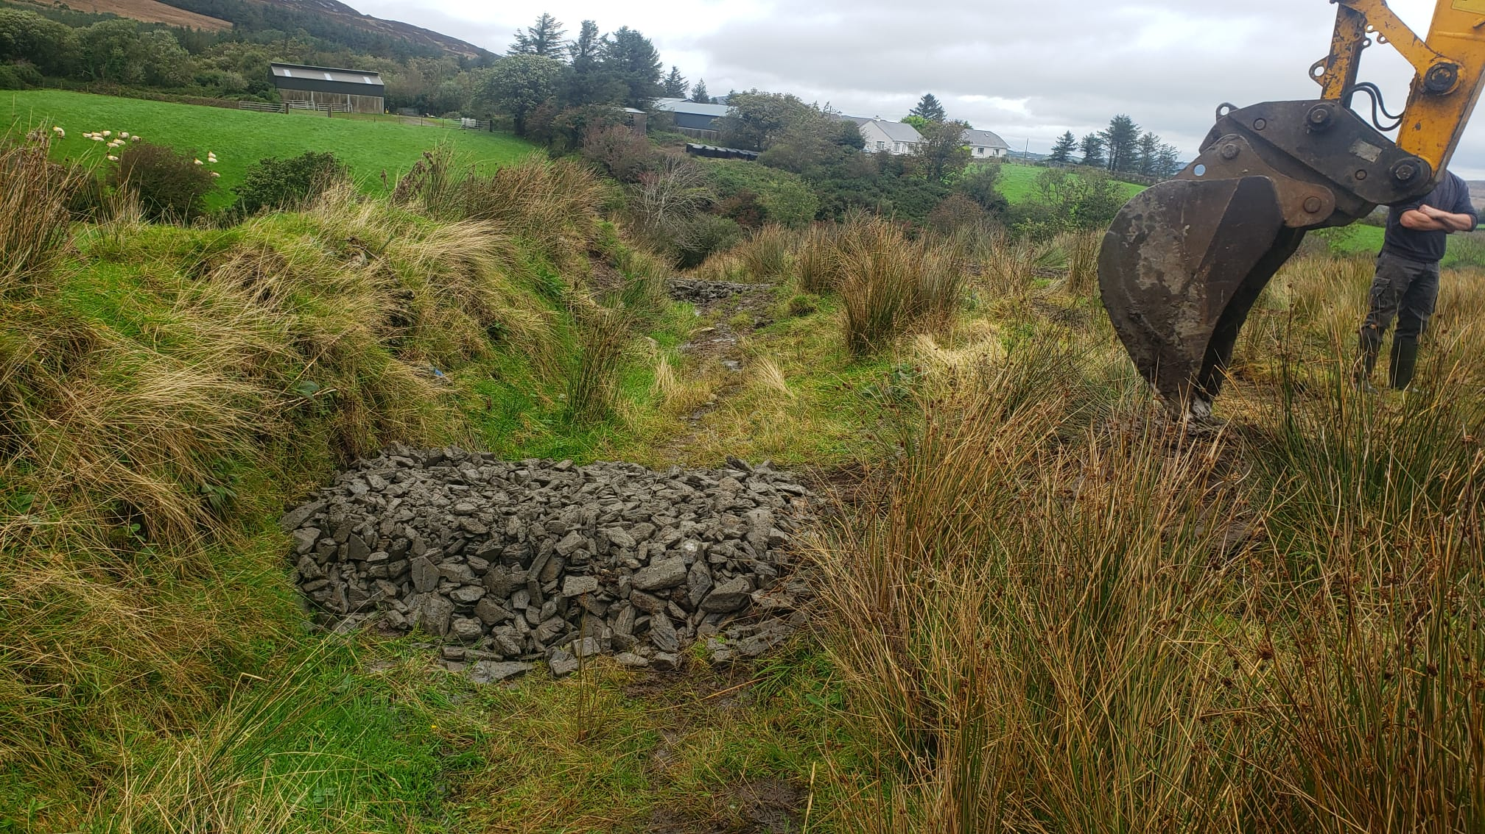
Check dams
  Stone
  Installed 4 per day
  Cost ~ €406 each for labour and stone

Slide 21
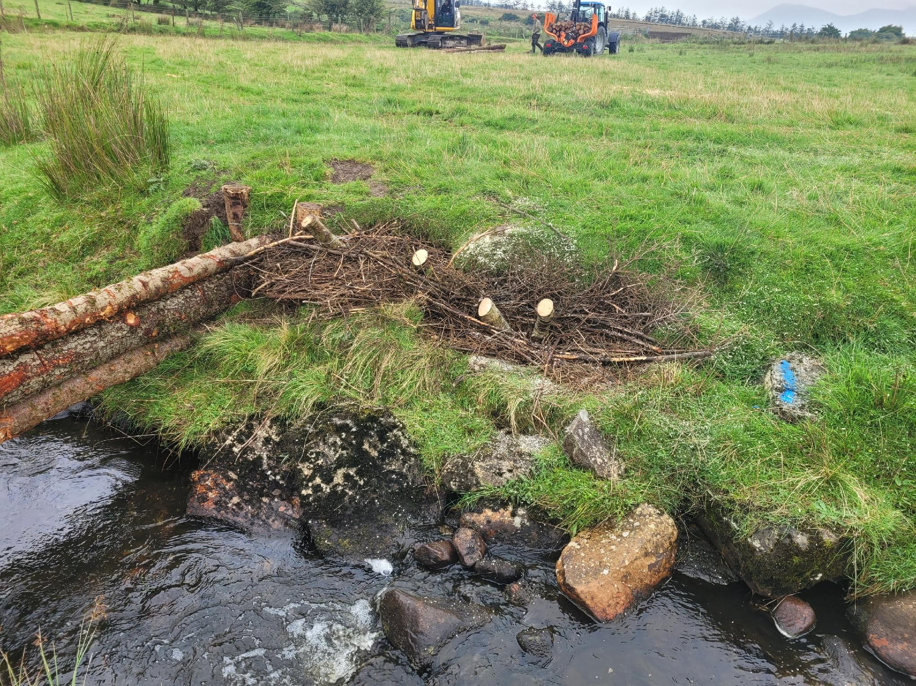
Erosion Control
  Erosion noted at some sites
  During construction small brash revetments put in place to prevent further erosion

Slide 22

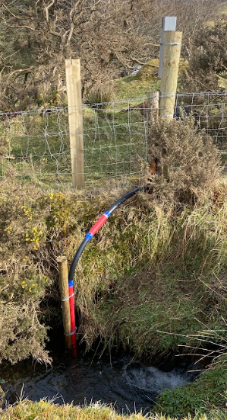
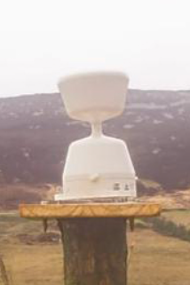
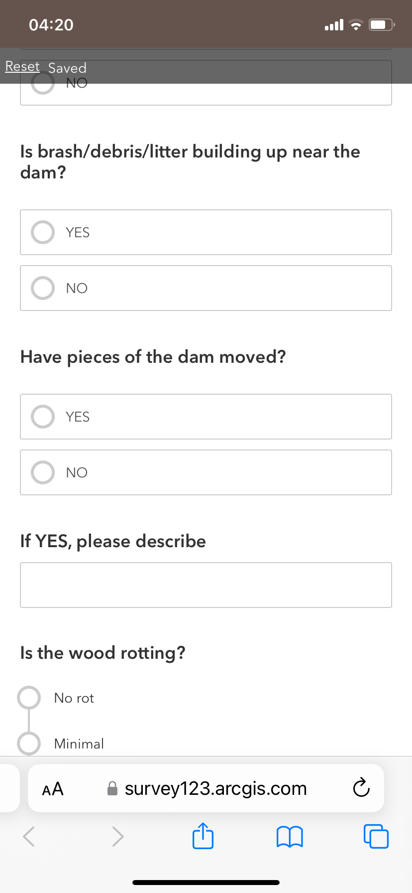
Monitoring
As part of original funding, IRT made a commitment to monitor the dams for a period of 5 years.
Staff member visits all the measures each year in late summer. 2026 is final year of monitoring.
Survey123 used to collect info on condition of each dam.
Data from weather station and water depth is gathered.

Slide 23
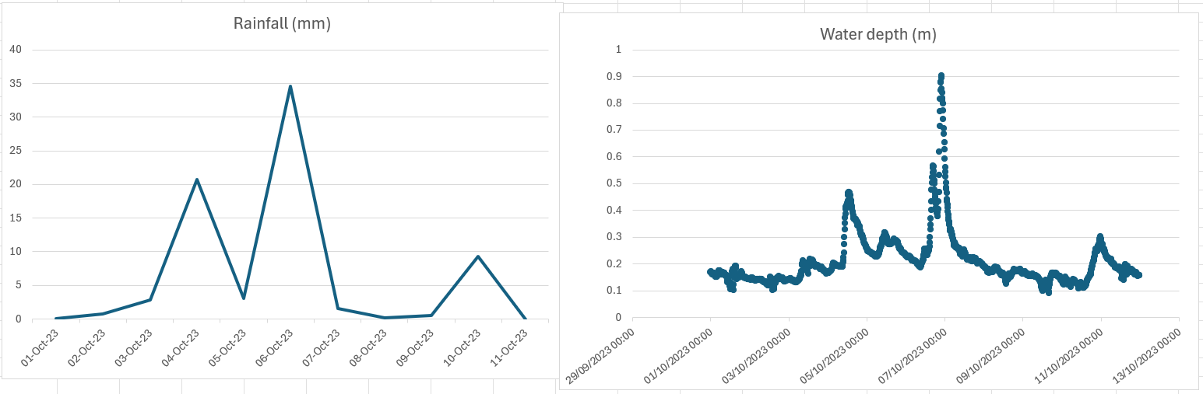
Rainfall event
6th October 2023 – Malin Head’s highest recorded rainfall in one day for 2023
34.6mm
Malin Head Weather Station 16.6km from gauge

Slide 24
Rainfall event
13th November 2023 – Storm Debi
Flooding in Clonmany – no photos

Slide 25
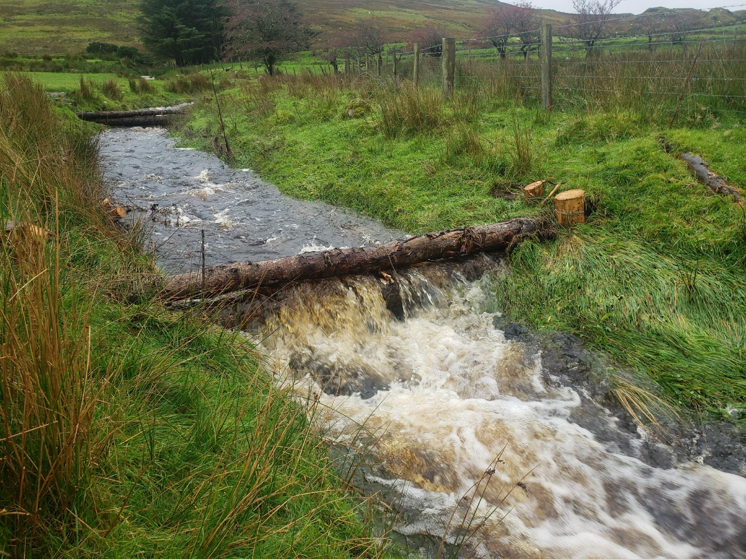

Slide 26
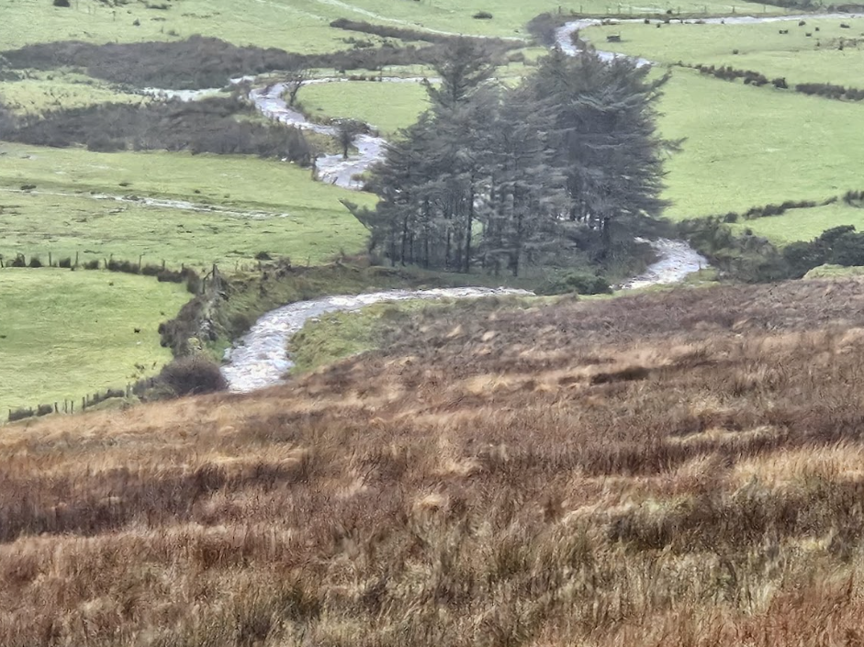
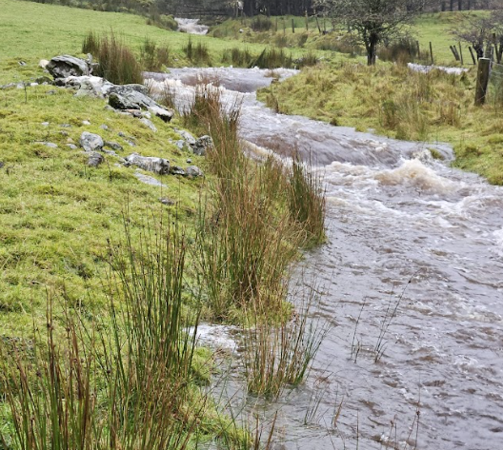
Saturday 9th Dec 2023 - Storm Elin
26.4mm rain recorded @ Malin head
Significant surface run off

Slide 27
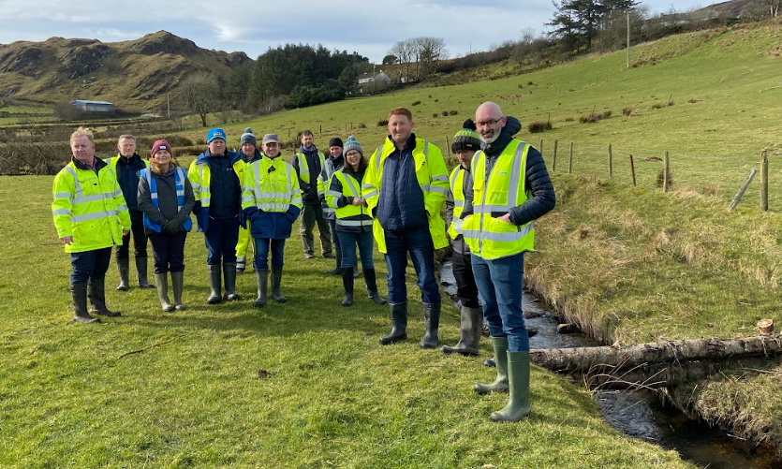
Benefits
Project has been more than a ‘demo’.
Pilot site for Ireland. More sites needed around Ireland. Large number of visitors to site, particularly agency staff.
Site is useful for learning about long term durability of NFM measures, co-benefits and impacts, construction methods, landowner engagement and permissions.
Reassurance to community - Possibly benefitting the community for real flood control. Downstream of the dams there has been no recorded flooding in housing estate. However, number of significant streams that could contribute to flooding in the area.

Slide 28
Challenges
Slow progress in early 2021 – Impeded by Covid restrictions
Lack of awareness of how leaky dam works. Difficult concepts to explain and require traditionally held beliefs to be challenged.
Need to work sensitively with community and environment, avoid sediment release into streams and avoid damage to farmland
Lack of tree cover on Inishowen rivers means few opportunities for natural dams.

Slide 29
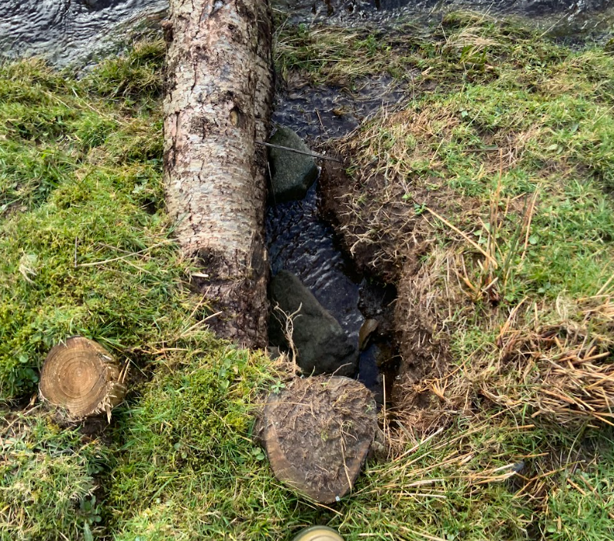
Challenges
Instrumentation challenges
  Gauges tempermental
  Cost of running / repairing
  Keeping calibrated correctly
Funding for monitoring
  Staff resource of 2-3 days to check all dams
  Data analysis expertise and time resource for report writing
  Highlights issue of short-term funding
Quantifying the effectiveness of natural flood management measures

Slide 30
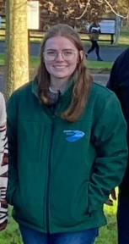
Future Projects & Funding
Applications made for additional funding:
  Interreg NWE Buffer+ Project – successful application with All Ireland Rivers Trust. Created demo site in Glenveagh National Park.
  Partnering on PeacePlus project on Nature-based Solutions (water quality and community engagement focus) with Lough Neagh Partnership.
  Nature-Based Solutions Community Support Officer – supporting community groups to plan and deliver NbS funded by Heritage Council.
  Encouraging take-up by farmers through ACRES & FFW.
  Micheala Gallagher
  NbS Community Support Officer

Slide 31
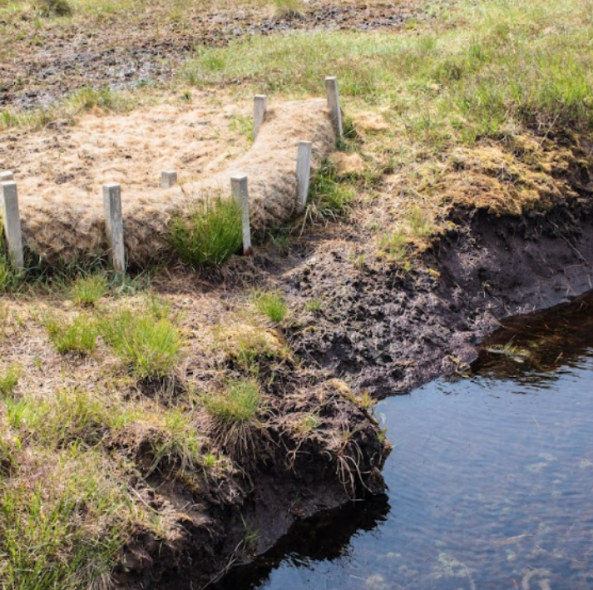
ACRES Co-operation Scheme
Ireland’s largest agri-scheme available to farmers
Nature-based solutions are available through Non-Productive Investments (NPIs) and Landscape Actions (LAs).
LAs include:
  Leaky dams
  Check dams
  Peatland restoration actions
  Tree planting
  Riparian margins
  Engineered ditches

Slide 32
Landowner Enagement

Slide 33
Landowner Importance
Engaging with landowners was the critical first step for the implementation of natural flood management measures
Landowners are the guardians of the land and if they can take ownership of the undertaking, care and maintenance it can ensure greater project success
Landowners were overall happy to help for the benefit of their communities

Slide 34
Farmer led issues
Dredging - There was a general consensus within the community that dredging is needed on rivers. Many community members feel that wood should be cleared from a river
A picture tells a thousand words - The first photographs of the first measures constructed for this project on the Bocharney River were used to explain the concept to the other landowners.
Local politics - Another consideration when dealing with landowners is local politics. It is recommended that the LLO be aware of any sensitivities in the area.
Early engagement - For areas where a new programme of measures is planned, prior education and engagement with the landowners is essential. This should be very much focused on the farming community and address their needs and concerns
Wording is very important Rewetting V Water Table Management

Slide 35
Landowner Liaison Officer role
Contact and meet with local landowners across the catchments, explaining the project and answer any questions
Engage with flood consultant and introduce landowners
Participate in engagement events
Secure all consents from landowners
Act as site advisor when measures are being installed providing a familiar face
Prepare final report
Liaise with all statutory agencies

Slide 36
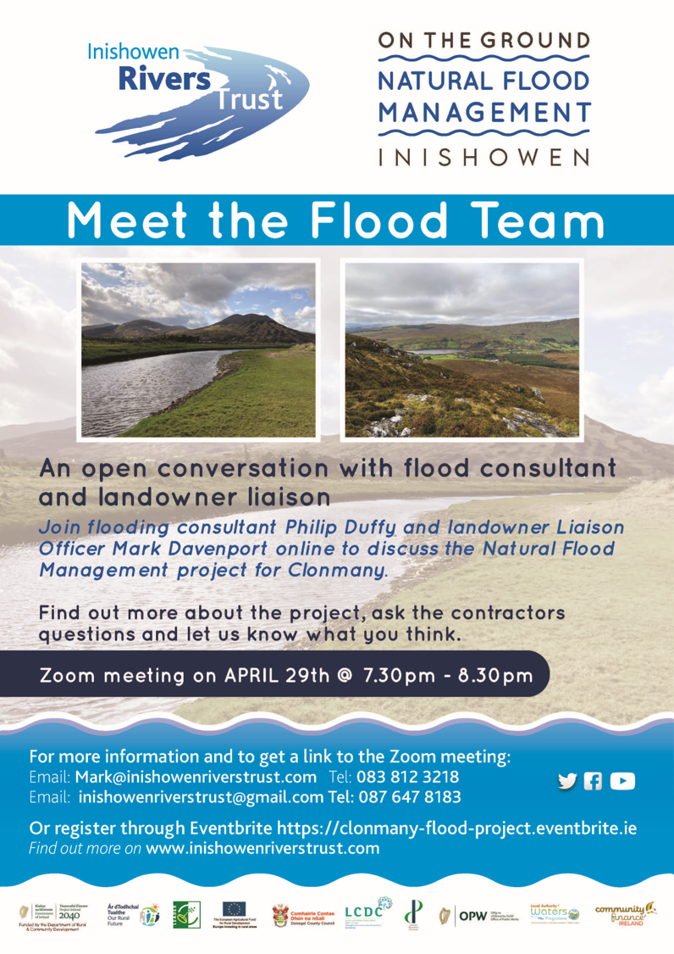
Methodology for landowner engagement
The approach taken was divided into separate phases
Reconnaissance, preliminary contacts and desktop research
Project promotion
Landowner engagement process
Post construction engagement and monitoring arrangements

Slide 37
Stages in the communication with landowners during the project
Stage | Activity
1 | Meet with landowners to ask for an initial walkover of their land to access feasibility of measures, while maintain social distancing. At this time the project was explained and a small map leaflet on project with contact details was left with the landowner
2 | A follow up call was made within one to two days or at a date specified by the landowner. The suitability of the land was discussed at this point. If the land was not suitable they were thanked for their time. If the ground was suitable they were given an initial idea of the types and numbers of measures that could be installed. They were also asked at this time if they would like to participate in the project, but they were not pressed to give an answer at this point
3 | Called again a few days later to provide a copy of the Landowner Agreement Form developed by the IRT. This was left with them
4 | Called to landowner to collect the form. If they were in agreement the type and number of measures suited to their land was agreed
5 | Each time a visit was made to the land, the landowner was contacted in advance. Several visit would have been made by the LLO and flooding consultants as well as the IRT and construction lead
6 | Landowner contacted to say build was to start. Given details of the build and asked if there were any issues
7 | Once the construction was completed the landowner was contacted
8 | The final contact is being made to discuss maintenance. The IRT team will provide information to the landowner on their measures and given a guide on how to monitor the measures and report any problems to the Trust

Slide 38




Landowner packs

Slide 39
Landowner Liaison Officer findings
The project was promoted periodically throughout and the local retails stores continually featured posters relating to the project. Despite this very few direct calls were received by the LLO and direct face-to-face contact was more successful in engaging landowners.
Being in contact with a local landowner who was in contact with other landowners is key to spreading the word.
Having the knowledge to answer questions accurately is also critical. A knowledge of farming practices and the local area are also essential to inspire overall confidence with the landowners (e.g., negative effects of dredging), 90% of conversation with landowners revolved around farming and other issues.
Landowner must have confidence in your understanding of the issues, your ability to follow through on the construction and how genuine your intentions are in carrying out the project.
Feedback indicated a lack of willingness to engage with agencies due to previous experiences.
Feedback from the landowners was positive overall. One landowner was surprised by the small scale of the structures and commented ‘Is that all it is?’

Slide 40


Slide 41
Summary
NFM measures are still in good condition.
Downstream of the dams there has been no recorded flooding in housing estate. However, number of significant streams that could contribute to flooding in the area.
Difficult to demonstrate flood control benefit. Changing weather patterns are adding to issue.
Important to expand the work across the catchment and an opportunity to trial other types of NFM measures.
Important to share learnings.
Landowners are key.

Slide 42


NFM model
5000ml of water added as standard to empty tub
Sponge added to demonstrate intact blanket bog

Slide 43


Thank You
Go raibh maith agaibh

