Slide 1
A community based approach to
Natural Flood Management
By Trish Murphy
A presentation to the Cavan-Monaghan Science Festival
15th November 2022

Slide 2
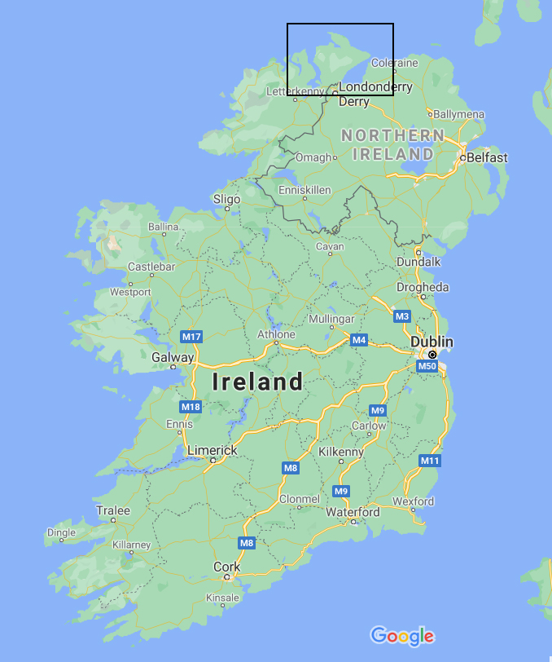
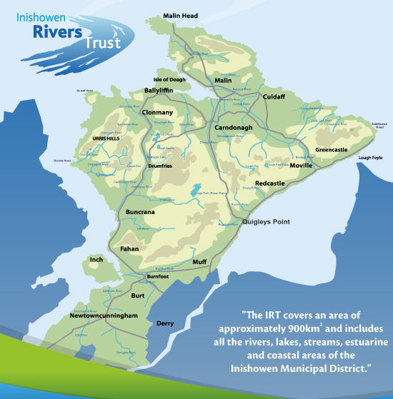
About IRT
Inishowen Peninsula
Journey began in October 2013
Established first board in Oct 2015
Established as a CLG in August 2016
Became a charity in March 2018
Six directors on board
Two staff members

Slide 3
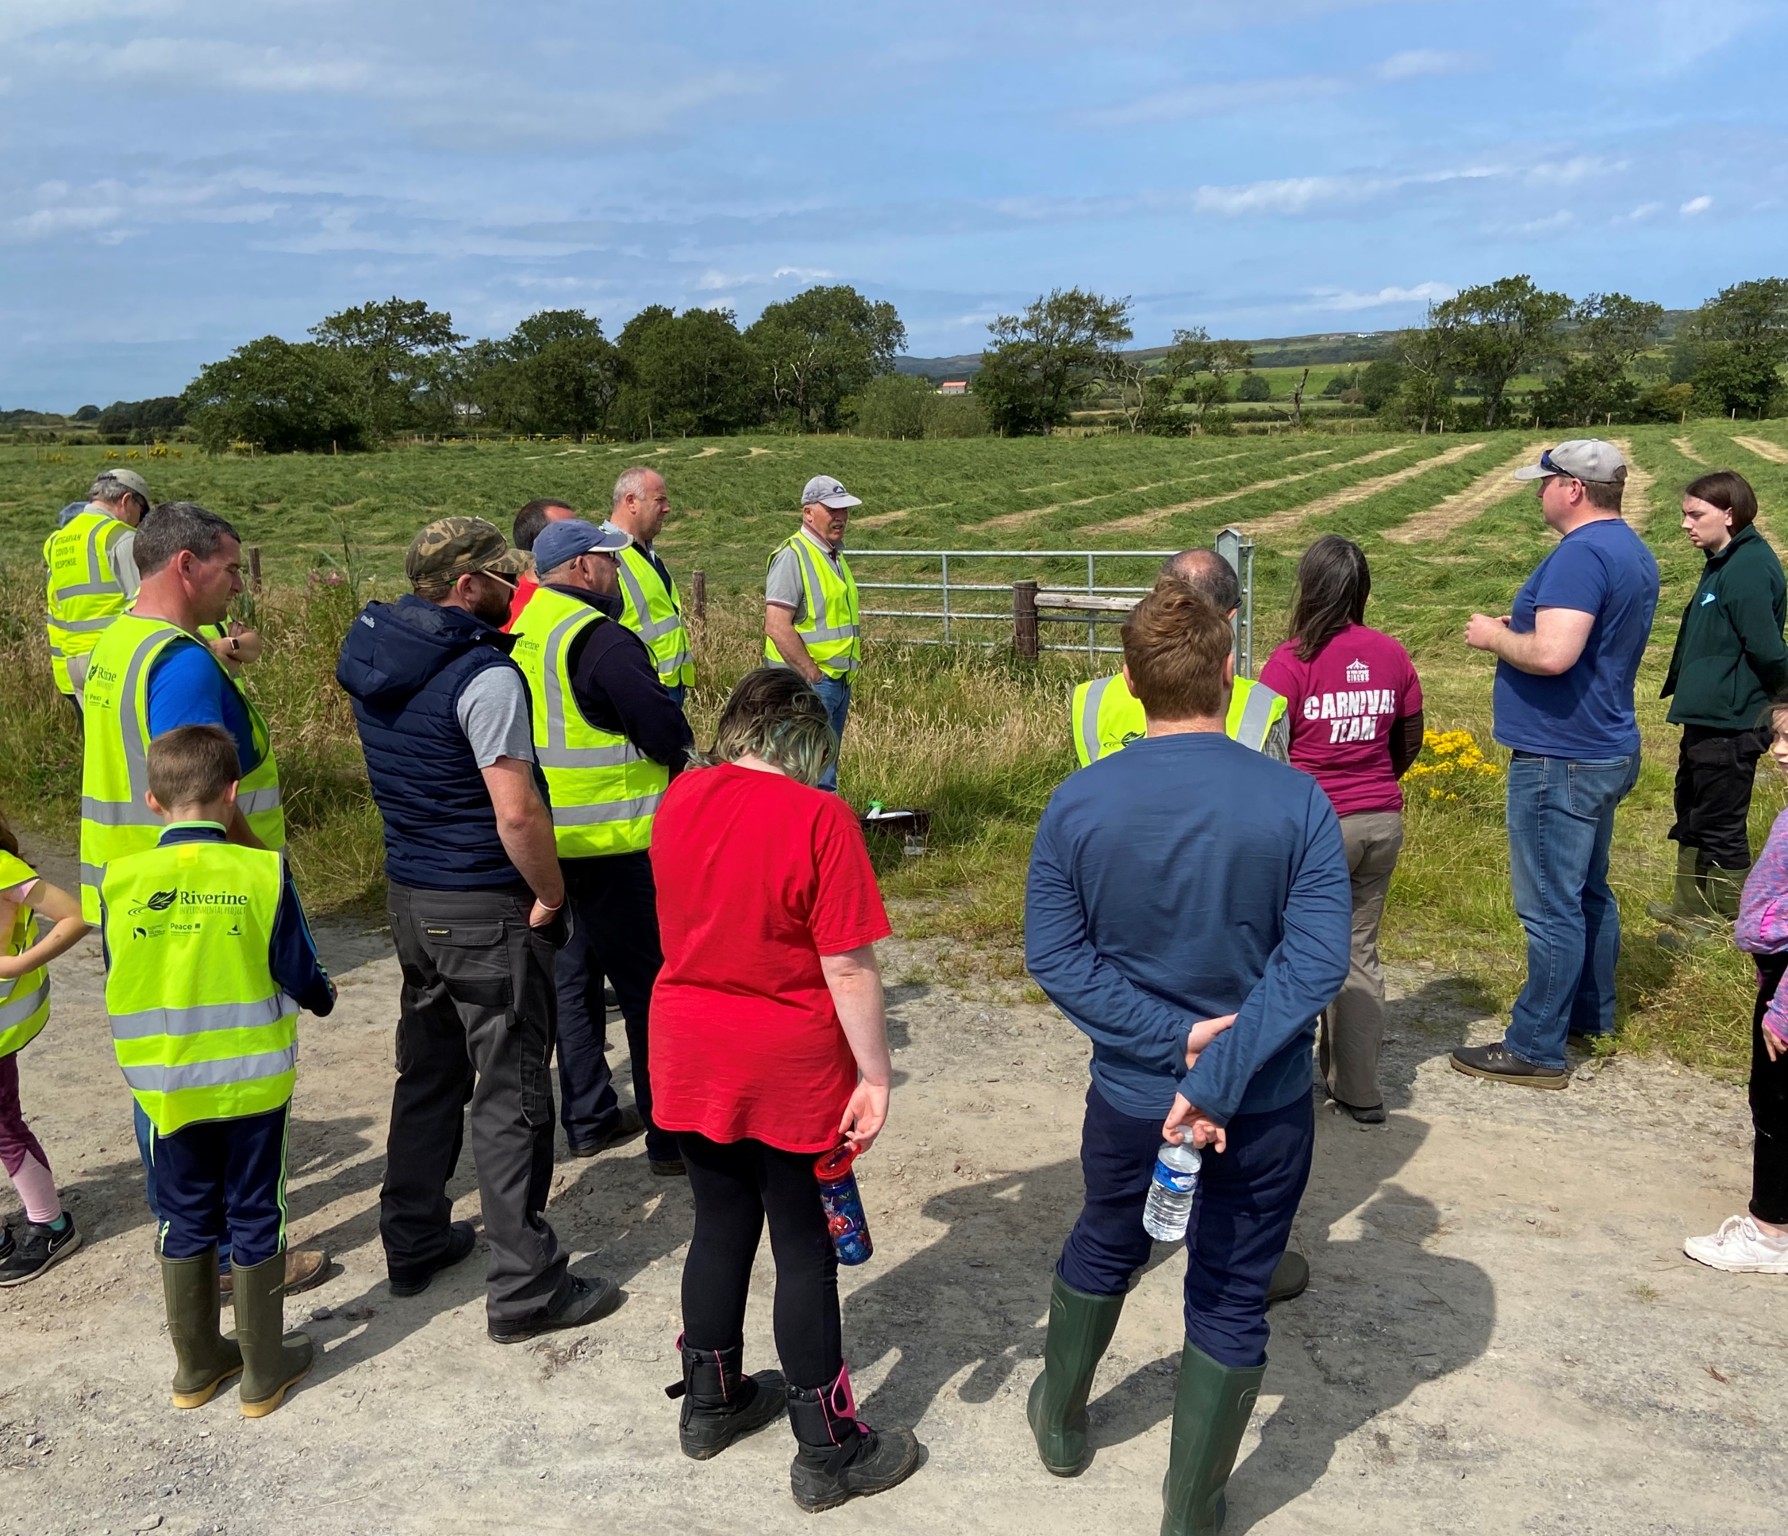


Strong community focus
Improves communication
Creates conversation
Helps identify the right solutions
Increases knowledge & acceptance
Increases ownership
Co-design & co-production
Develop Partnerships
Long term benefits for success

Slide 4
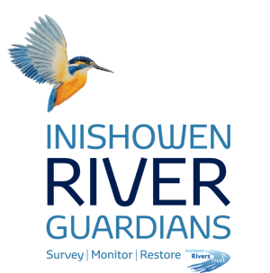
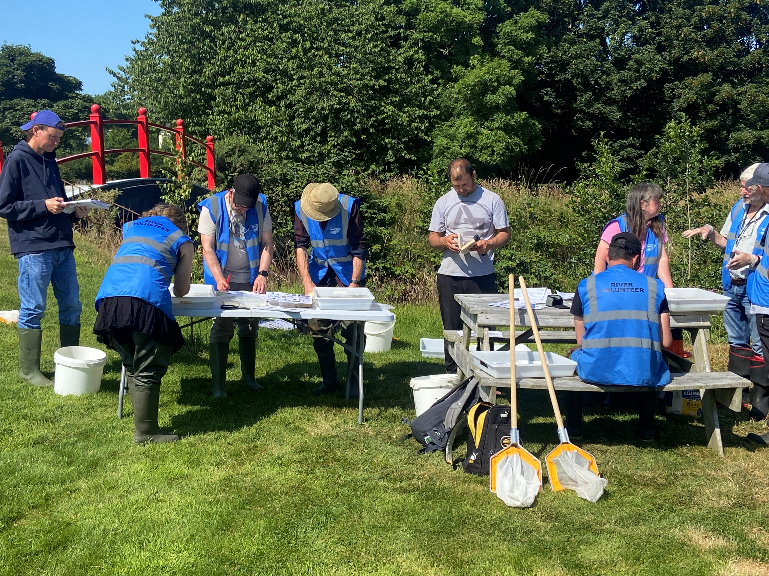
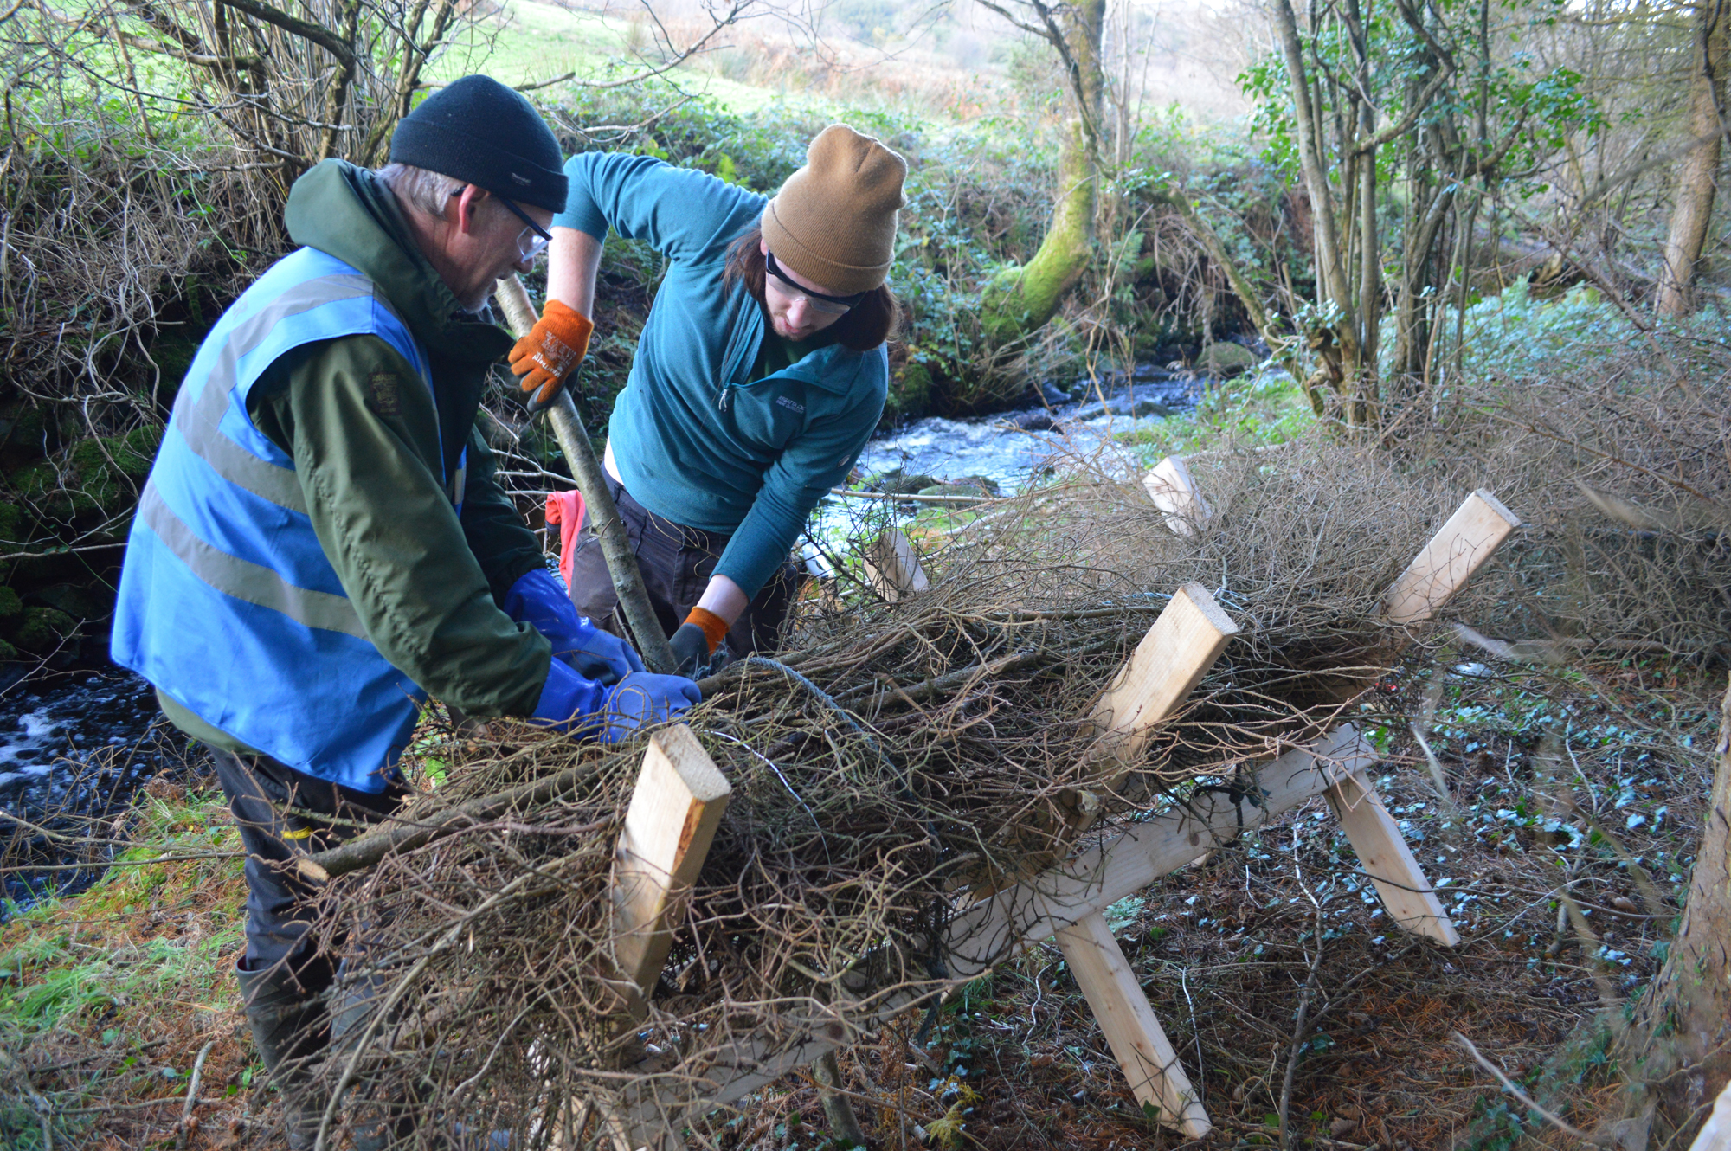
Training Programme
Volunteers who help survey, monitor and restore the natural waterbodies of Inishowen
Specialised training
BUILD CAPACITY TO DELIVER
Funded by EU LEADER & Rethink Ireland

Slide 5
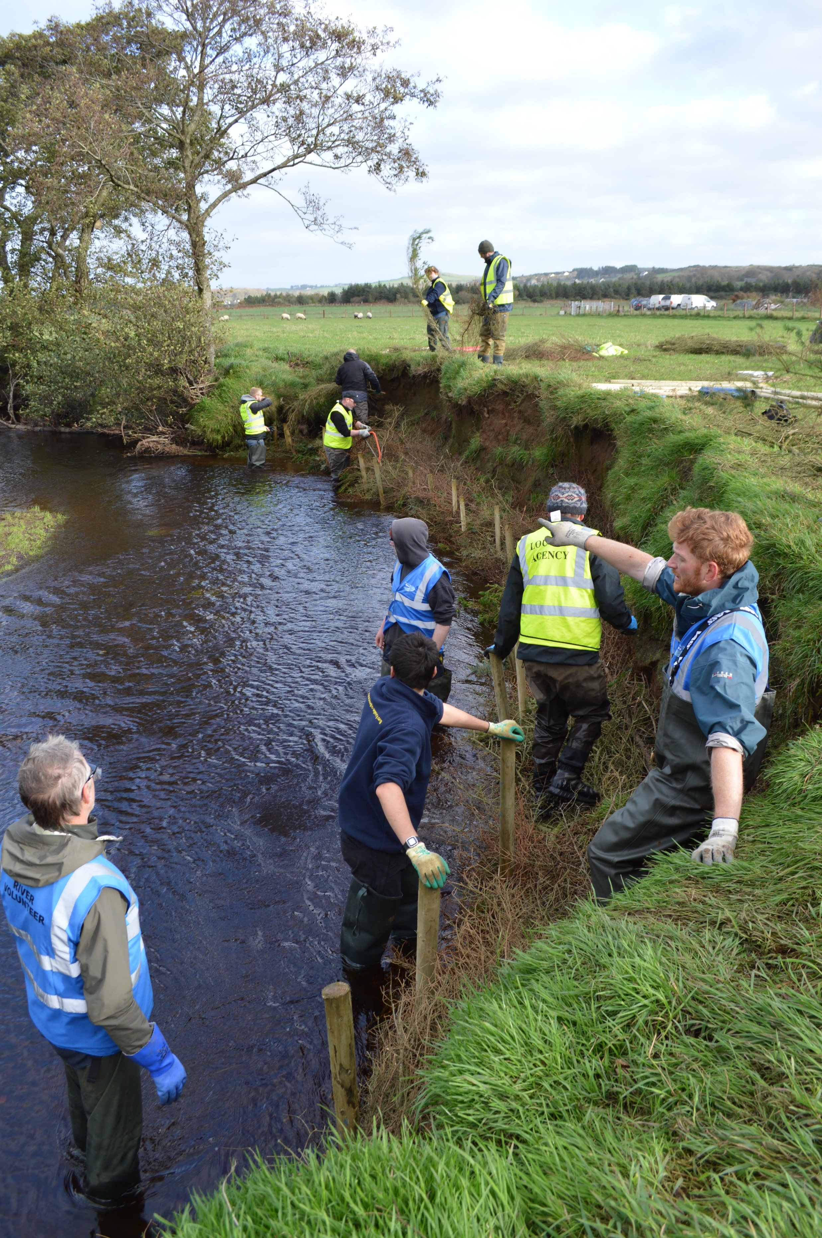
Nature based solutions
Practical experience
  revetments, spiling, use of woody material, fish passage, leaky dams
Knowledge (hydromorphology, river processes, local rivers)
Small projects to date but scaling up to a catchment based approach

Slide 6
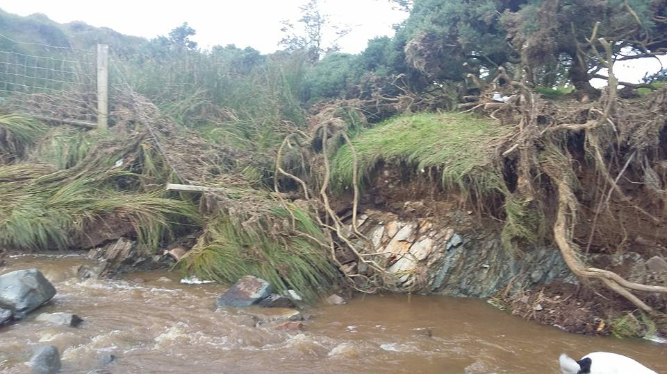
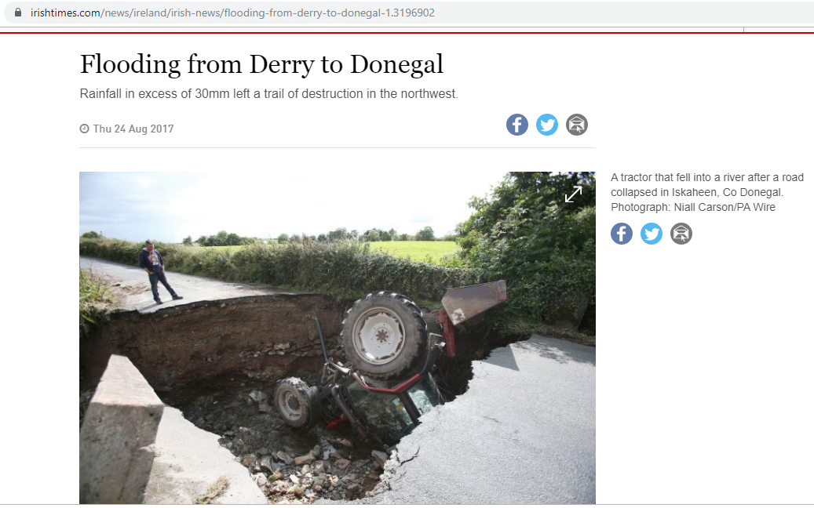
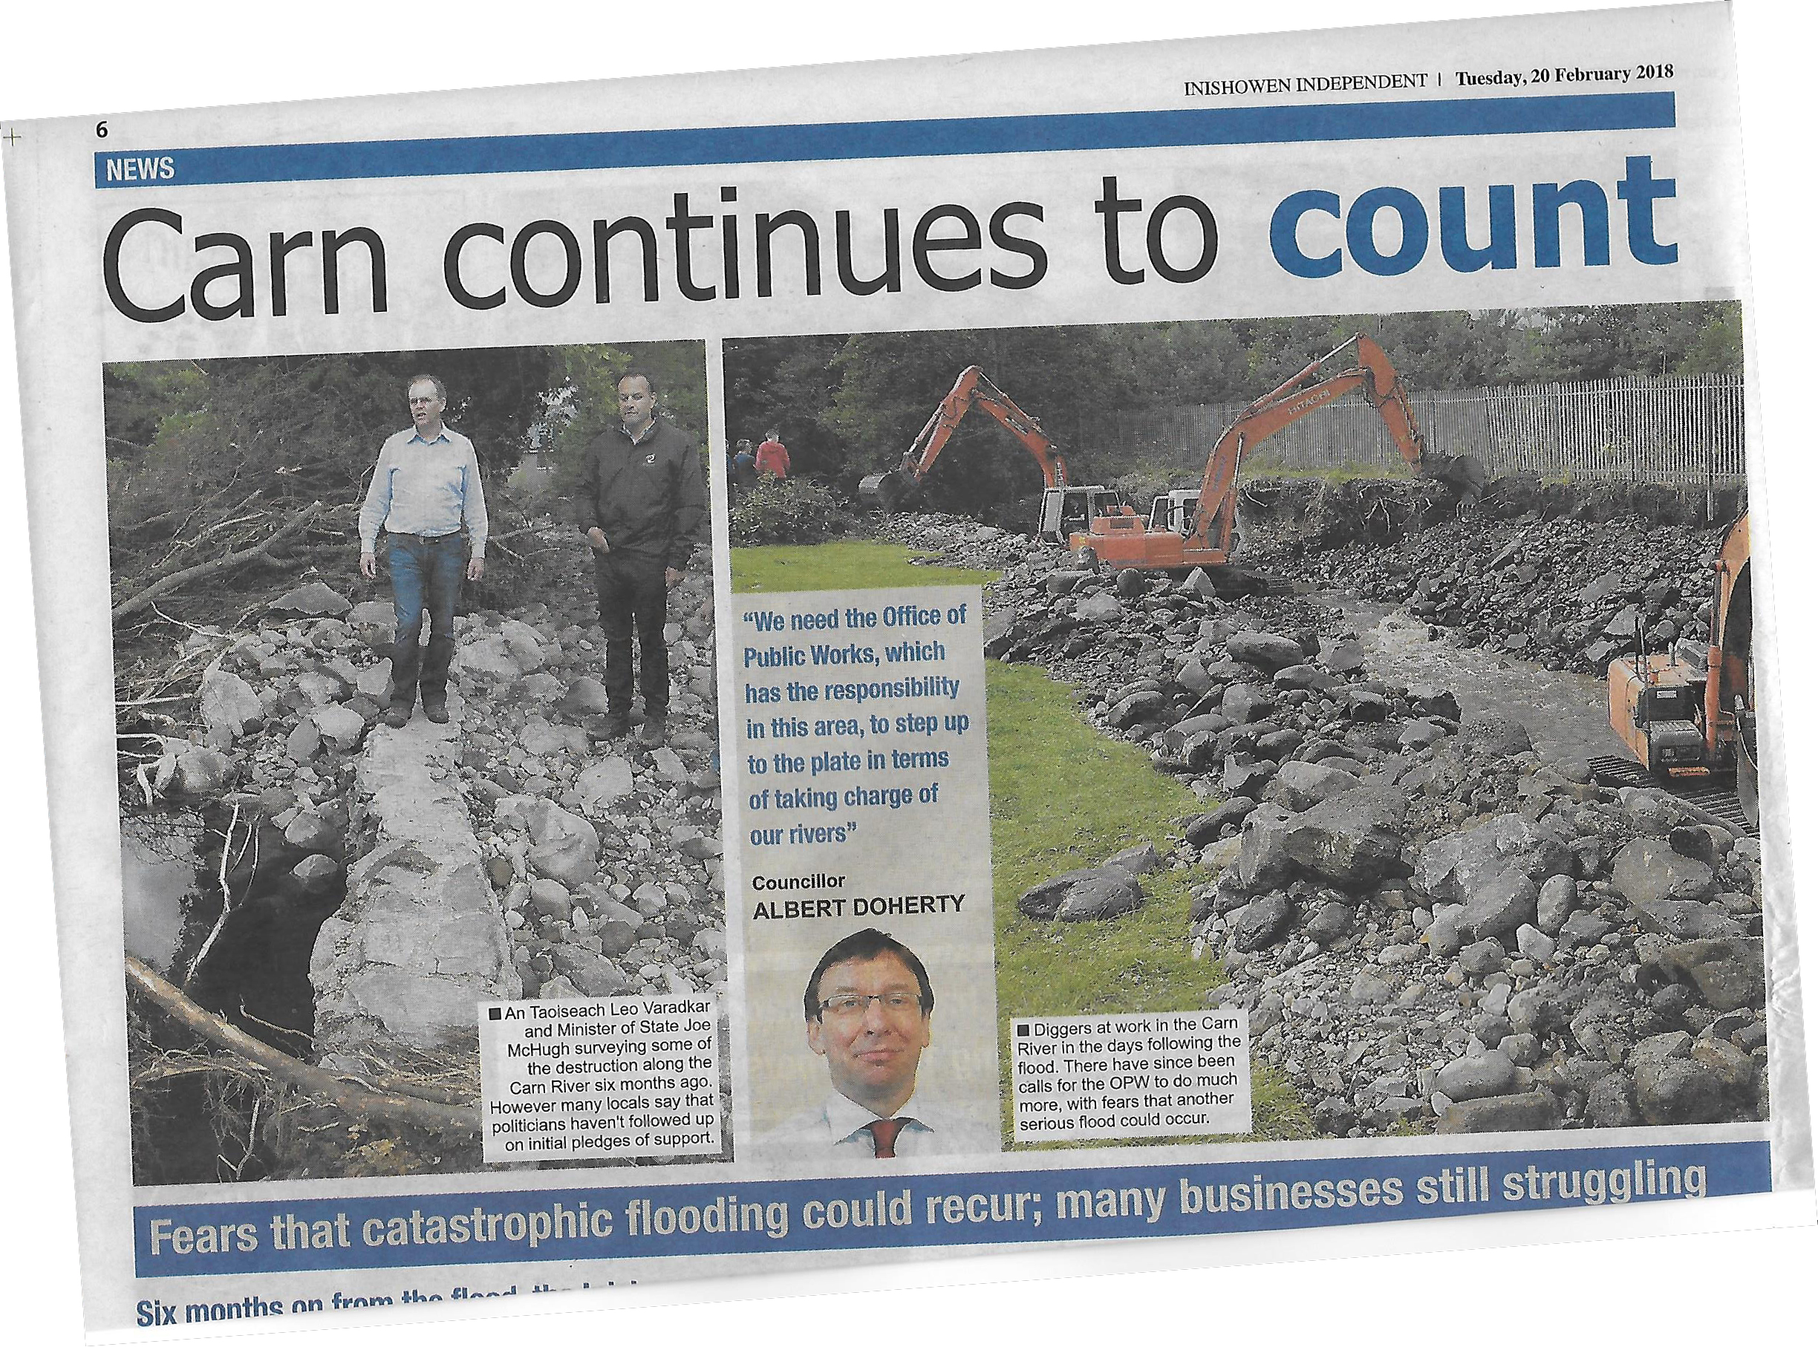
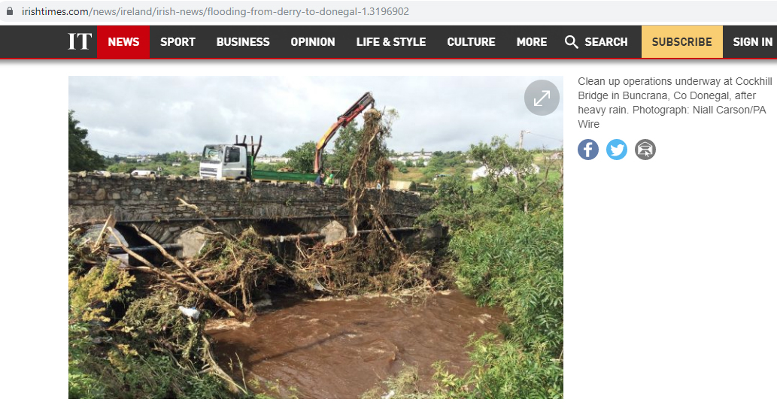
Inishowen Flood
22nd August 2017

Slide 7
Natural Flood Management
After the flood of 2017, IRT began looking into natural water retention measures. 3 phase project:
1. Awareness raising
  Feb 2018 Slow the Flow event to introduce concept to community. Funded by LAWPRO/OPW
  Sep-Oct 2018 Awareness of measures for river restoration and woodlands for water. Funded by LAWPRO
2. Scoping Project
  Nov 2018 Collaboration with Trinity College to look at potential for NFM in Inishowen. Funded by OPW
  Mar-Jul 2020 Community Consultations to gauge interest
3. Implementation
  Dec 2020 Secured funds from multiple agencies to implement measures
  (EU Leader, OPW, LAWPRO, Donegal CoCo)

Slide 8
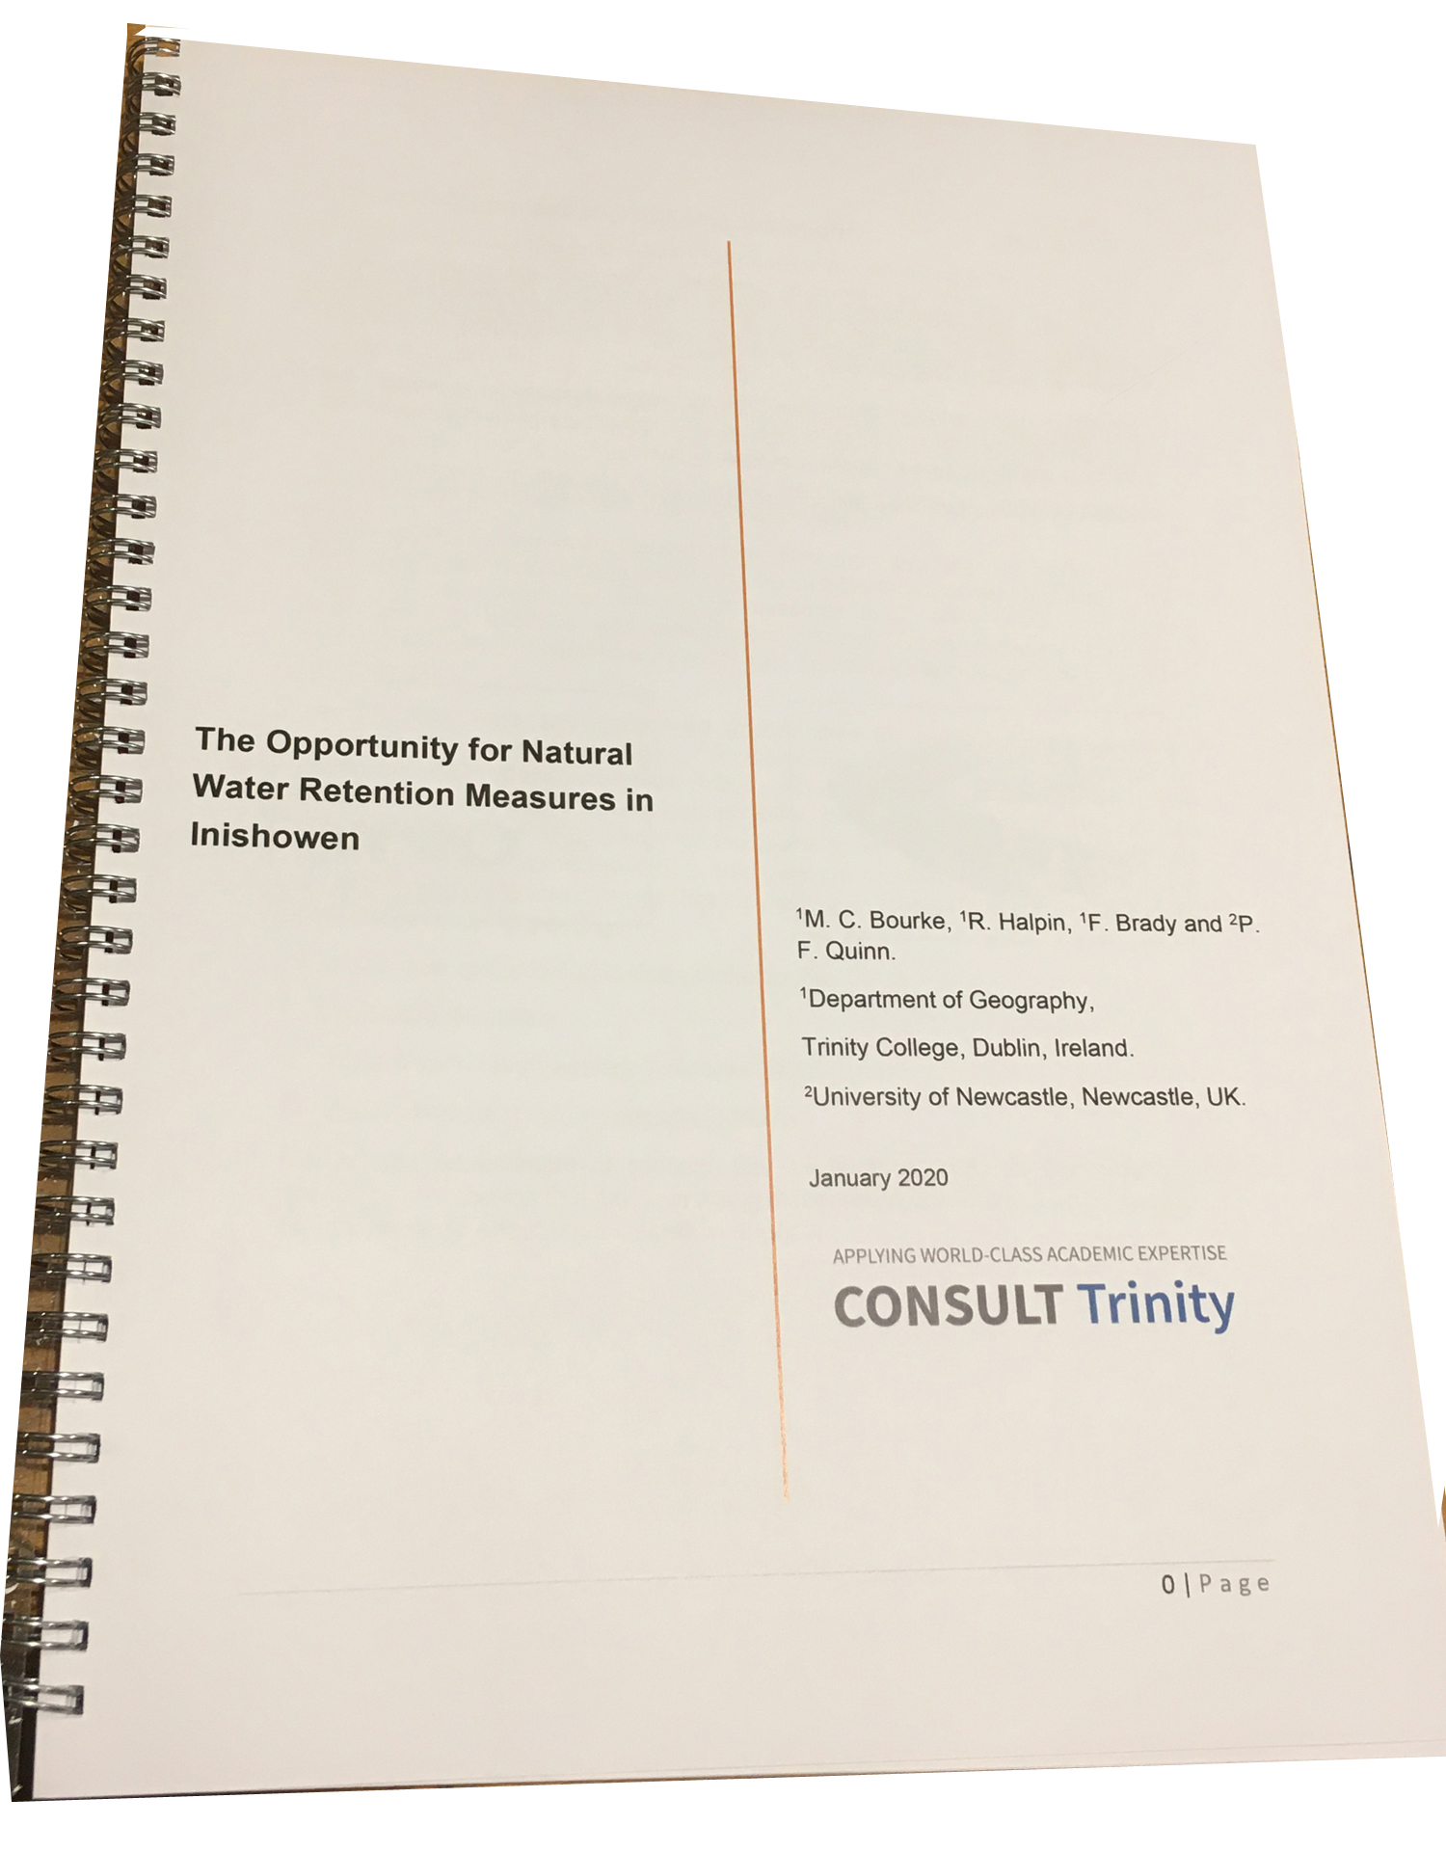
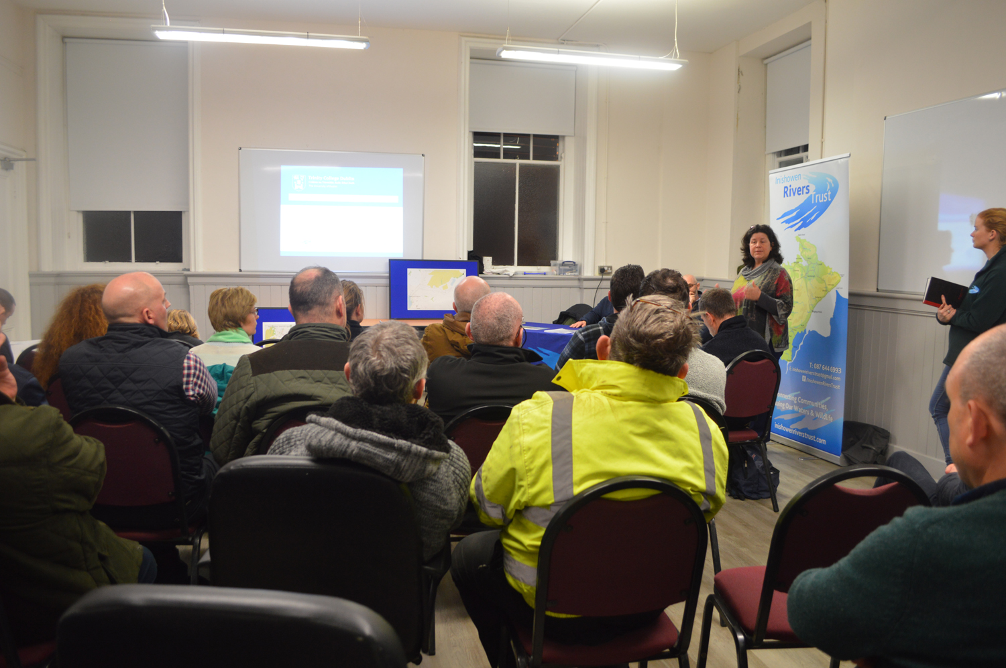
Community
Knowledge
Scientific
Knowledge
Co-designed & Co-produced Nature Based Solutions
Community consultation

Slide 9

Project Partners
Flooding consultant
Landowner Liaison
Ecologist
Works Contractor
Film Services
Branding and Promotion
Community facilities
Agencies
EU LEADER
OPW
LAWPRO
Donegal CoCo
~€ 135,000

Slide 10
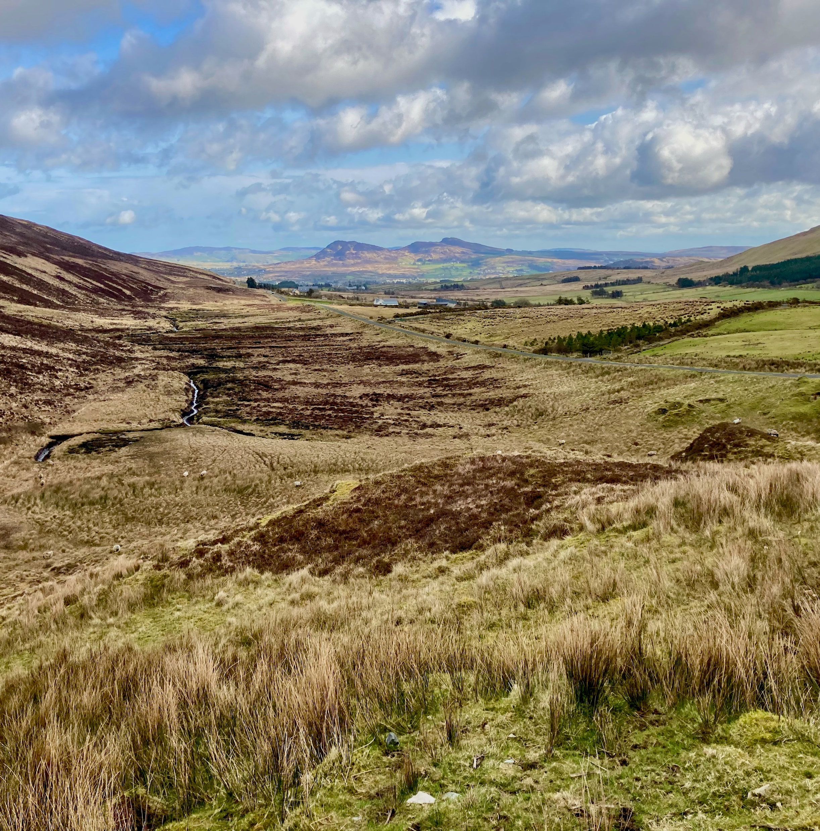
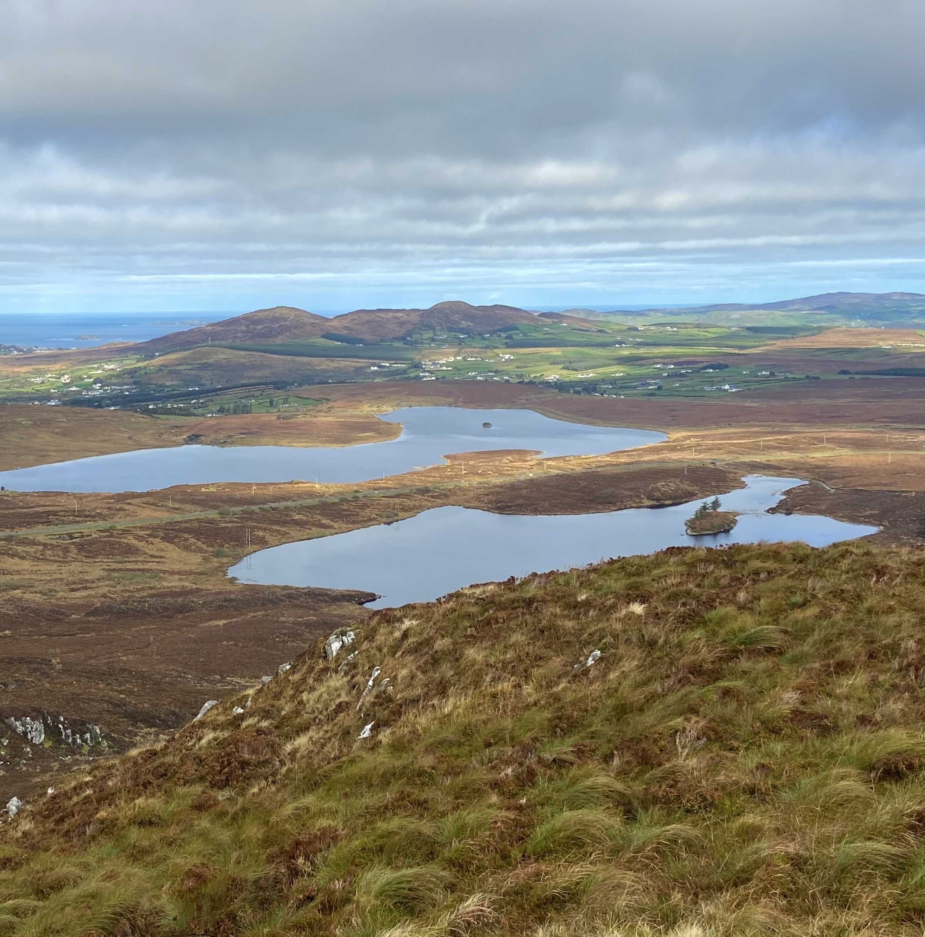
Parts of the project area upper catchment

Slide 11

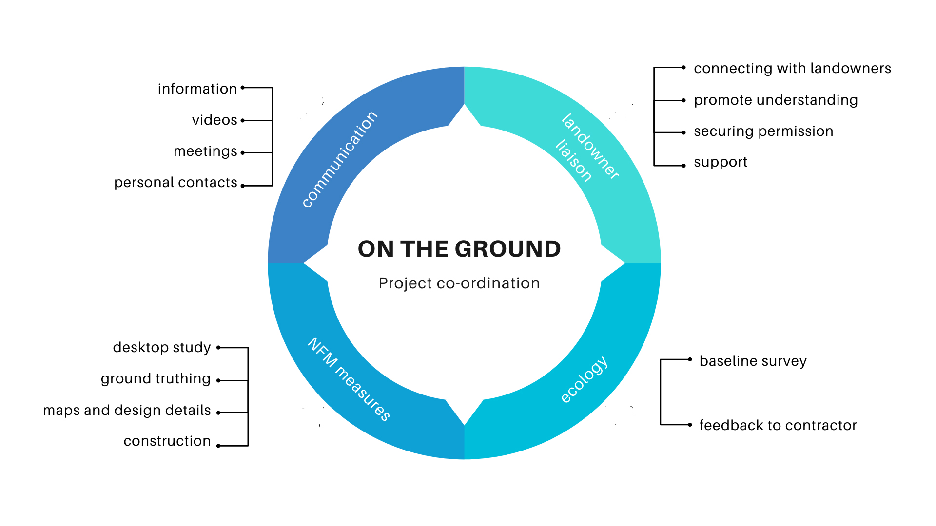



Slide 12
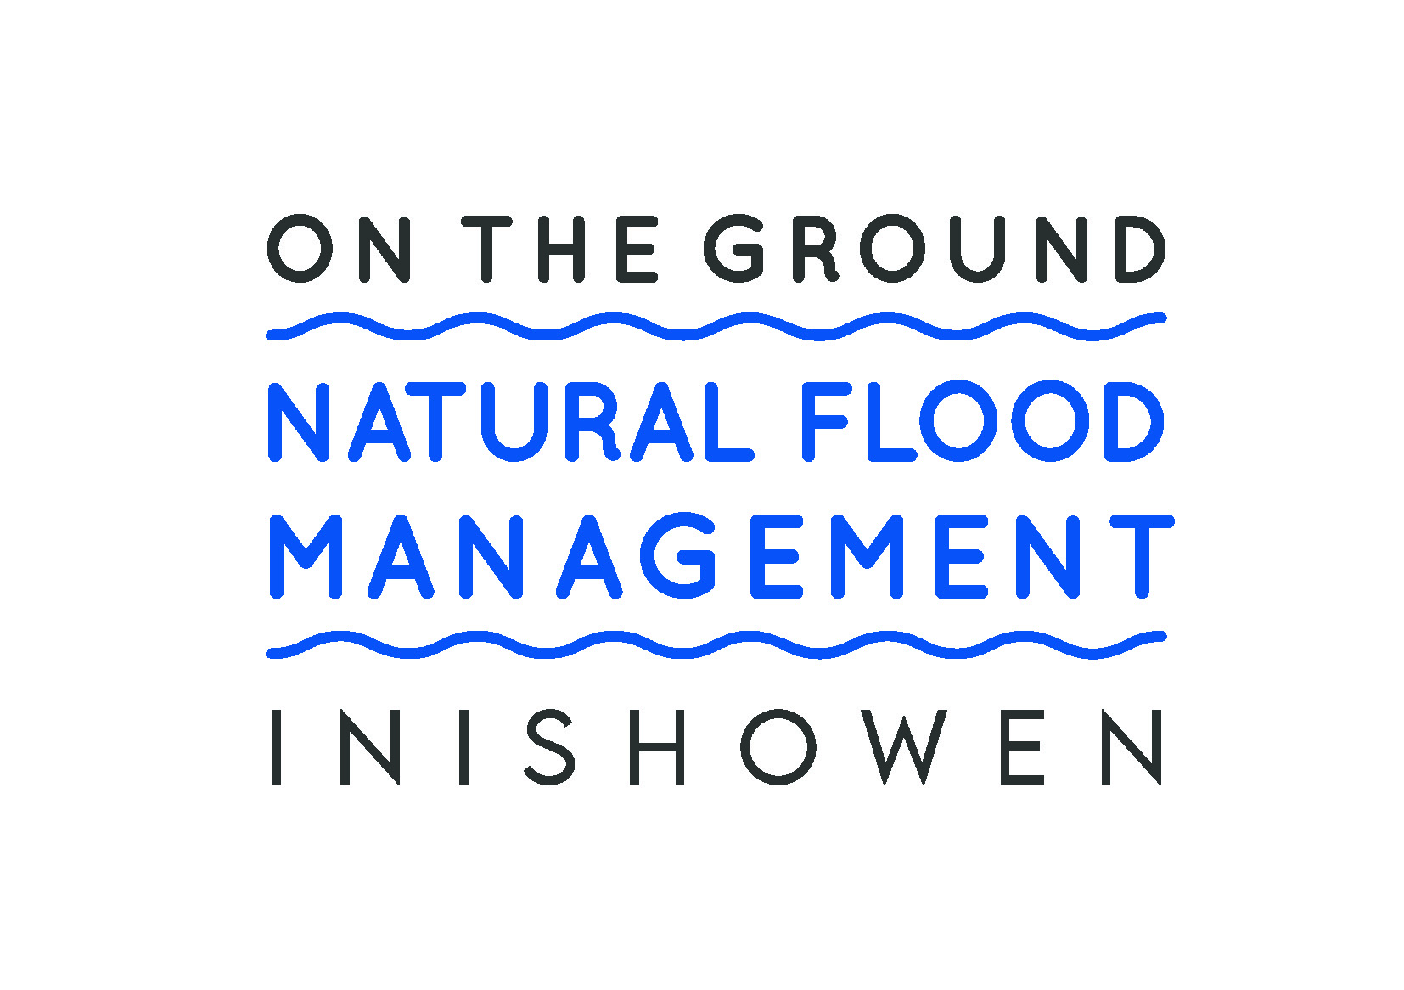
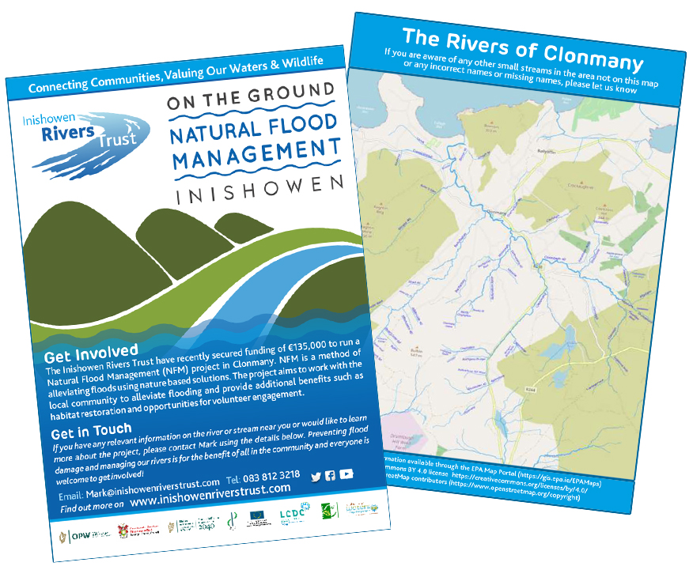
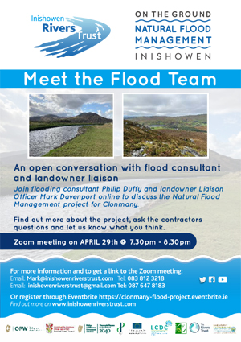
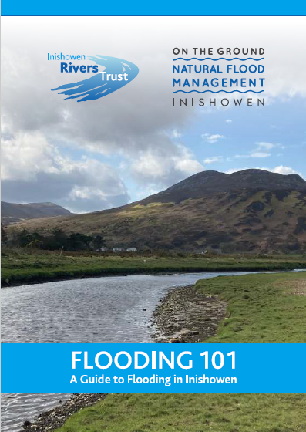
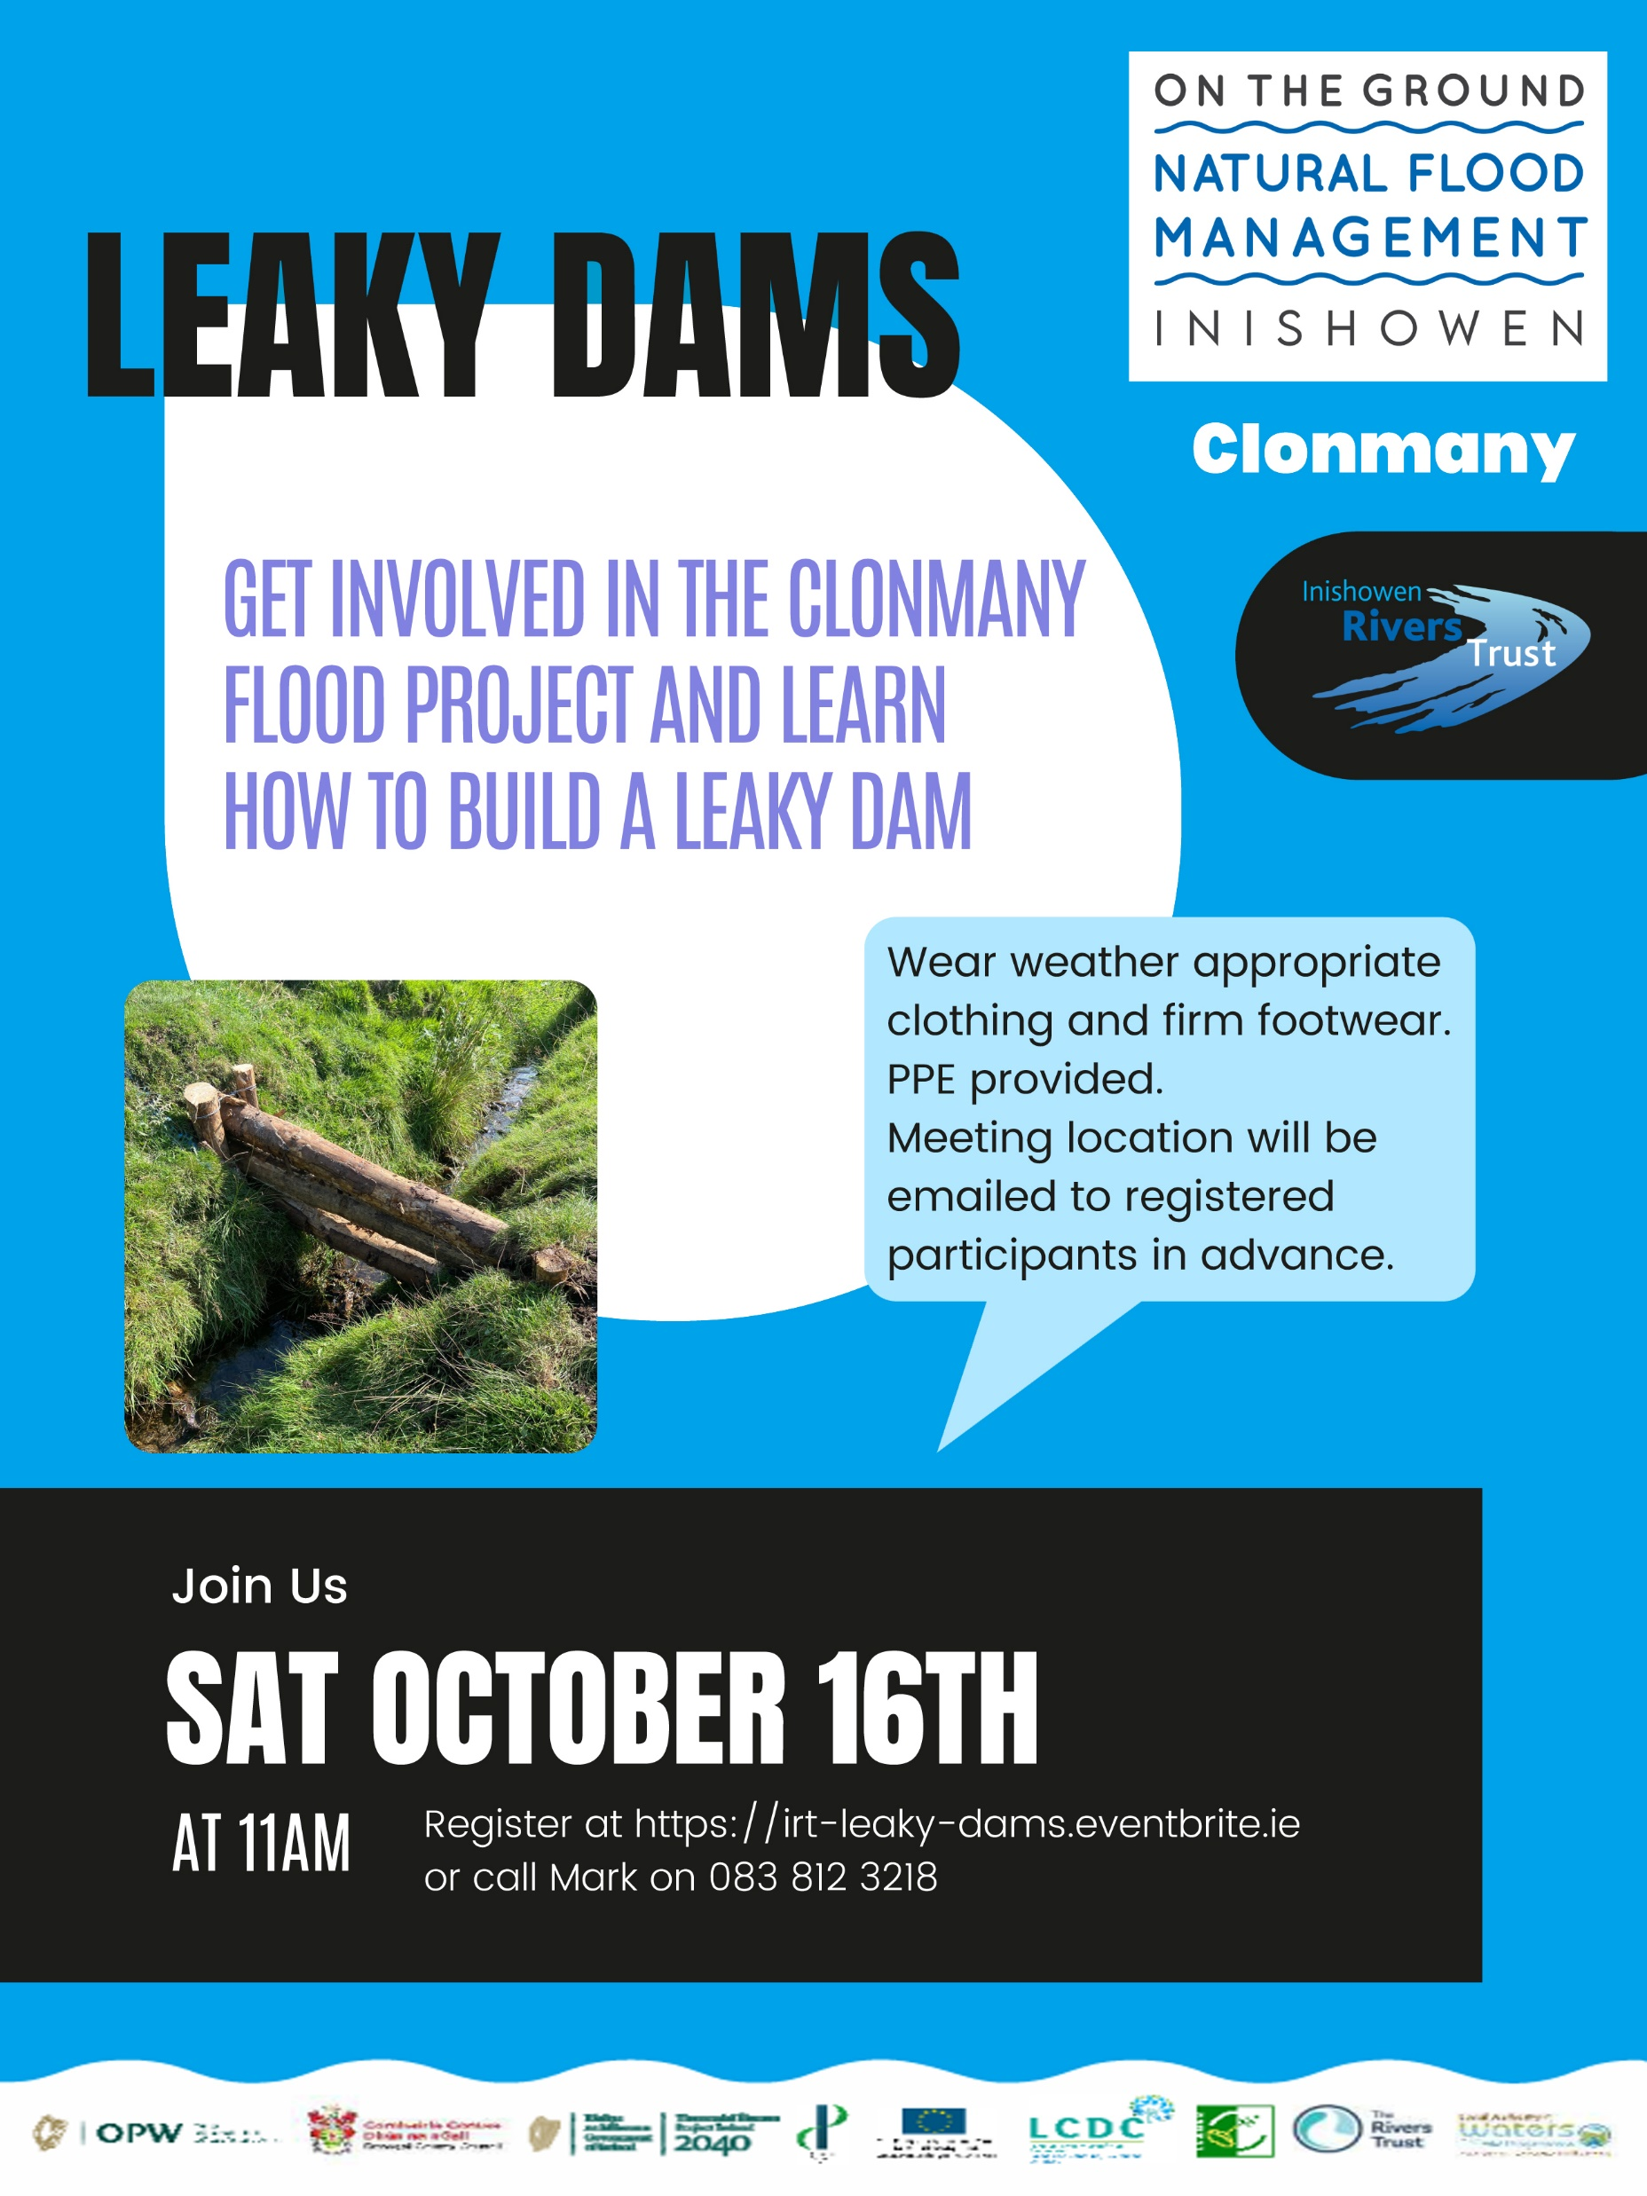

Community Engagement
Flooding 101
Guide to Flooding

Slide 13
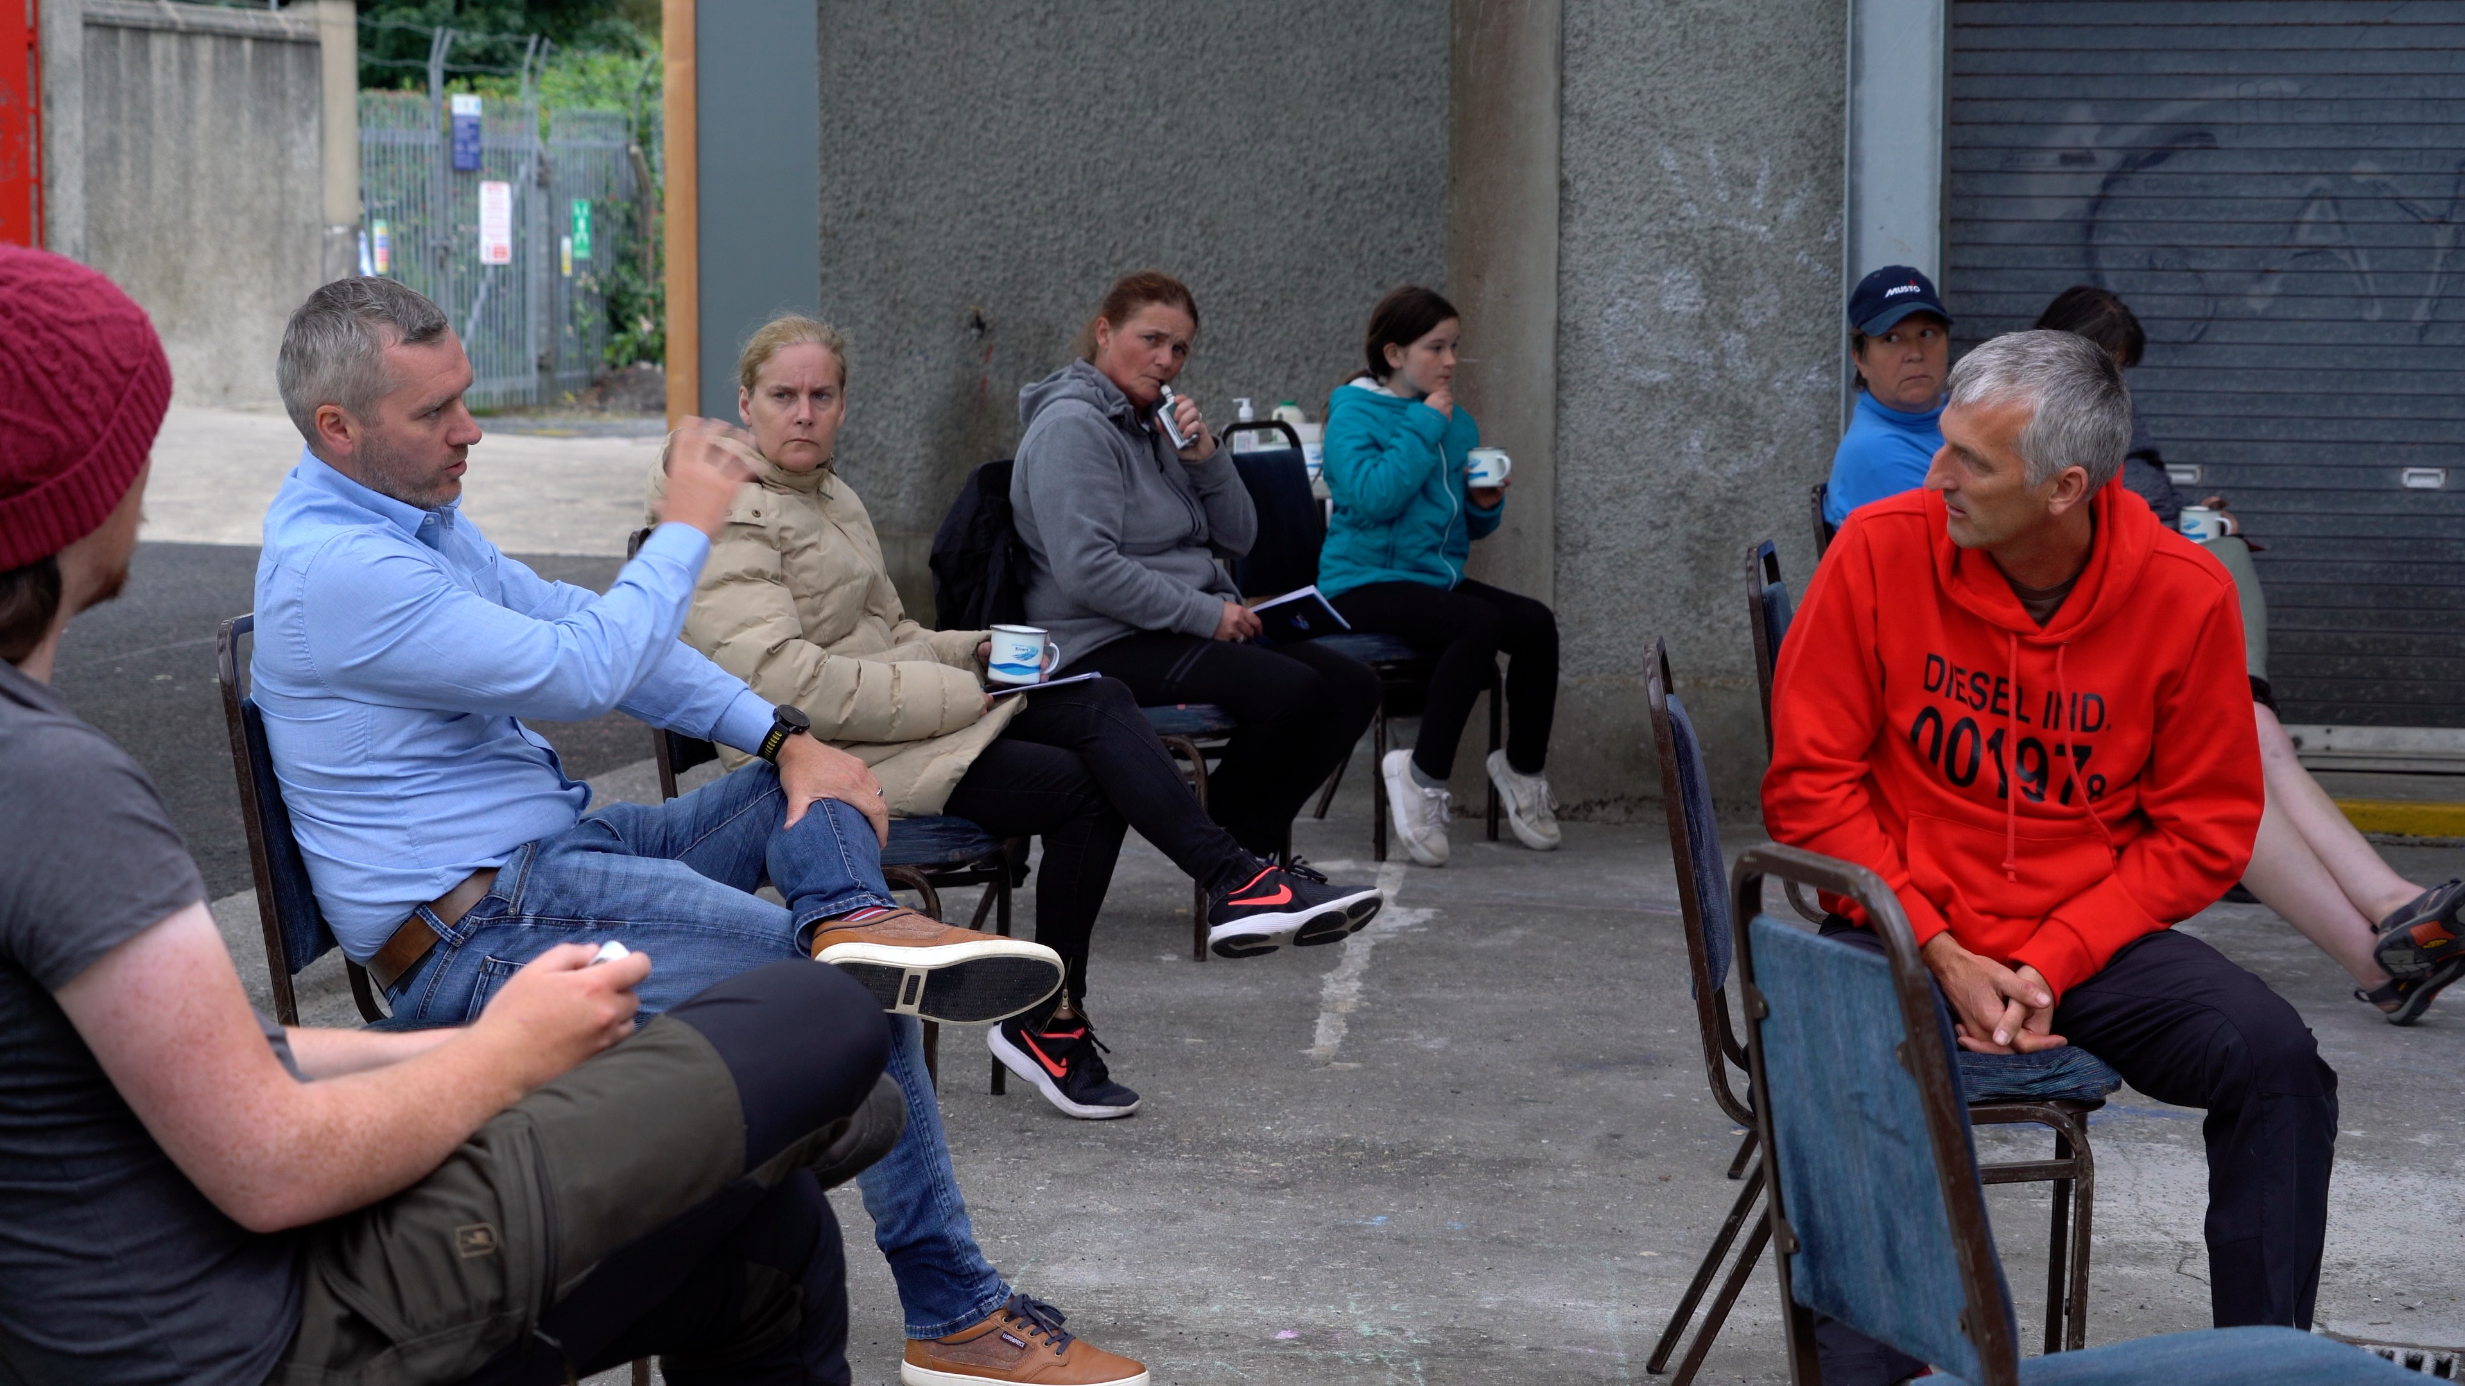
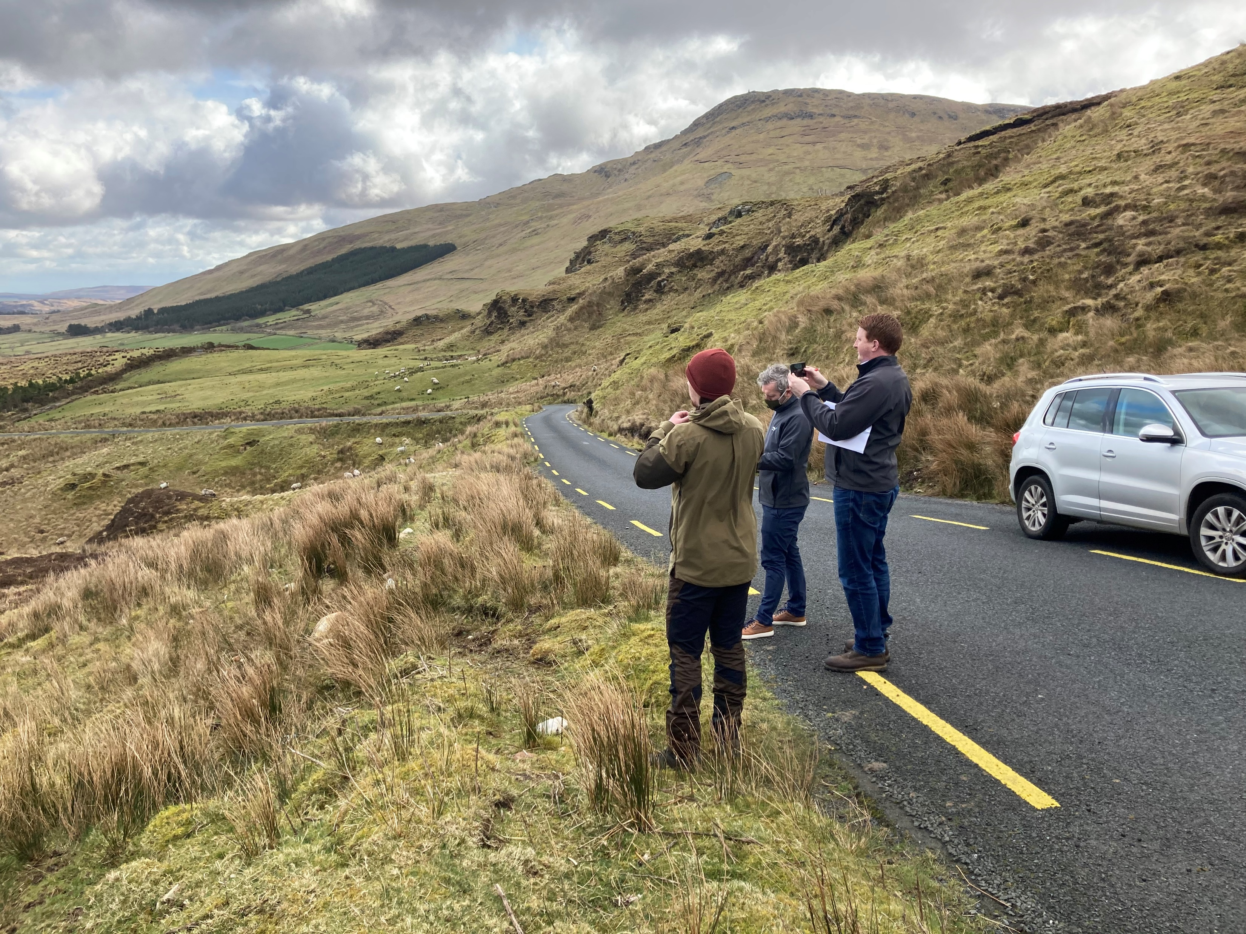
Community Engagement
Landowners & Consents
200 locals contacted
30 landowners engaged
11 sites agreed

Slide 14
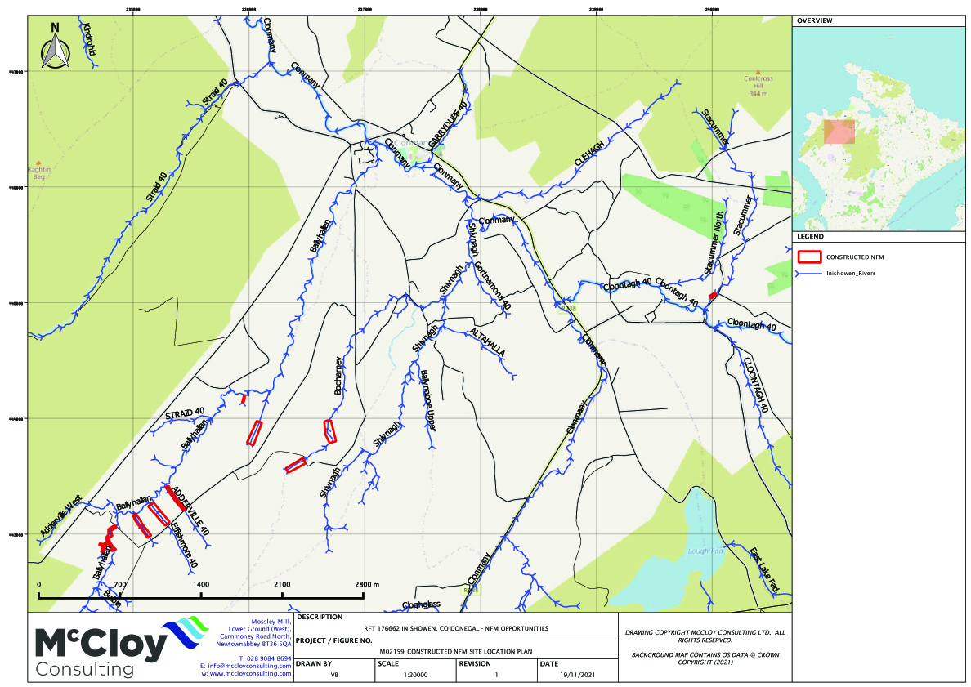

Slide 15
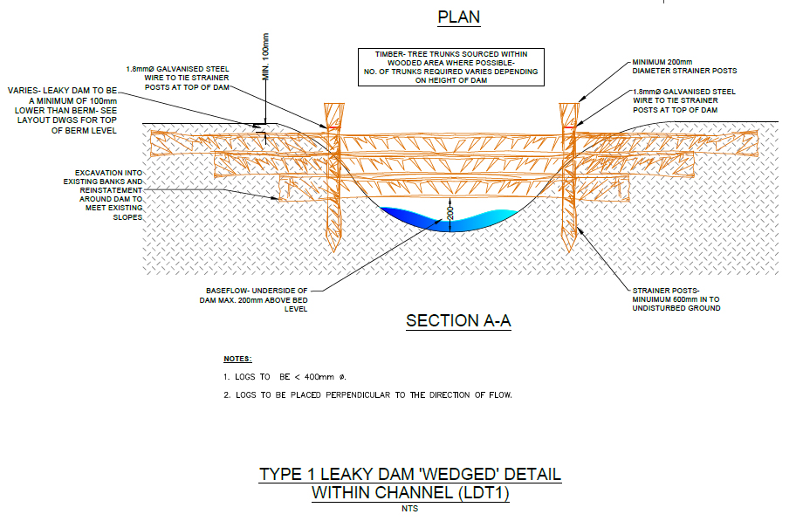
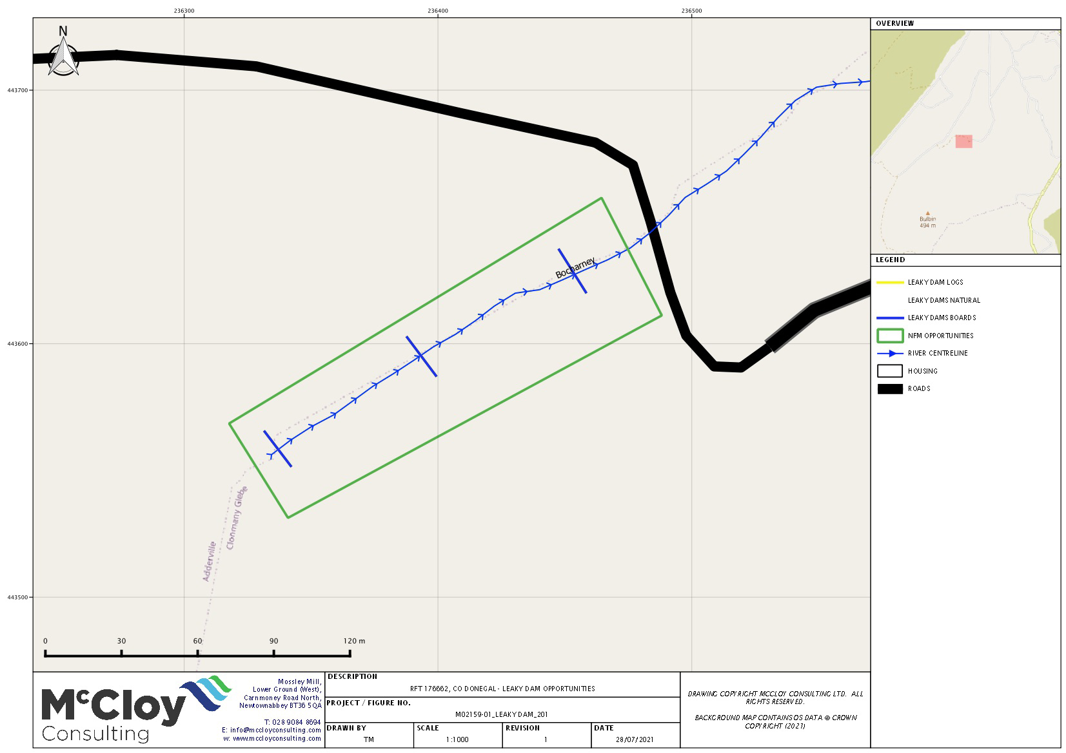

Slide 16
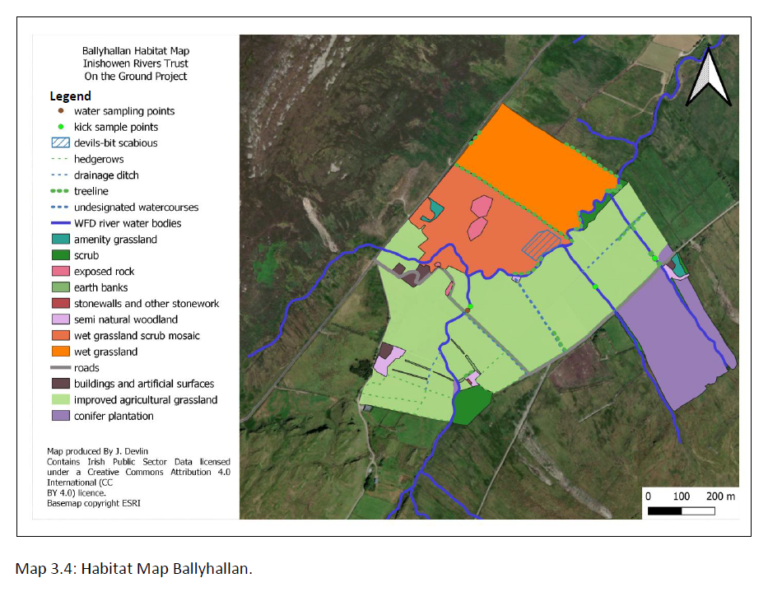
Ecological assessment of sites

Slide 17
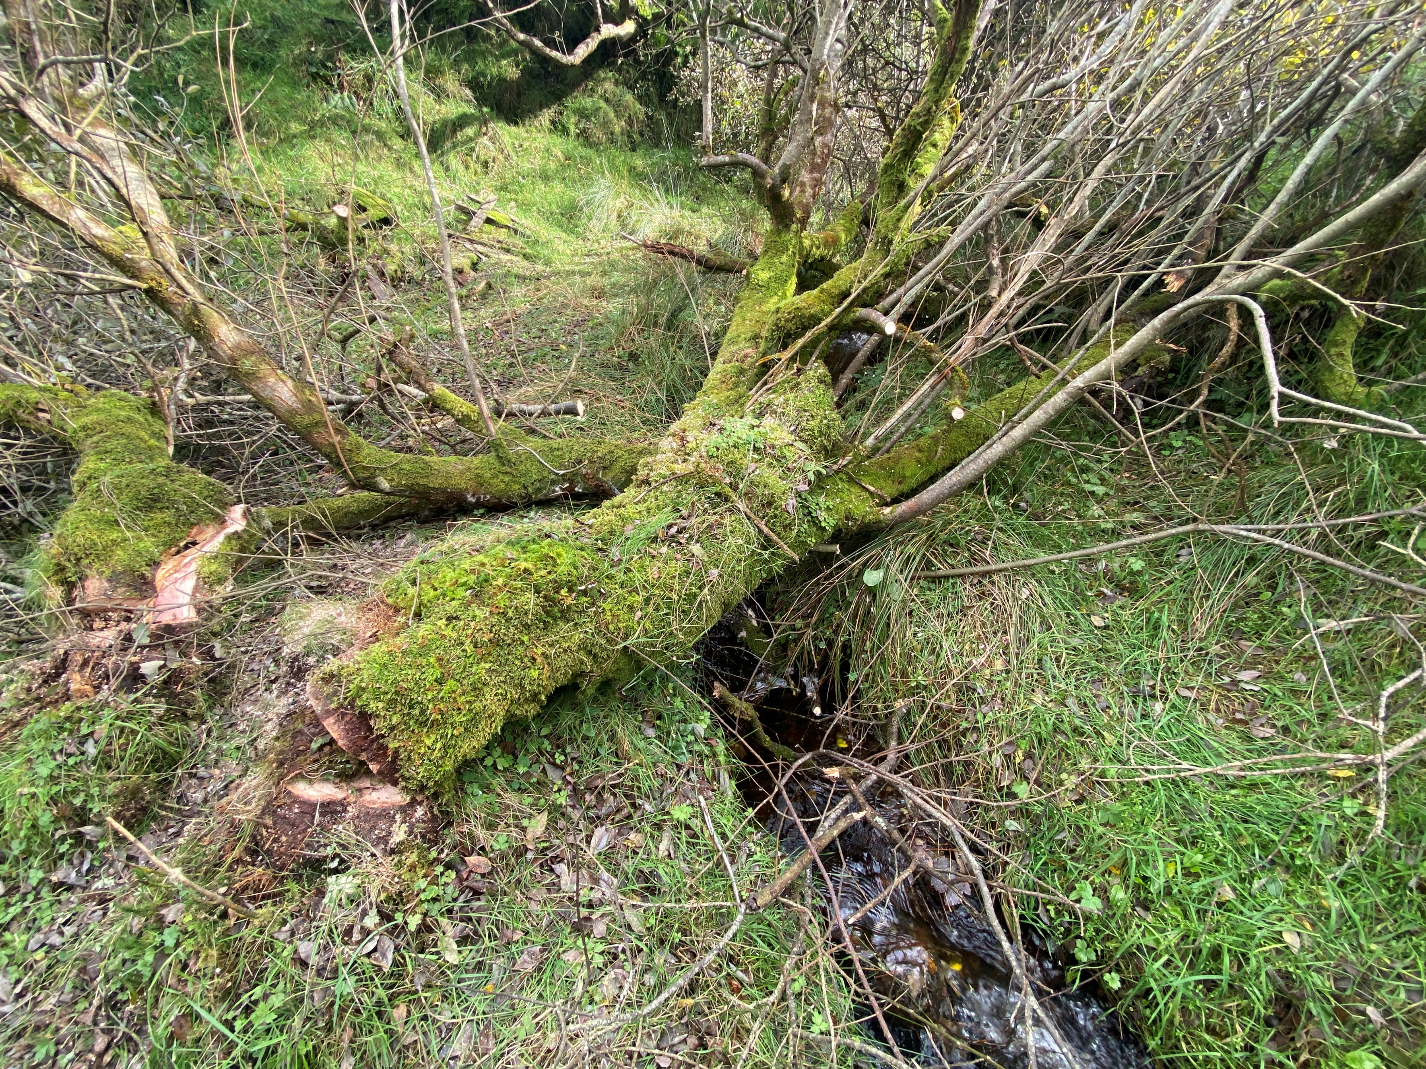
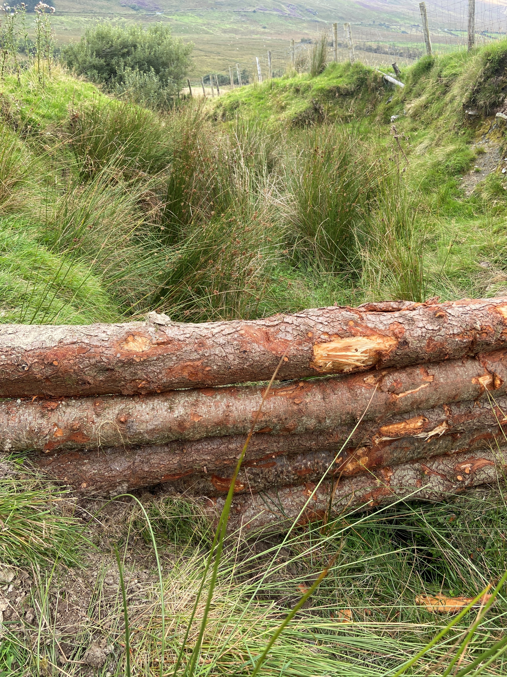
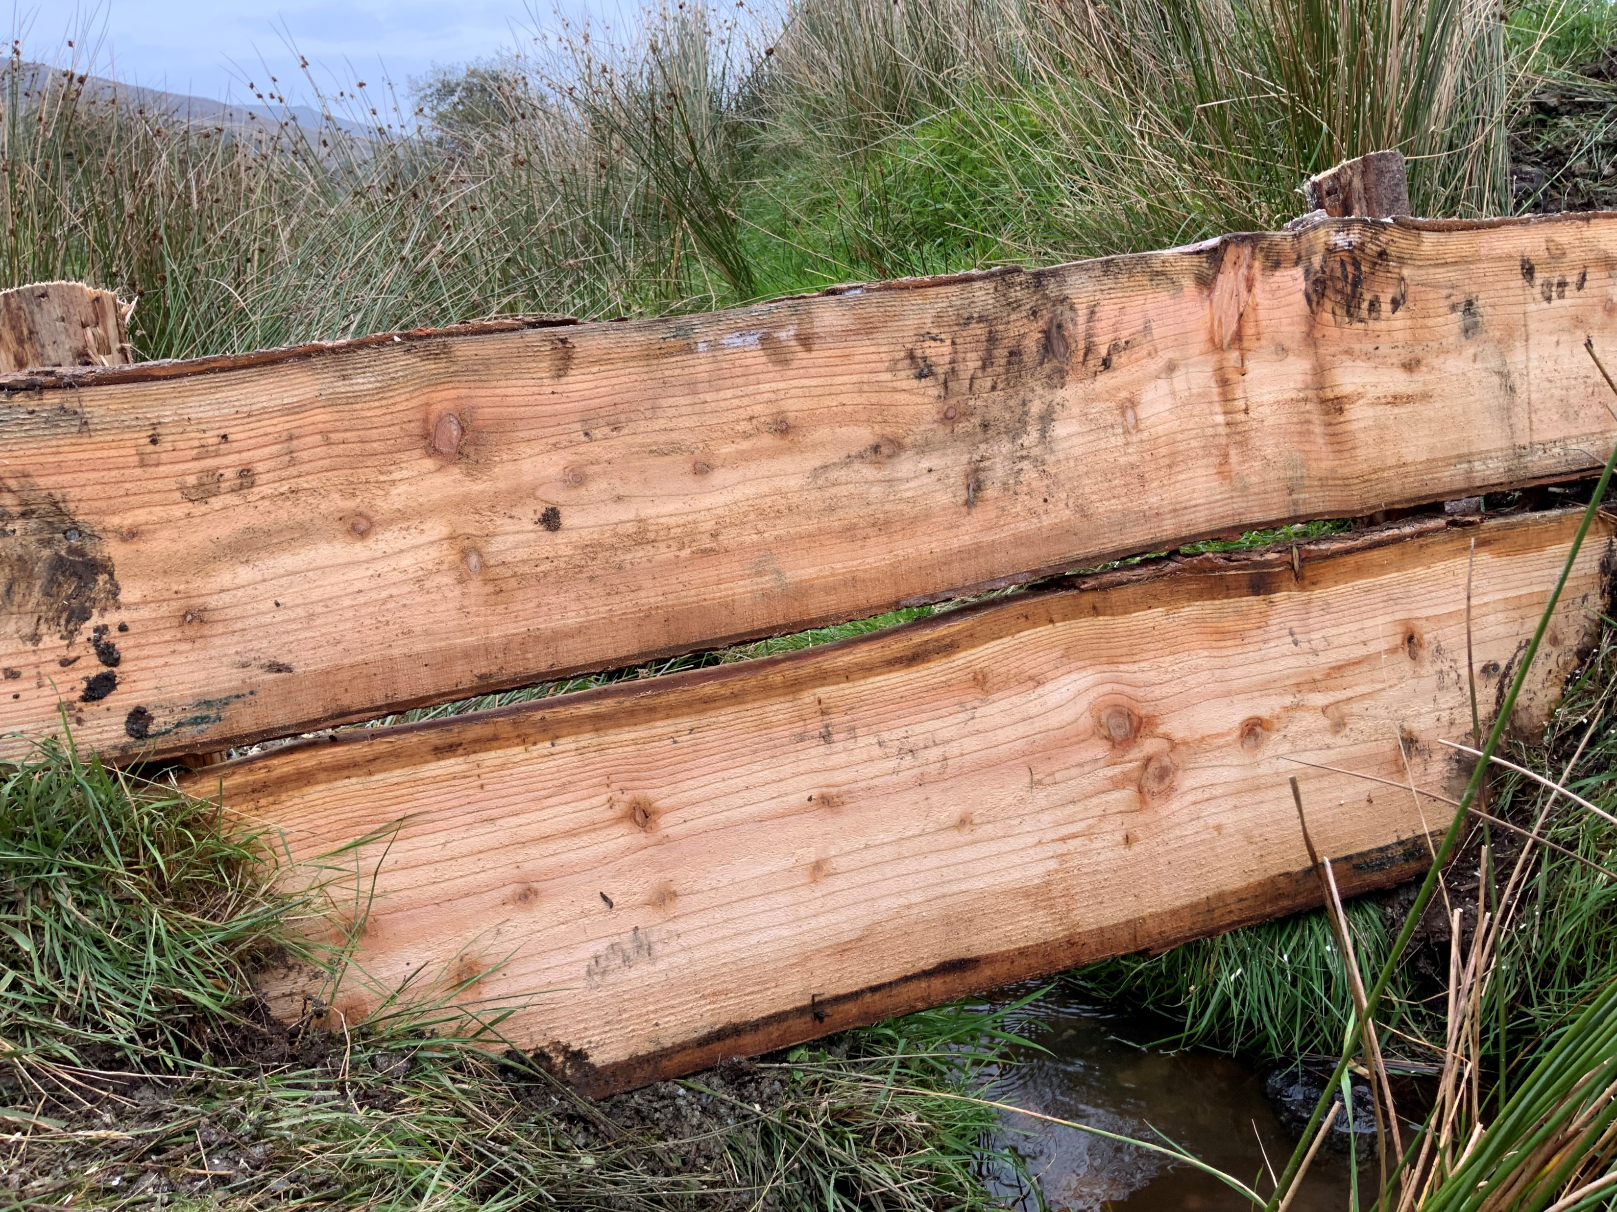
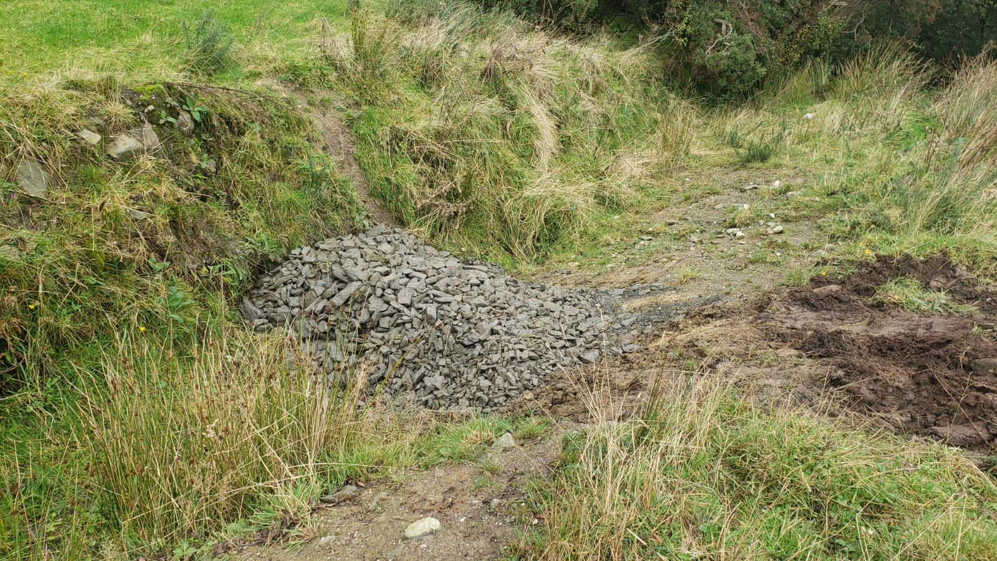
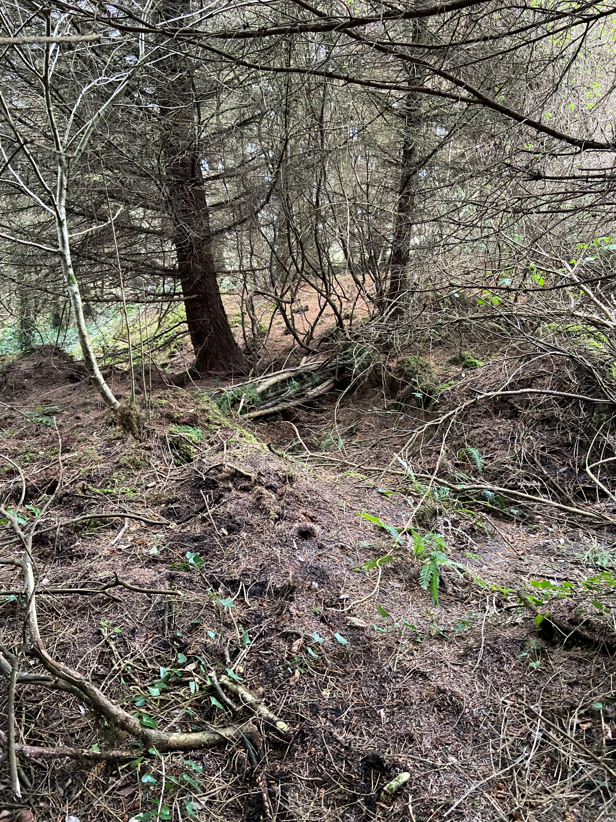
NFM measures
52 Log leaky dams
7 Natural log dams
6 Boarded dams
4 Check dams
Gully stuffing
Natural leaky dam
Log leaky dam
Check dam
Boarded dam
Gully stuffing

Slide 18
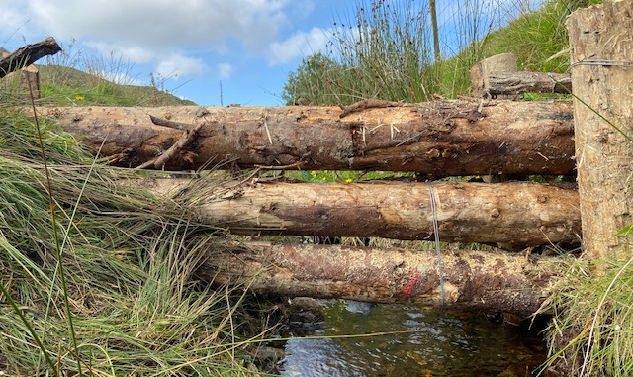
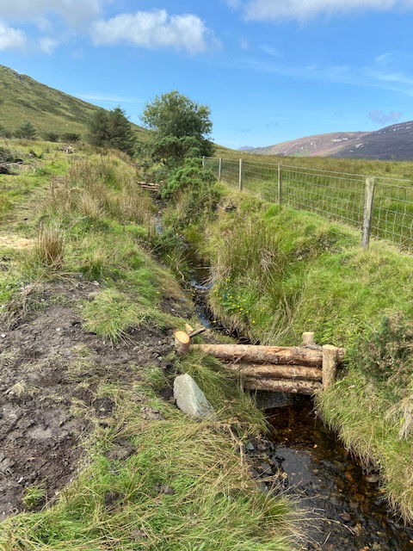
Log leaky dams
  approx. 0.5m³ / dam of larch or spruce
  Install 3-5 per day
  Cost ~ €568 each for labour and materials

Slide 19
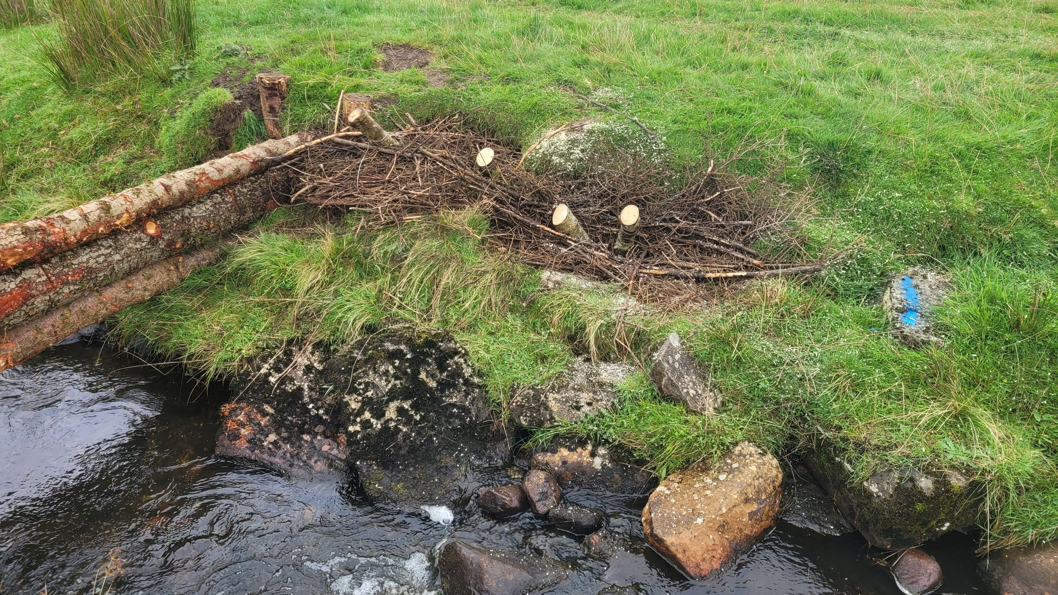
Erosion Control
  Erosion noted at some sites
  During construction small brash revetments put in place to prevent further erosion

Slide 20
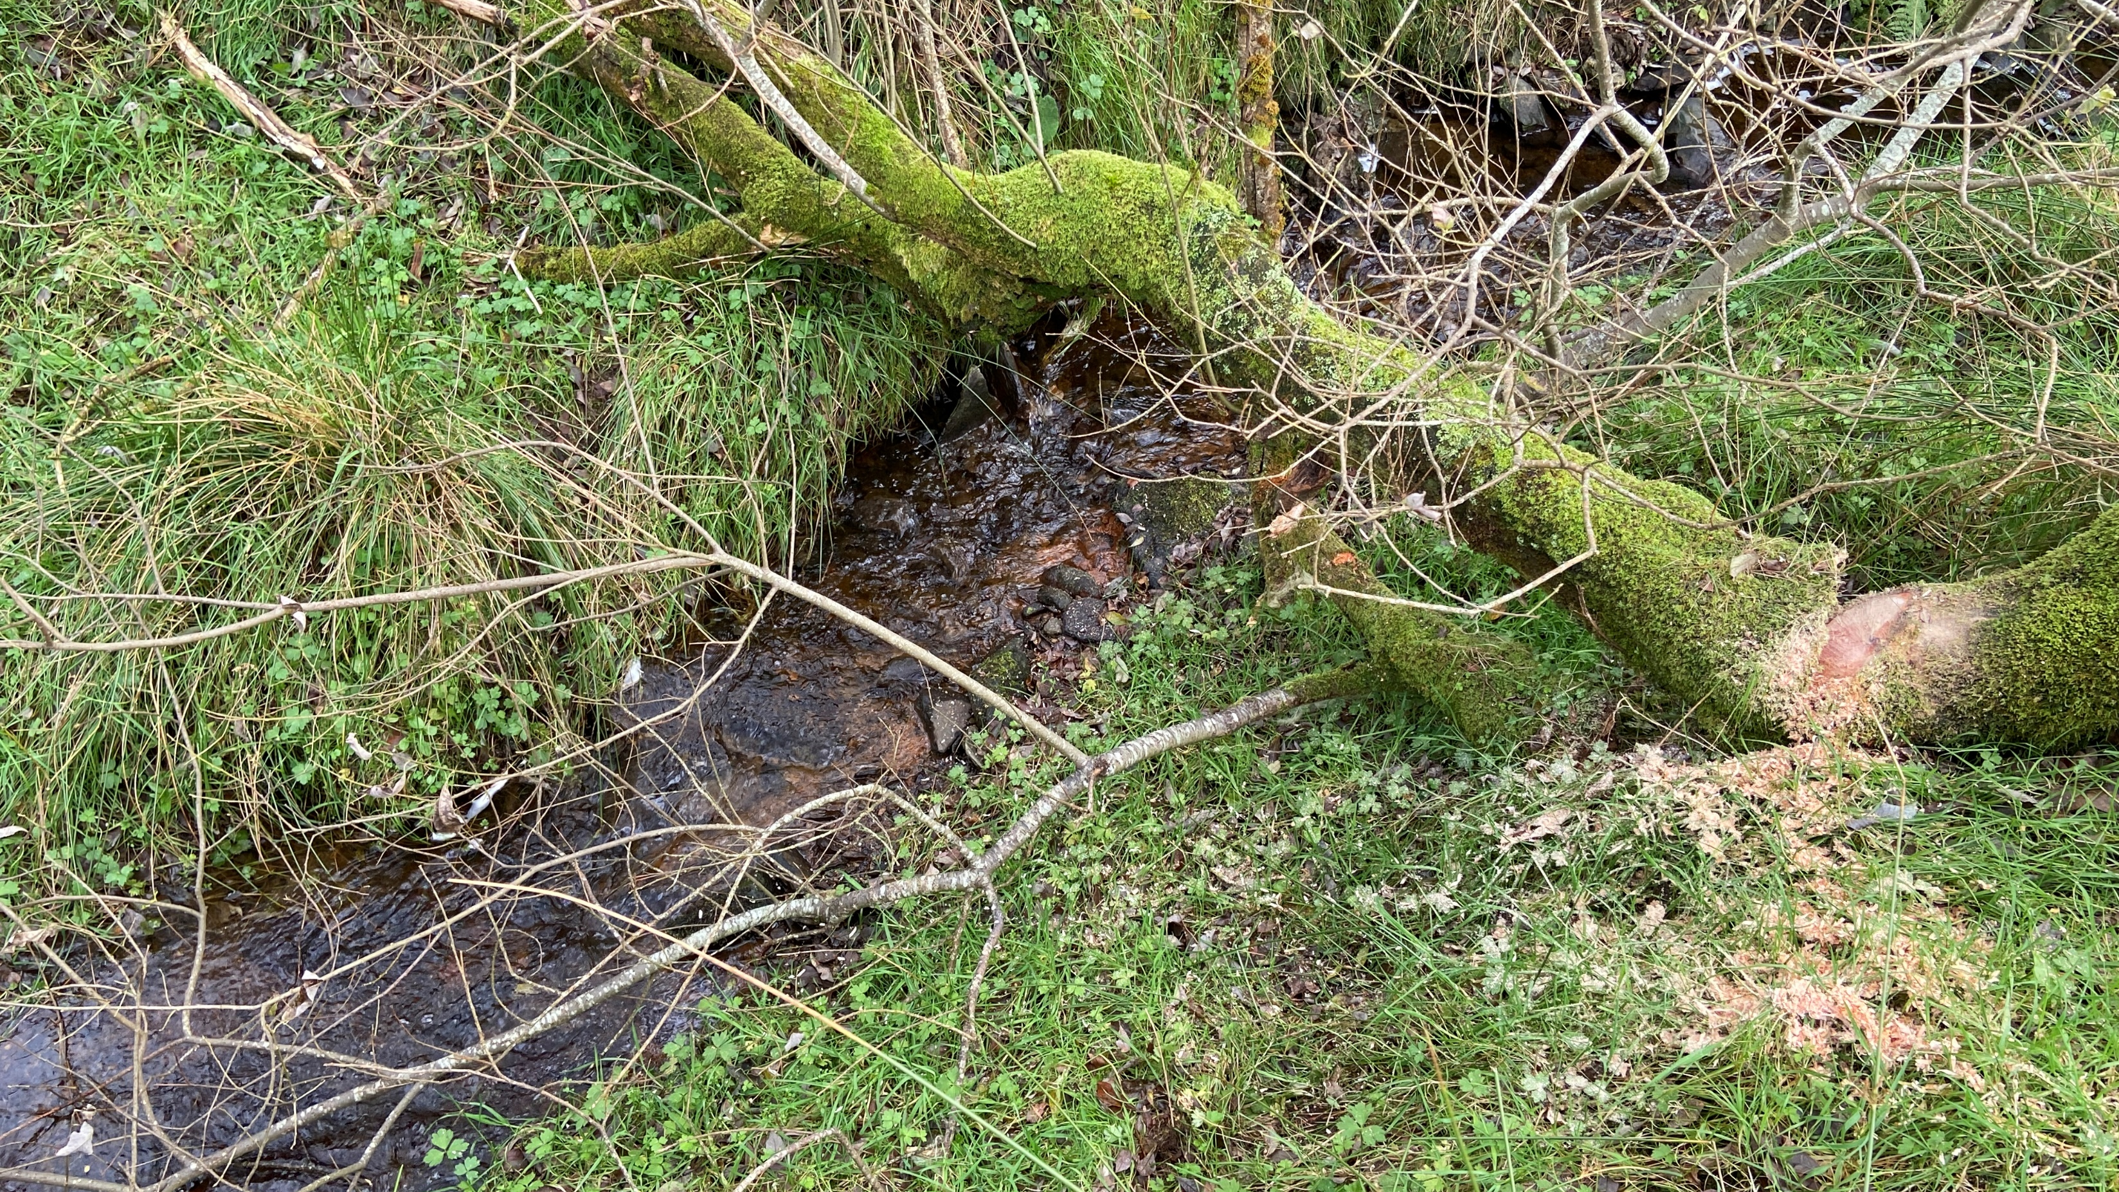
Natural log leaky dams
  Very little riparian vegetation available
  Installed 7 in one day
  Cost ~ €150 each for labour and materials (rebar)

Slide 21
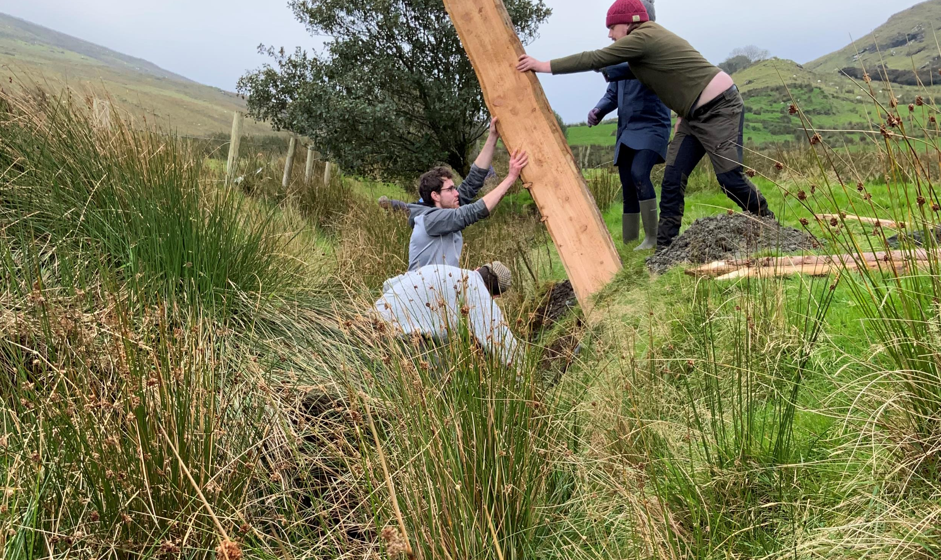
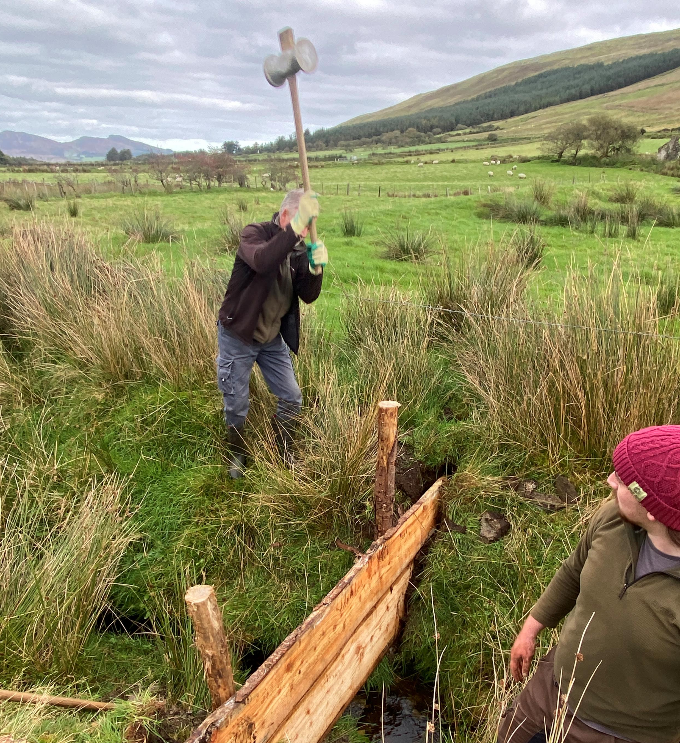
Boarded leaky dams
  2 inch larch boards
  Installed with help of volunteers
  Cost ~ €384 each for preparation, labour and materials

Slide 22
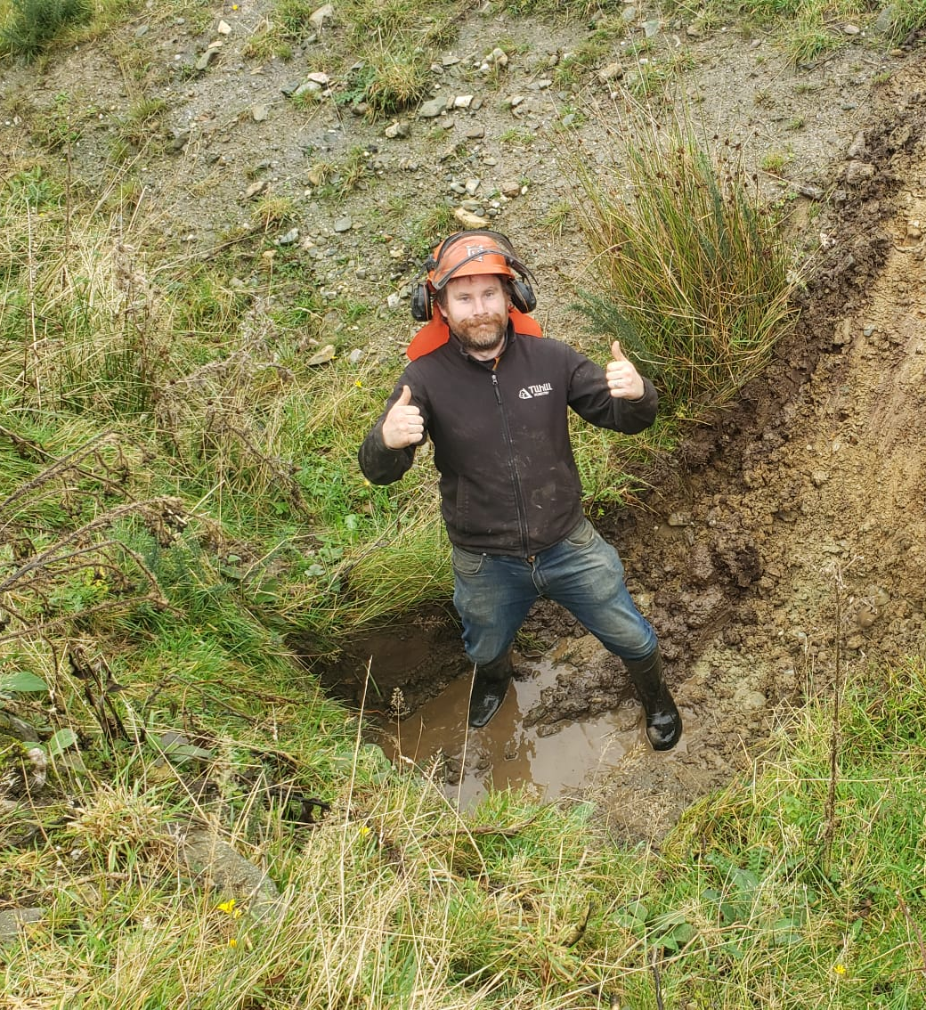
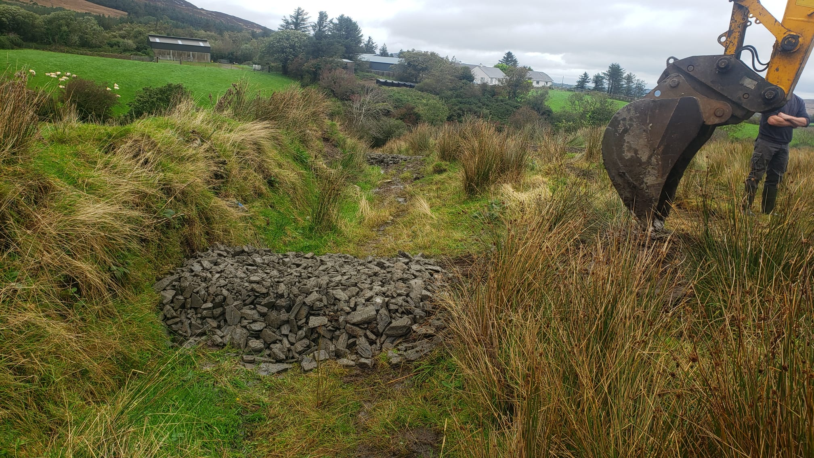
Check dams
  Stone
  Installed 4 per day
  Cost ~ €406 each for labour and stone

Slide 23
Obstacles & Challenges
Slow progress in early 2021 – Impeded by Covid restrictions
Lack of awareness of how leaky dam works. Difficult concepts to explain and require traditionally held beliefs to be challenged.
Need to work sensitively with community and environment, avoid sediment release into streams and avoid damage to farming lands
Lack of tree cover on Inishowen rivers means wood needs to be brought in from outside of Clonmany. Few opportunities for natural dams.

Slide 24
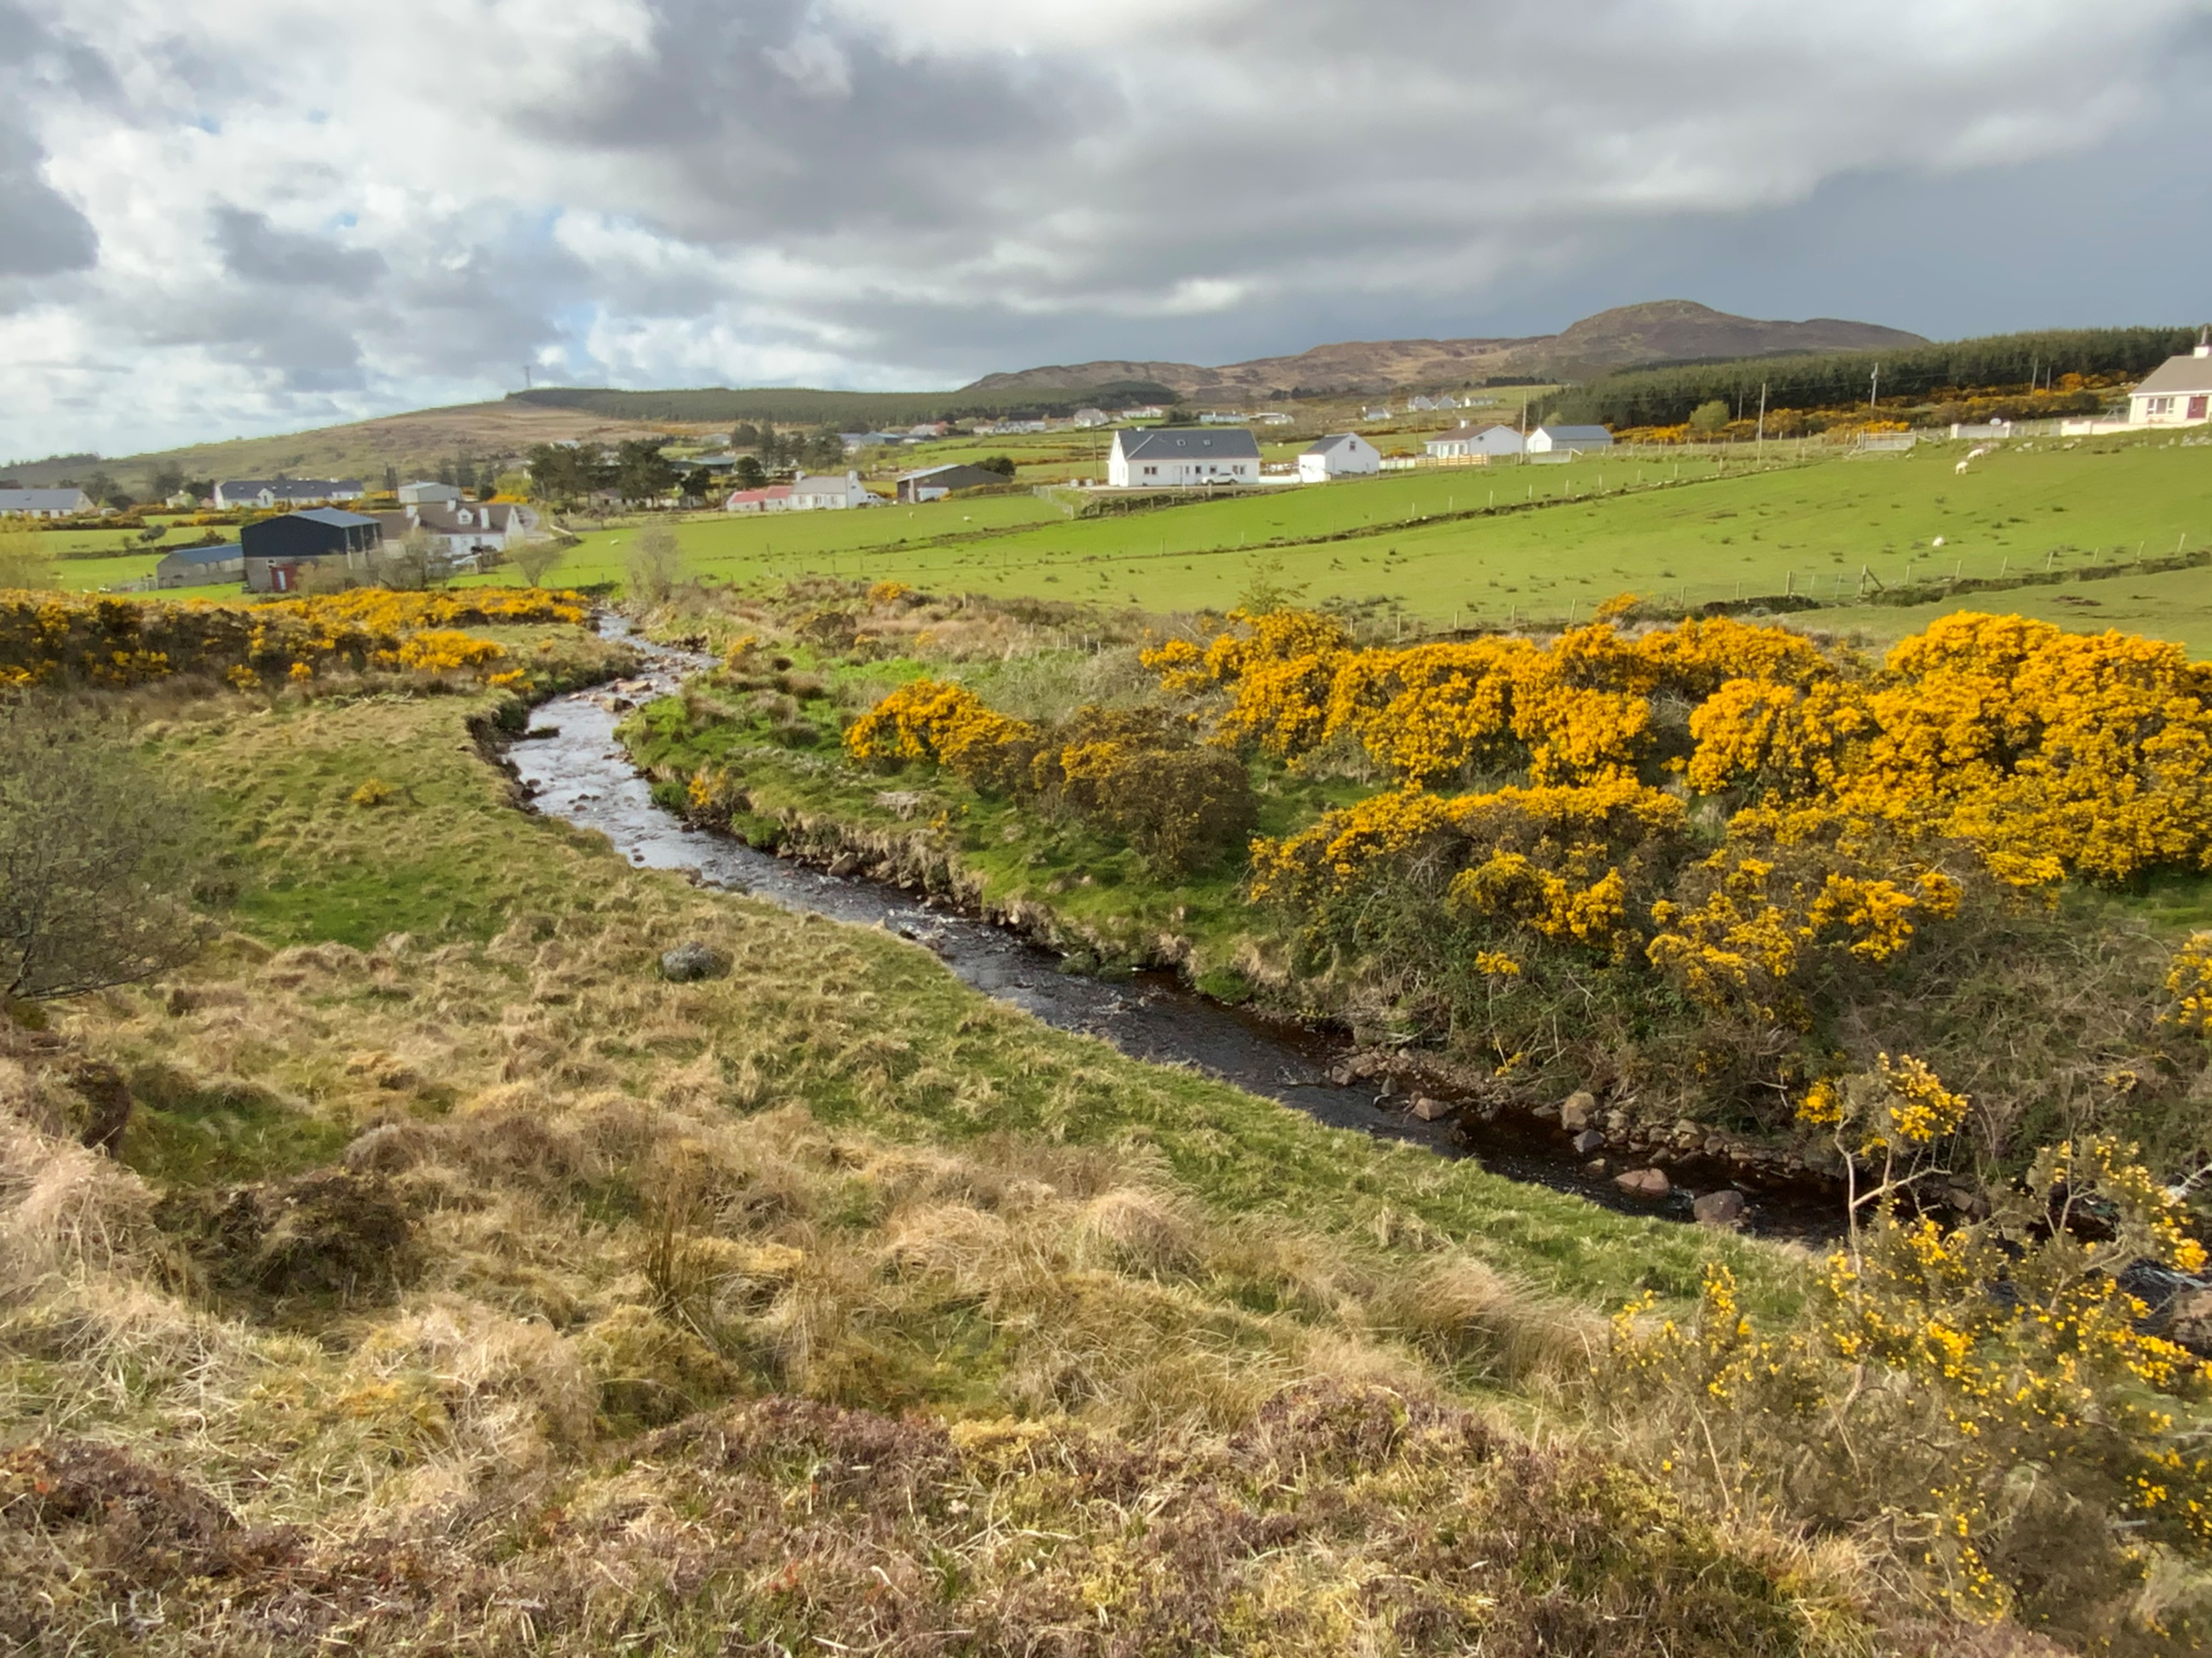

Next Steps for community
Community consultation after project end and in October 2022. Build on community engagement
Yearly monitoring of dams
Identify further opportunities for measures
Options
Scientific assessment of new sites
- purchase monitoring equipment
River restoration on a catchment scale
Climate and biodiversity benefits
Third level research
EU funding
Funding a key issue

Slide 25
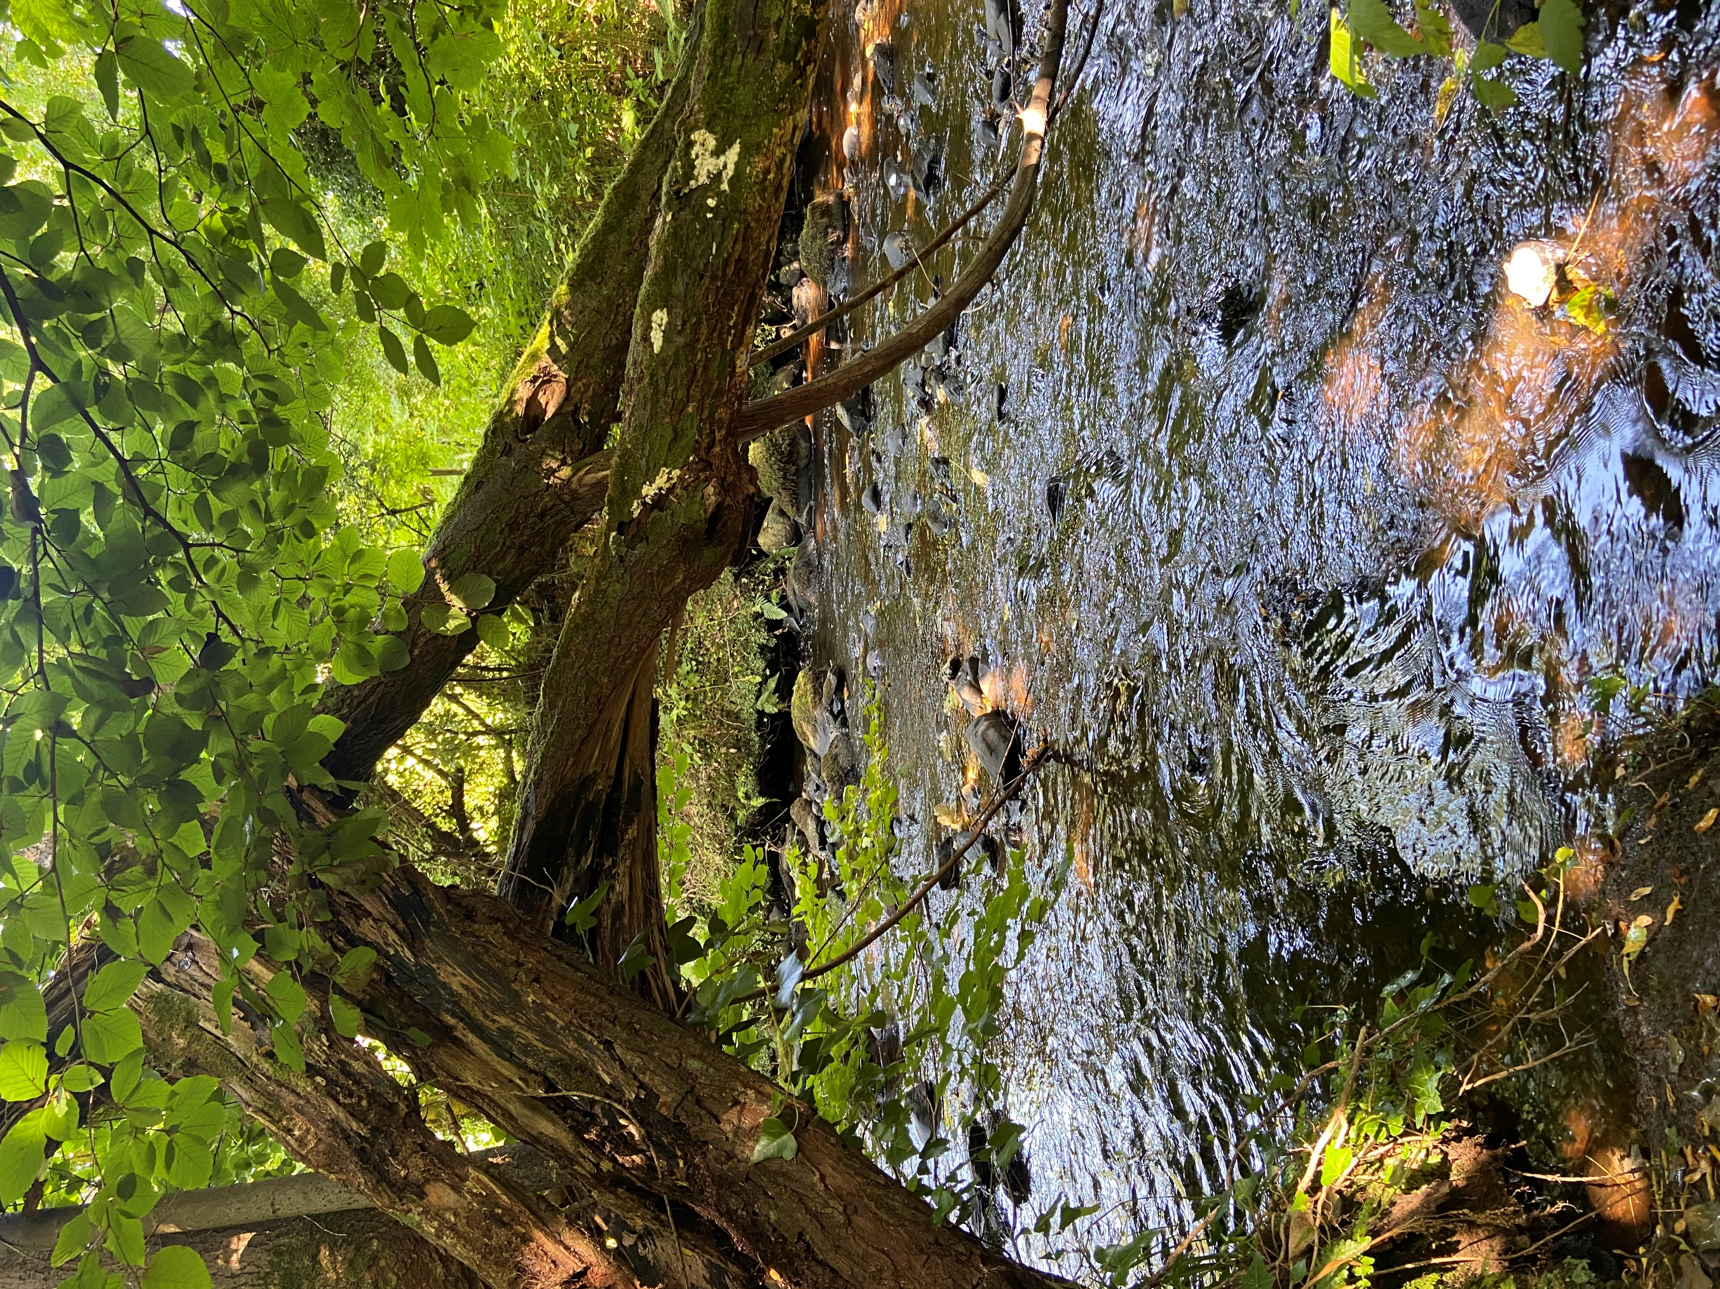
Summary
Collaboration with range of stakeholders essential for success
Local knowledge & ownership can be increased
Long lead time needed – help to increase efficiencies
Importance of fundamental knowledge of natural processes in rivers - training construction workers and project stakeholders

Slide 26
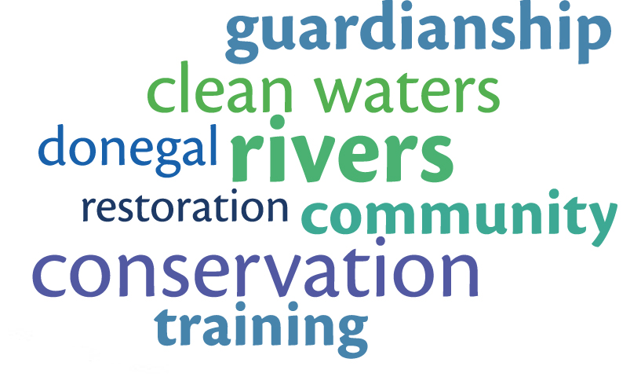
Thank You | Go raibh maith agaibh

